Slide 1
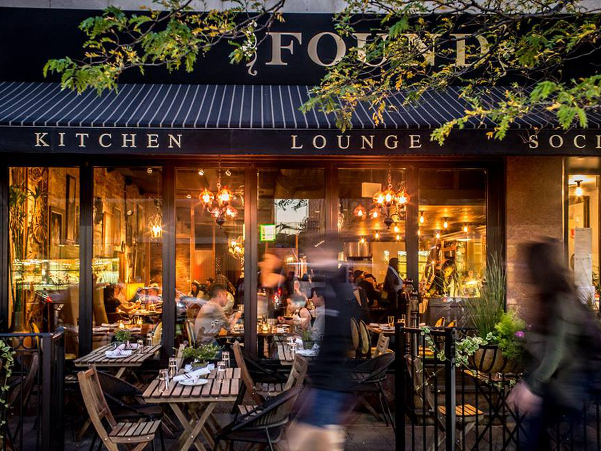
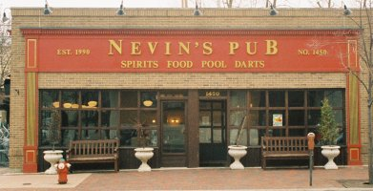
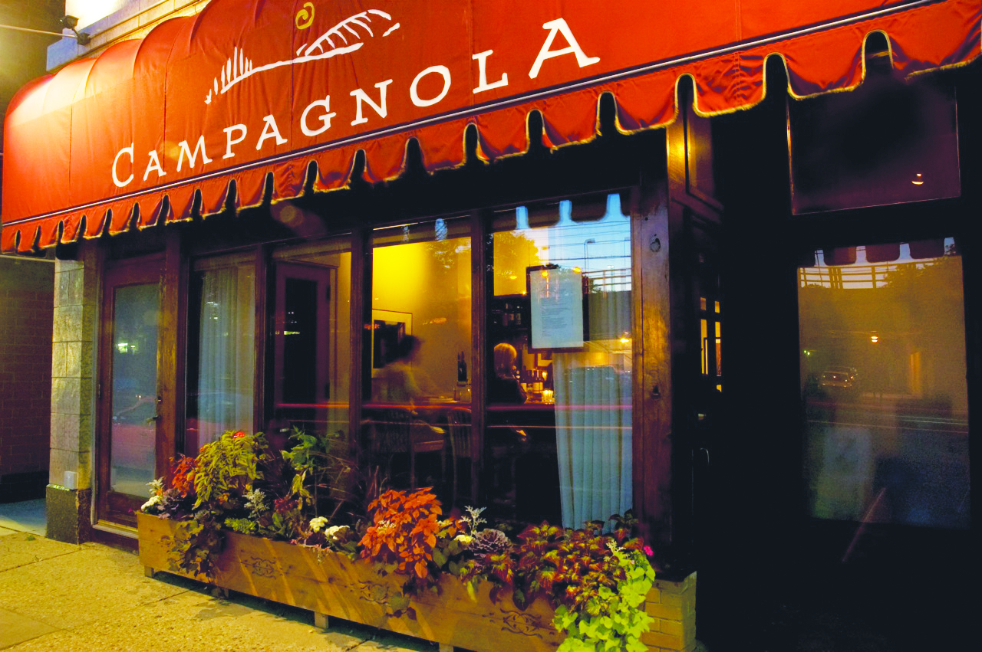
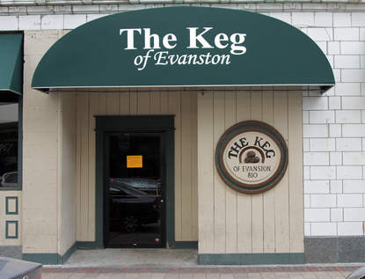
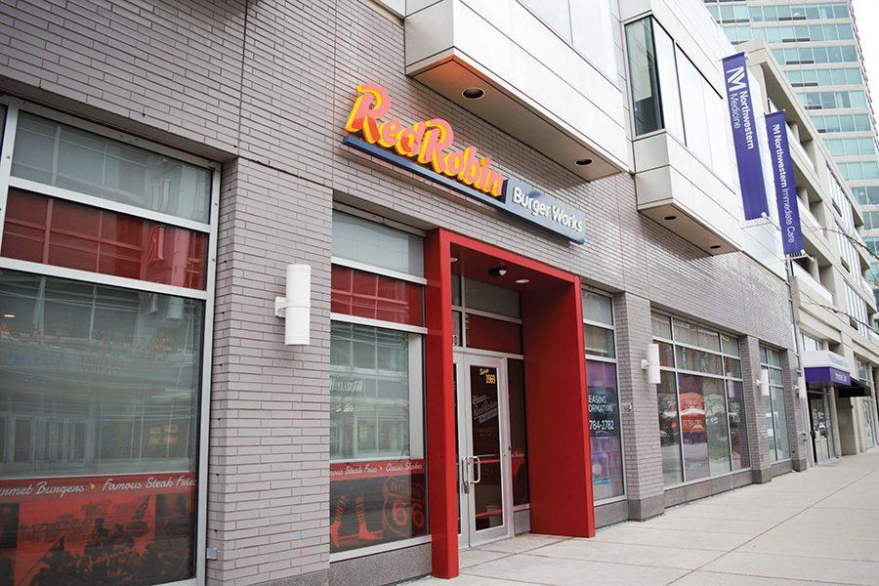
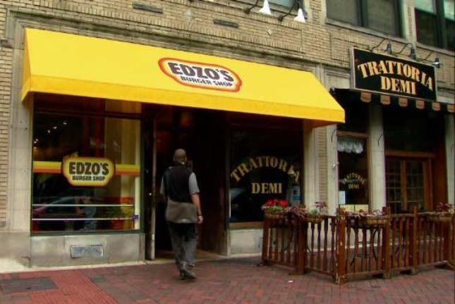
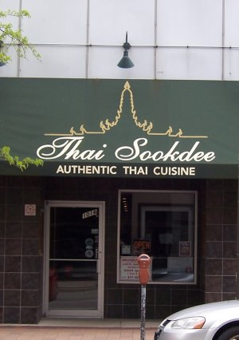
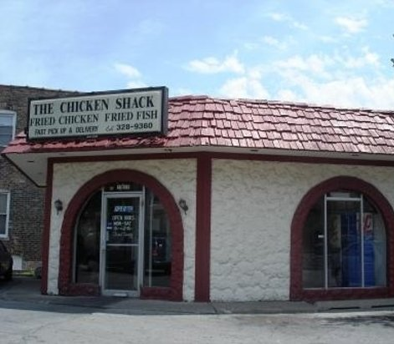
What’s Cooking in Evanston? Restaurant Turnover
Northwestern University Posner Symposium 2017
Mentor James Hornsten (Economics)
By: Anu Raife

Slide 2
Profit = Revenues - Costs
(Number of Meals Sold) (Price of Meal)
Rent (5-10% of total cost)
Sunk Costs/ Start Up Costs: A cost that is incurred once and cannot be recovered
Examples: Liquor license, Food Establishment license, original interior design, equipment, seating
Labor (30-40% of total cost)
Ingredients (30% of total cost)
As of July 2017, the minimum wage in Evanston went up from $8.25/hr. to $10 (a 21% increase)
Advertising
Maintenance/Utilities
Menus/ Disposable Containers
Opportunity Costs (cost of owning a restaurant over another career)
If expected Profit > 0 , we are likely to see existing firms expanding and more firms entering the market in the long run
If expected Profit < 0, we are likely to see existing firms exiting and fewer firms will enter in the long run
Source for percentages: Stabiner, Karen. “Is New York Too Expensive for Restaurateurs? We Do the Math.” The New York Times. October 2016

Slide 3
Data Collection
Created a data set of restaurants from:
City of Evanston
List of restaurants opened and closed from 2000-2016
Didn’t include dates
Economic Development Committee
Meeting minutes from 2009-2016
Main-Dempster Mile (a local business association)
Local Newspapers
Found the years of opening and closures
Qualitative Understanding through Interviews
Interview with Commercial Real Estate Agent
Interviews with 2 local restaurant owners

Slide 4
The Data Set

Slide 5
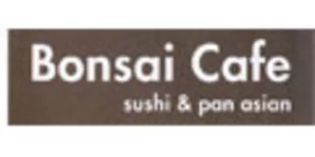
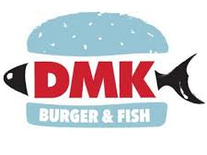
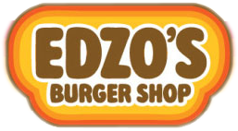
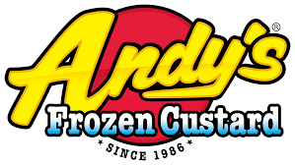
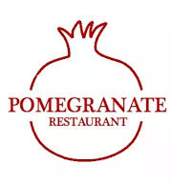
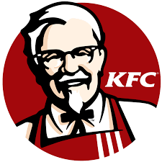
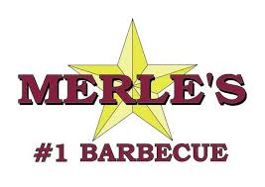
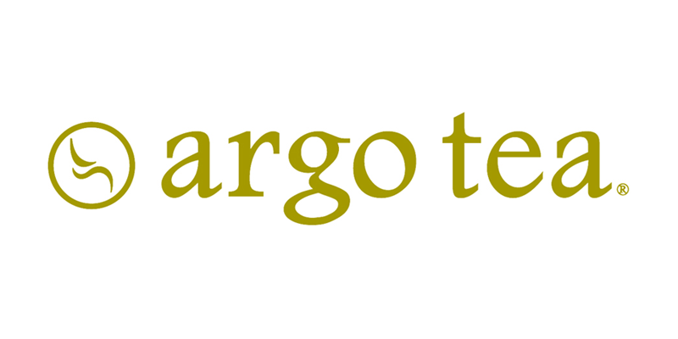
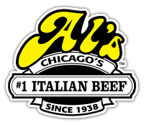
Notes:
Downtown Evanston used to be full of retailers, but with online shopping popularity increasing, it is more food centered
Cost of opening a restaurant is less because it is easier to open a restaurant in a building that was already a restaurant
Nationally, more money is being spent on restaurants than anywhere else (Wall street Journal)

Slide 6
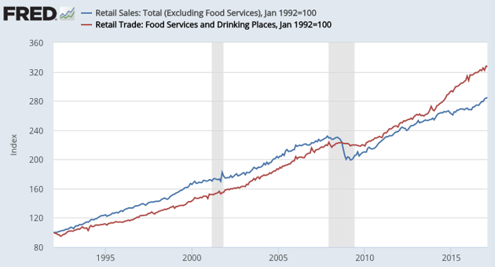
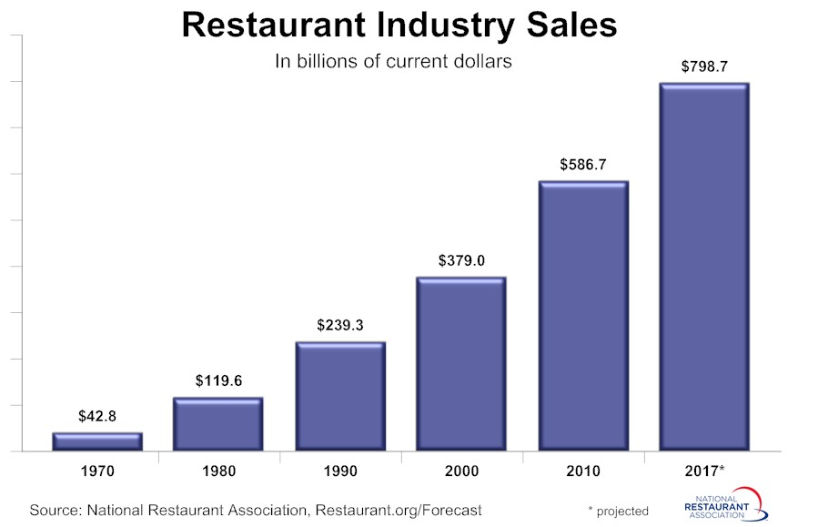
Increased Competition
Downtown Evanston used to be full of retailers, but with increased popularity in online shopping, it is now more food centered
Cost of opening a restaurant is less because it is easier to open a restaurant in a building that already held a restaurant
Thompson, Derek. “What In the World is Causing the Retail Meltdown of 2017?” The Atlantic April 2017
National Restaurant Association

Slide 7
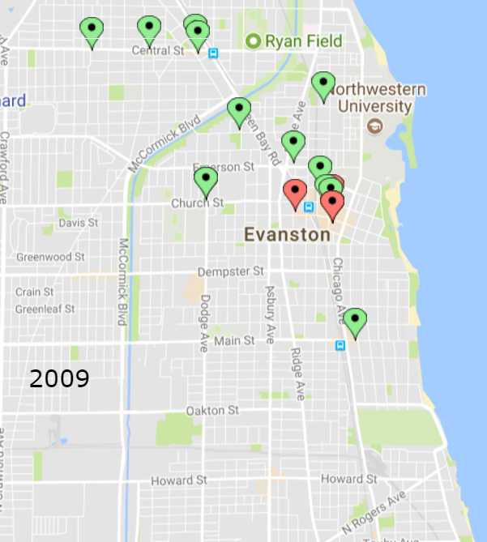
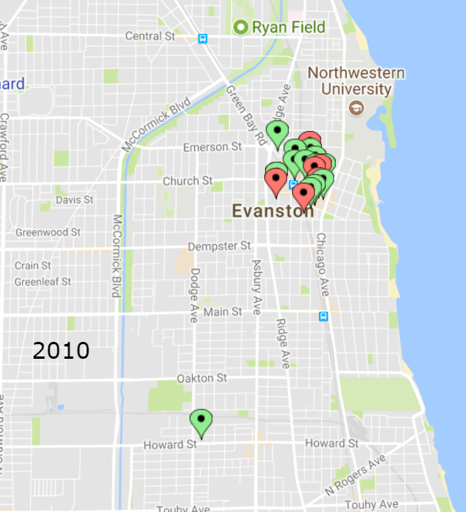
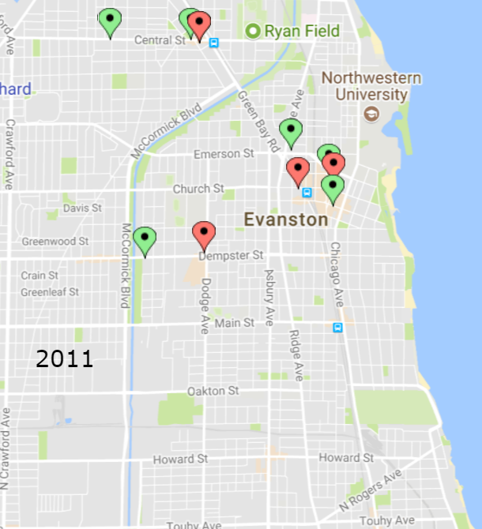
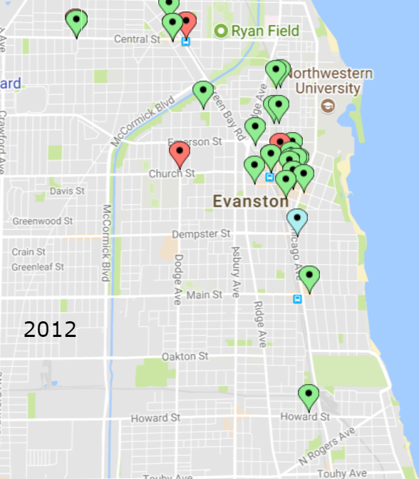
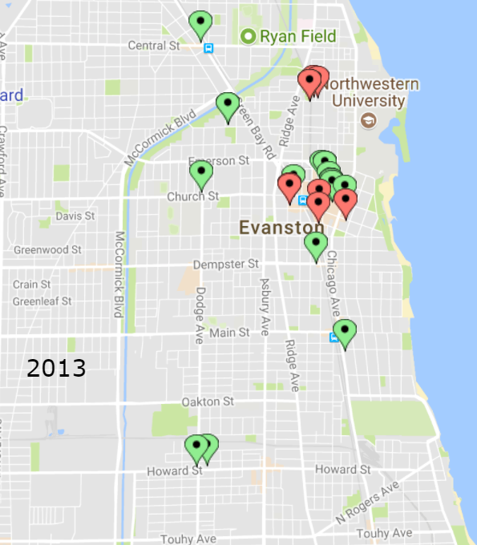
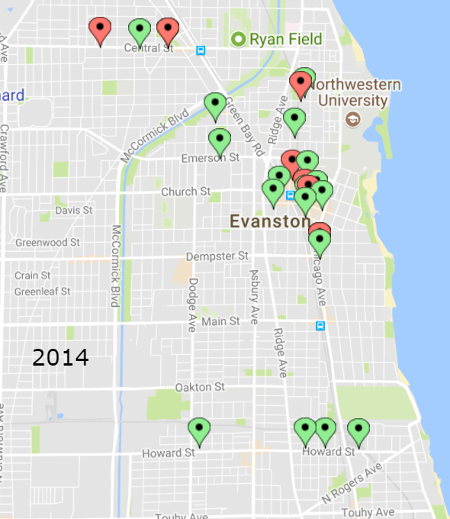
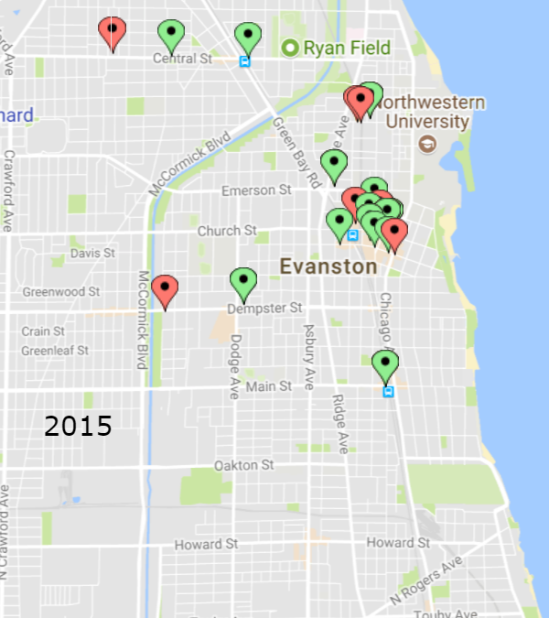
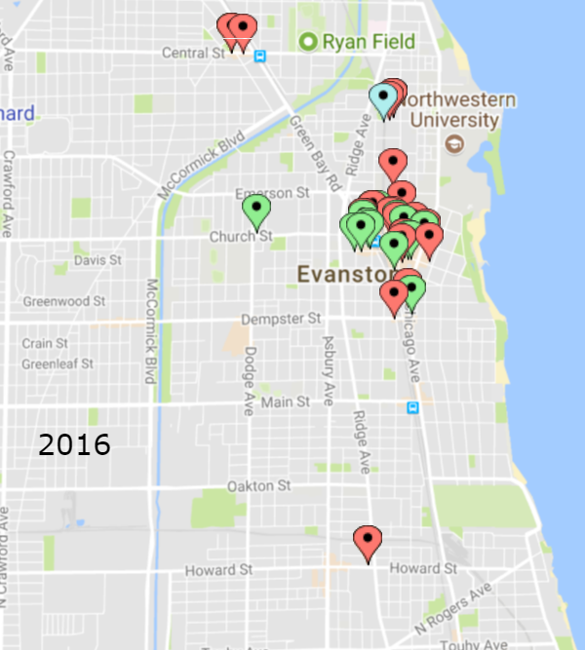
Opened
Closed
Relocated
Geographical Representation of Restaurant Turnover

Slide 8
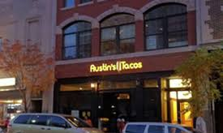
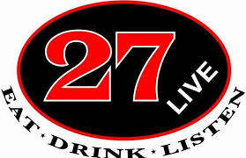
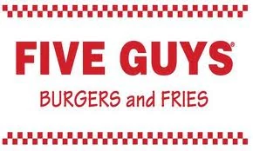
Restaurants Close Together, Close Together
In 2002, a cluster of restaurants opened on Church Street by the theater
In 2012, a number of businesses on Davis Street closed
In this past year, 10 businesses closed along the five blocks of Church Street from Oak Avenue to Chicago Avenue
Notes:
Talking points:
Need an anchor, if the anchor closes, other businesses suffer (lots of stuff happens around the theater bc they thought it would be an anchor but it isn’t)

Slide 9
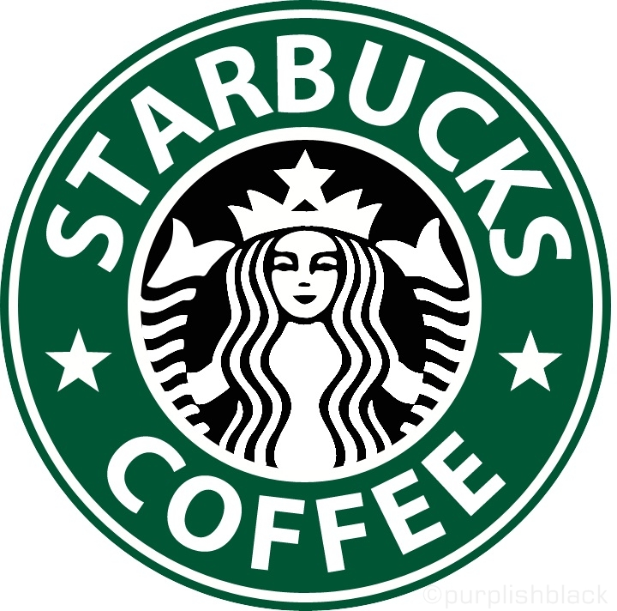
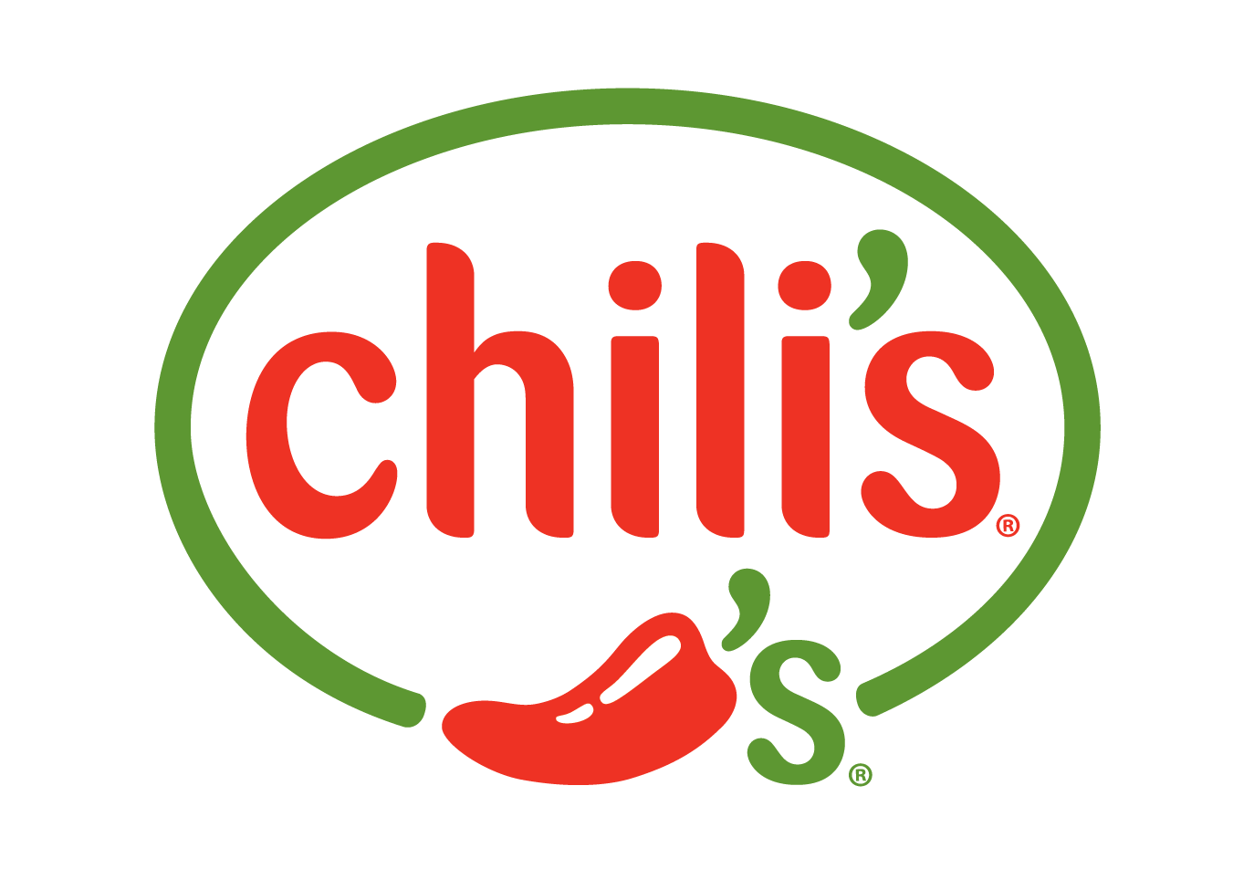
More Chains are Opening and they are Likely to Stay
Chains: Not a standardized definition
More than 5 restaurants or restaurants in multiple states
Multiple locations give the ability to buy in bulk
Starbucks pays around $2/lb. of coffee and sells it for about $13, whereas Curt’s buys coffee for about $14 and sells for $16
Have the financial backing to withstand months of low activity
E.g. when Northwestern has breaks
Notes:
Chains: Not a standardized definition
More than 5 restaurants or restaurants in multiple states

Slide 10
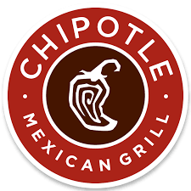
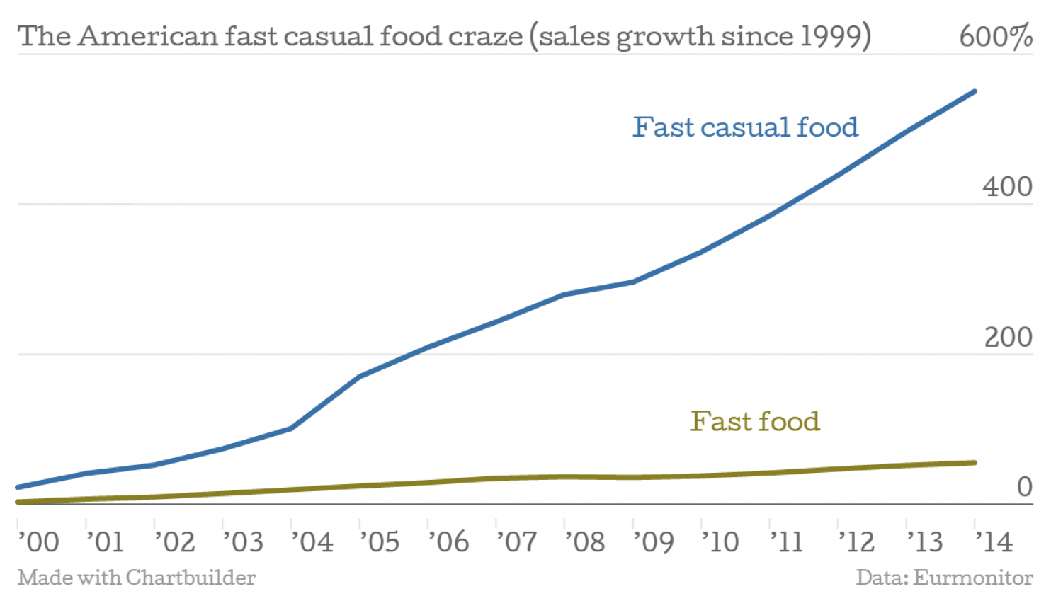
What Are We Hungry For?
Fast Casual: High quality food, blend of table/counter service, relatively low prices
Outpacing the growth of fast food
Source: Ferdman, Roberto A. “The Chipotle Effect: Why America is Obsessed with Fast Casual Food.” Washington Post February 2015
Notes:
Talking Points: relate to profit by the increase in demand

Slide 11
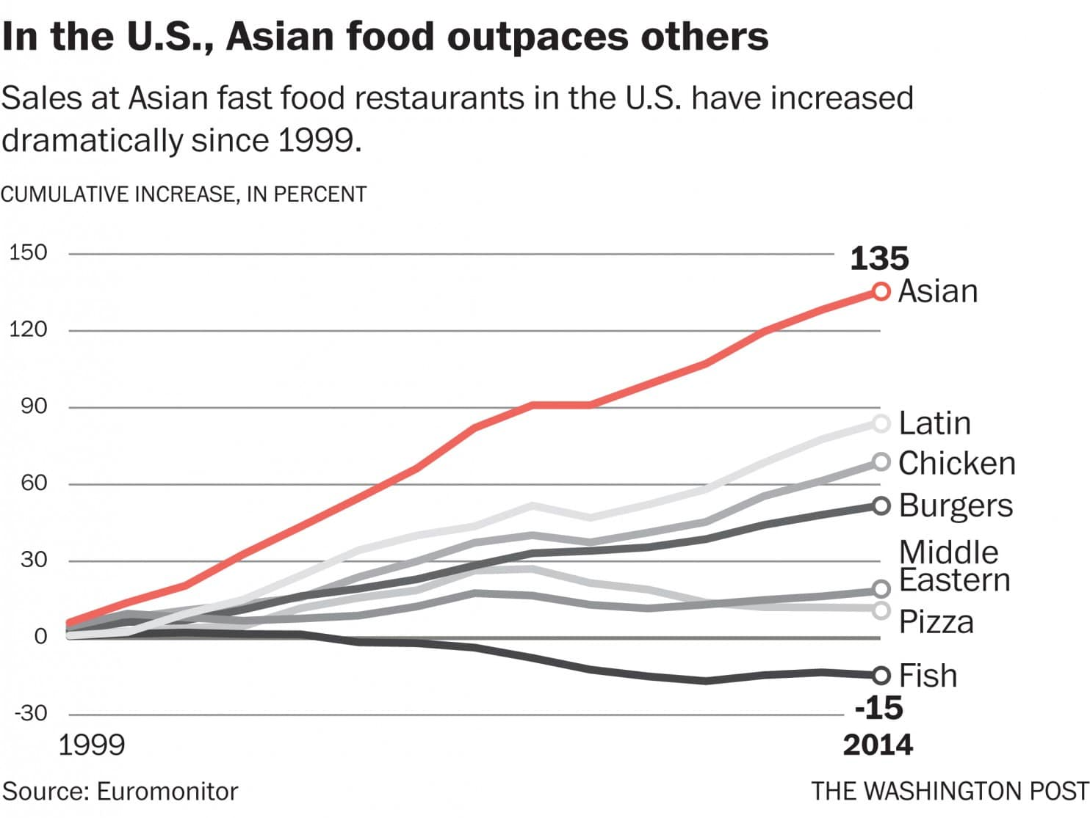
Asian Cuisine is Heating Up, Too
Asian Restaurants: Broad category that encompasses Chinese, Japanese, Vietnamese, and Korean cuisines
Source: Ferdman, Roberto A. “Asian Food: The Fastest Growing Food in the World.” Washington Post February 2015

Slide 12
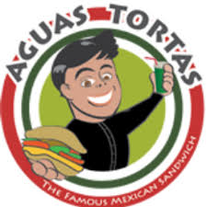
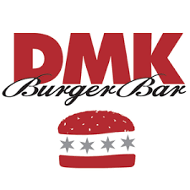
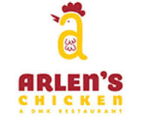
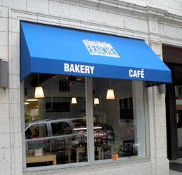
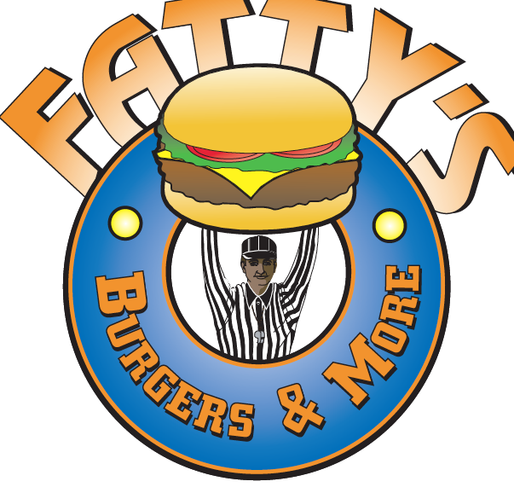
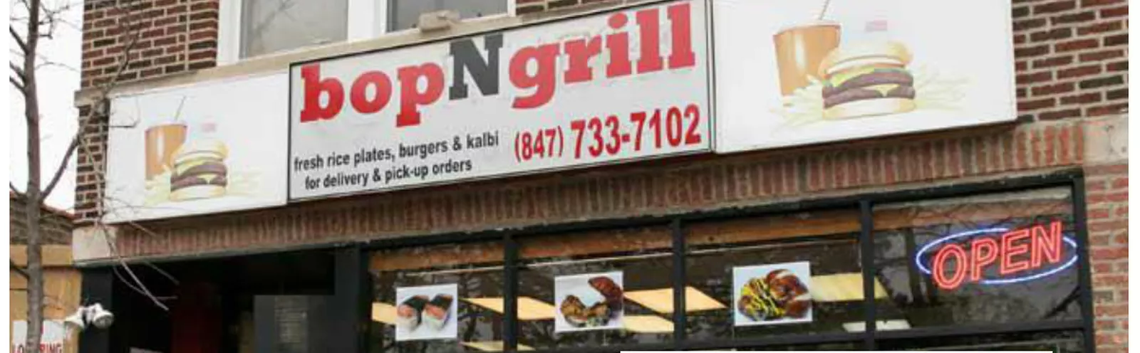
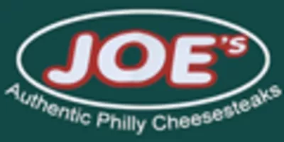
Locations with High Turnover
618 ½ Church Street (across from Evanston Public Library)
815 Noyes Street (by the Noyes El stop)
1903 Church Street (across from ETHS)
2005-2007
2008-2009
2012-2015
2015
Open Currently
2001-2008
2009-2013
2014-2015
2015-2016
Open Currently
2009-2012
2013-2015
2015-2016
Open Currently
Notes:
Talking points: bad landlord compared to bad location compared to unique anecdotes on Noyes

Slide 13
Avenues for Further Research
What’s going to happen to Evanston restaurant industry with the minimum wage raise?
How will delivery services affect the restaurant industry?
If ordering meals online is the primary way people are getting their food, as opposed to eating out, do we even need the physical storefronts anymore? Why pay the price of rent, labor, and utilities if you can run the business from home?
How are grocery stores faring?
Restaurants compete with increasingly better prepared foods, but grocery stores compete with the increased delivery options

