Slide 1
Mixed Race Students at Northwestern
Serena Salgado
Professor Elizabeth Smith
Posner Fellowship 2017

Slide 2
Research questions
Do students face pressure to choose certain racial identities in different social spheres on campus?
What identities are selected in what situations?
What struggles are faced by those of more than one race on Northwestern’s campus?
What privileges are associated with being a multi-racial student at Northwestern University?

Slide 3
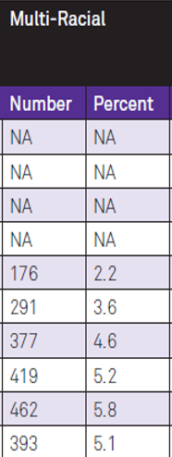
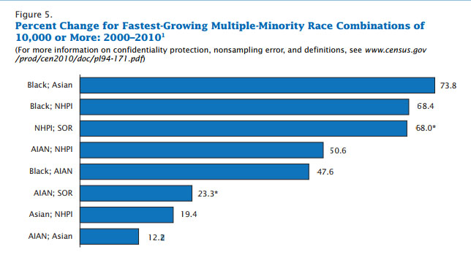
Why is this significant
Mixed race population in the United States has grown 50% since 2000
Northwestern’s population grew by almost 3% from 2010 to 2015

Slide 4
What defines mixed race
Self Identification
Does not have to be
Partially white
Only two races

Slide 5
POSTON’S THEORY ON RACIAL RESOLUTION
Stage One: Personal Identity
Stage Two: Choice of Group Categorization
Stage Three: Enmeshment/Denial
Stage Four: Appreciation
Stage Five : Integration

Slide 6
Other THEORIES on racial resolution
Root (1990)
when racial identity and self-concept are difficult for biracial people, it is because of the tension between the two racial components of the self
Roy’s 2 step theory
Mixed race adolescents are more likely to act out in order to prove themselves as a result of harsher judgement from both racial groups

Slide 7
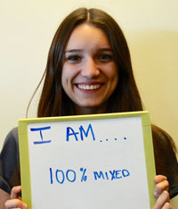
How does northwestern interact with mixed race students?
Mixed Race Student Coalition founded in 2013
Allowing students to select multi-racial on documents
Not much else.

Slide 8
What is next?
Ethnographic interviews
Applications for Northwestern
Applications for the general public

