Slide 1
Emotional Behavior During Conflict and Marital Satisfaction: A Laboratory-Based Study of Married Couples
Jordyn Ricard
Northwestern University
Notes:
In other talks, we’ve heard about how conflict is engaged in broader contexts. However,
I’m interested in how conflict is expressed in individual interactions on a day-to-day basis. In particular, in married couples. We’re also interested in exploring how conflict operates as a predictor of marital satisfaction.

Slide 2
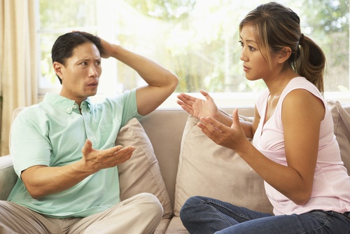
Conflict in Marriage
Notes:
We know that conflict is a normal part of any marriage. In fact, conflict can often be seen as an a valuable component of intimate relationships
Despite some benefits, conflict itself may be unpleasant and create temporary dissatisfaction in marriage. Too much conflict, as well as specific kinds of conflict, can lead to marital dissatisfaction.
And marital satisfaction is a large predictor of divorce.

Slide 3
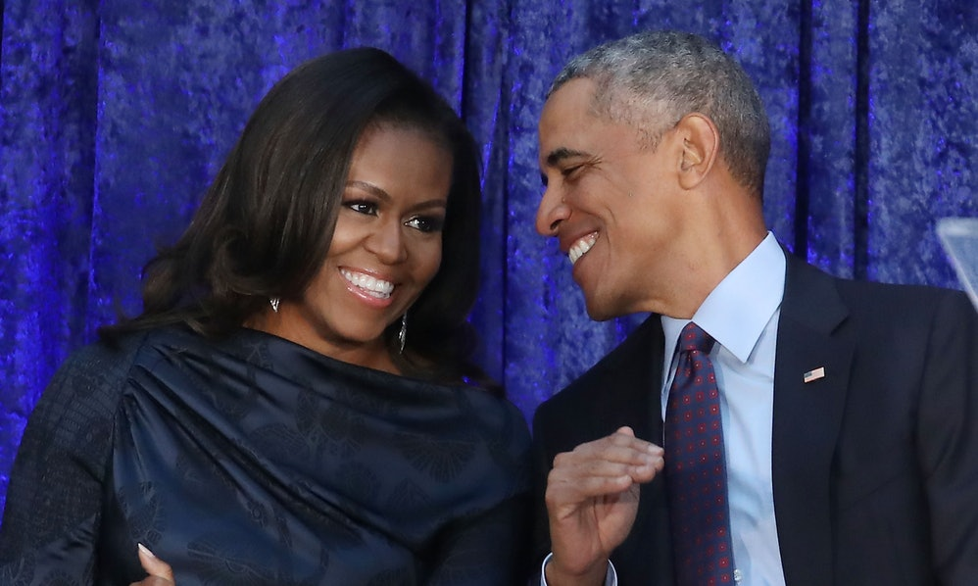
What makes for a satisfied marriage?
Family
Money
Attractiveness
Compatibility
Notes:
So, we know that too much conflict can lead to marital dissatisfaction. But what makes for a satisfied marriage?
Is it… having a family?
Is it… money?
Is it… how attractive you are?
Is it… how compatible the two of you are?
There are many ways that we can explore marital satisfaction.

Slide 4
Marital Conflict
Notes:
In our lab, one way we are interested in exploring marital satisfaction is through emotional expressions. We can do that in a lot of different ways, but my study focused on emotional expressions in conflict conversations.
Here is an example of a clip of a couple that came into the lab. In the video, they are currently in the middle of their conflict conversations.
As you may have noticed, there are many facial expressions going on.
So, raise your hand if you believe that this couple has high levels of marital satisfaction. Raise your hand if you believe that this couple has low levels of marital satisfaction.
Well, there is actually a science to be able to predict marital satisfaction.

Slide 5
Emotional Behavior
Notes:
In the video, I’m sure it was clear to many that there was a a lot of different emotions being displayed. We measure the facial expressions in our lab, particularly the negative expressions, to assess marital satisfaction.
So emotional behavior can be expressed by our facial expressions, word choice, tone of voice and body language. Emotional behavior is expressed during communication.
And we know that clear communication between spouses is regarded as an important factor in successful marital interaction.
So that leaves us with the question, instead of looking at things like family, money, attractiveness, compatibility, can we look at emotional behavior beyond communication to give us an insight into marital satisfaction?

Slide 6
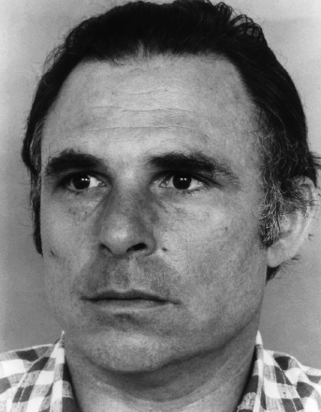
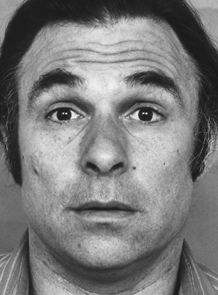
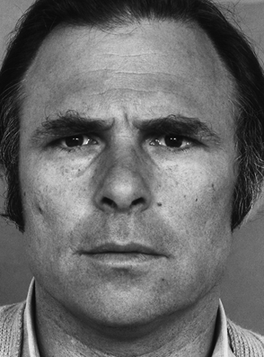
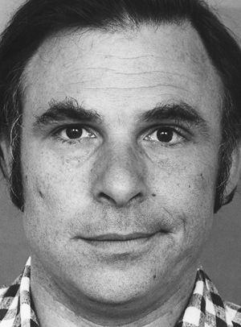
The Study
How does negative emotional behavior in conflict conversations predict marital satisfaction?
Emotional Behavior
Marital Satisfaction
4 Horsemen of the Apocalypse
Stonewalling
Defensiveness
Criticism
Contempt
Notes:
In particular, we were looked to answer the question.. “How does negative emotional behavior in conflict conversations predict marital satisfaction?”
I looked at the following emotional behaviors:
Stonewalling, Criticism, Defensiveness, Contempt
I looked at these 4 for a reason. They’re known as the “4 Horsemen of the Apocalypse,” which reflect a much likelier chance of divorce in married couples based on previous research.
I’m going to broadly cover what each emotional behavior entails, and then I will go more in depth about each later.
Criticism functions as an attack on someone’s character or personality in a way that is not obviously insulting
First, stonewalling is characterized by an active disinterest in and disengagement from the spouse.
Next, defensiveness functions to deflect responsibility or blame
Criticism functions as an attack on someone’s character or personality in a way that is not obviously insulting
And contempt serves to belittle, hurt, or humiliate.
So, how did we do conduct this experiment?

Slide 7
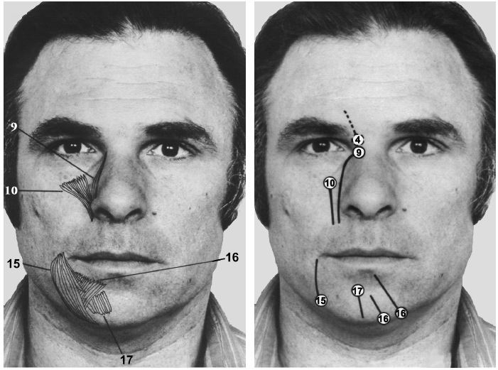
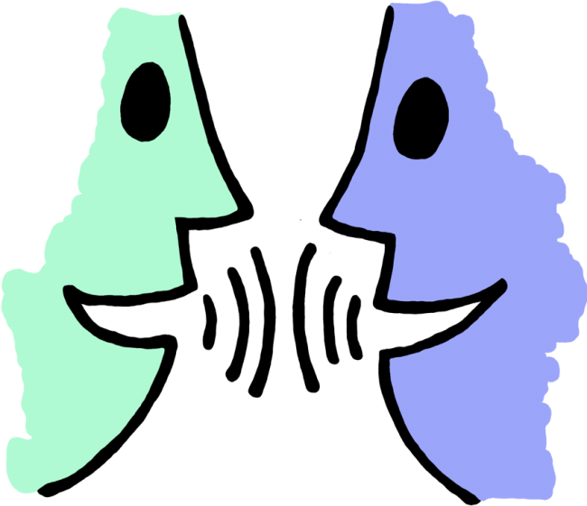
Who Were the Married Couples?
N = 37 married couples (74 individuals)
Age: M= 41.98
Income: M = $50,001 - $75,000
Engaging in conflict conversation.
Money
Communication
Sex
Notes:
First, we invited heterosexual married couples in the Chicagoland area to engage in a conflict conversation.
One of the strengths of our sample was the diversity.
The mean age of the couples was about 42 years old.
While the mean income of the couples was from $50,000-$75,000, the incomes ranged from less than $20,000 to greater than $150,000
Also, 44% of our couples were African American
Before engaging in the conversation, each spouse would separately fill out a form about topics of disagreement. Then each form would be compared to see the topics with the highest level of disagreement.
A common question we receive is: “What are the most common areas of disagreement?”
When looking at our data, there is a clear trend that money….communication….and sex are the three most common areas of disagreement.
“How real can these conversations be?”
Mean on the scale is high to address this
People cant help but engaging in the conversation
Picture of lab set up
“Are there gender differences?”
“Differences in SES?”

Slide 8
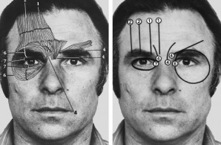
How Did We Measure Marital Conflict?
Recording emotional behavior.
Specific Affect Coding System (SPAFF) Manual
Two trained coders
Notes:
During each conversation, the couples’ facial expressions and emotional behavior were being recorded. Emotional behaviors, that is – stonewalling, criticism, defensiveness, and contempt, were coded by two trained raters - myself and a graduate student in my lab. We coded the last 30 seconds of each 10 minute conversation.
Each video was coded using the Specific Affect Coding System, also known as SPAFF, using established indicators. SPAFF is an objective, emotional behavior coding system that is used most often between married spouses.

Slide 9
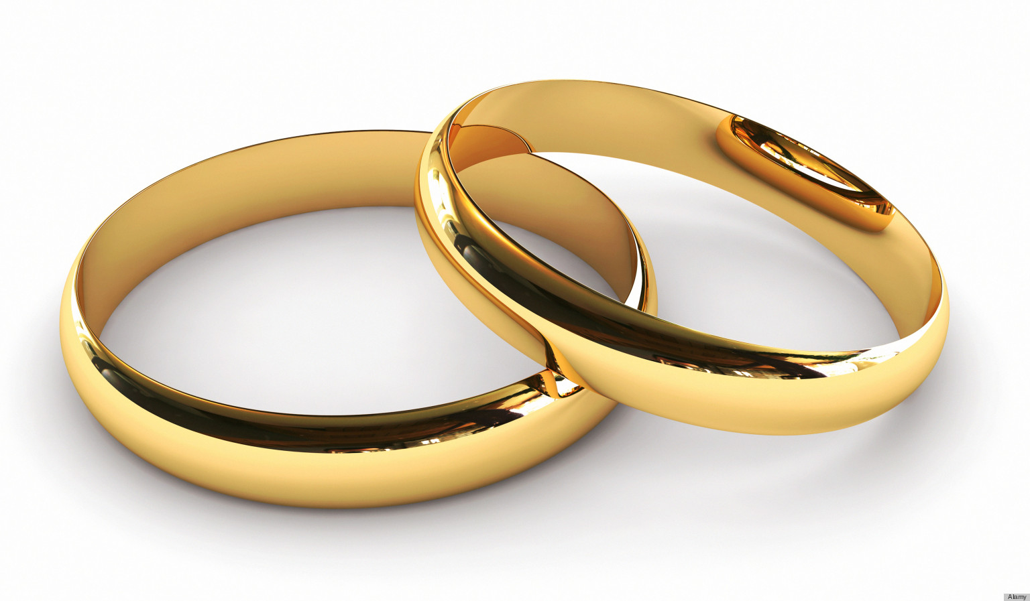
How Did We Measure Marital Satisfaction?
Marital Adjustment Test
“How often do you confide in your mate?”
Take the marital satisfaction survey.
Notes:
After completing the 10-minute conflict conversation, the couples completed the Marital Adjustment Test, which is a 15-item scale that has been used and validated by many researchers.
An example of a question on the scale would be, “How often do you confide in in your mate?”
Couples filled out the scale separately.

Slide 10
Stonewalling and Defensiveness
Stonewalling
Defensiveness
Notes:
As I begin to take about the results, I want to remind you all of the four emotional behaviors that I studied - that is, stonewalling, defensiveness, criticism, and contepmt.
Stonewalling is characterized by prolonged and active disengagement.
Defensiveness functions to deflect responsibility or blame and is characterized by the raising of eyebrows and arms folded across the chest.
In our study, we found no relationship between stonewalling and defensiveness and marital satisfaction.

Slide 11
Criticism
Notes:
As a reminder, criticism is characterized by blaming, character attacks, and negative mind reading.
There are no particular physical indicators because criticism is mostly in the word choice and tone of voice.
-----
Instead, add picture of criticism face and jog the memory of the audiences and then move into the results.

Slide 12
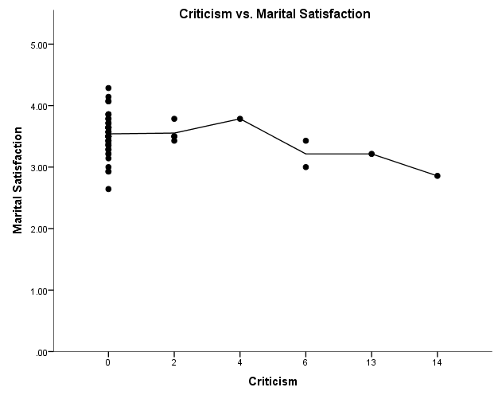
Criticism Negatively Predicted Marital Satisfaction
r = -0.306*
Notes:
You will see that criticism was found to be negatively associated with marital satisfaction meaning that the more spouses expressed criticism behavior, the lower the marital satisfaction for both spouses.
This relationship was significant.

Slide 13
Contempt
Notes:
Lastly is contempt. The purpose of contempt is to hurt, belittle, or humiliate.
Sarcasm, mockery, and insults are key components of contempt.
Common indicators of contempt include side sneer as shown in the photograph, and eye rolls.
In the video I am about to show you will see the side sneer and the eye roll on the wife's face. The video is pretty quick, so be sure to pay attention.

Slide 14
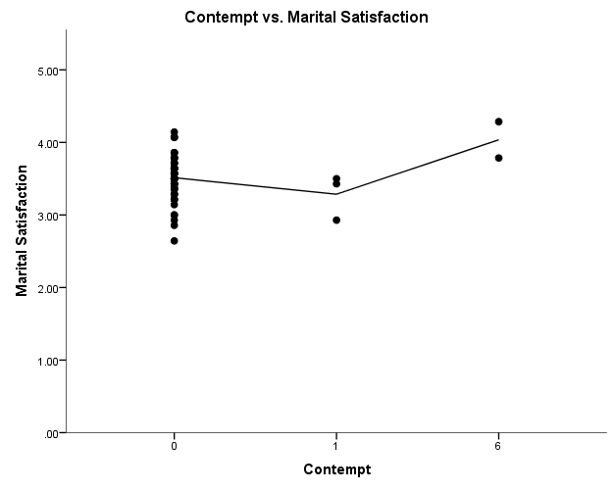
Contempt Positively Predicted Marital Satisfaction
r = 0.266*
Notes:
Now contempt was slightly different that expected.
Contempt was found to be positively associated with marital satisfaction, meaning that the more individuals expressed sarcasm, mockery, insults, etc., the higher the marital satisfaction.
While this does not agree with the idea of the 4 horsemen of the apocalypse and previous research, there may be an explanation for this finding.
First, we had a small sample size. There were only 37 couples.
Second, the base rates for all of the emotions, but especially contempt, were very low meaning that these were not common emotional behaviors. Because of this, the data can be skewed.

Slide 15
Marital Conflict
Extremely Dissatisfied.
Notes:
We’ve watched this couple throughout the presentation display a wide range of emotions.
And while we don’t have follow up information on whether or not they divorced, we do have information on their marital satisfaction.
The reported marital satisfaction for both spouses was: dissatisfied, as many of you all guessed.

Slide 16
“Thin slices” of interpersonal behavior can be used to predict marital outcomes.
Notes:
The big take away is that our findings provide initial evidence that objectively coded “thin slices” of interpersonal emotional behavior during 30 seconds of a conflict conversation can be used to predict marital outcomes. In our study we looked at marital satisfaction, but in future research we hope to look at divorce.

Slide 17
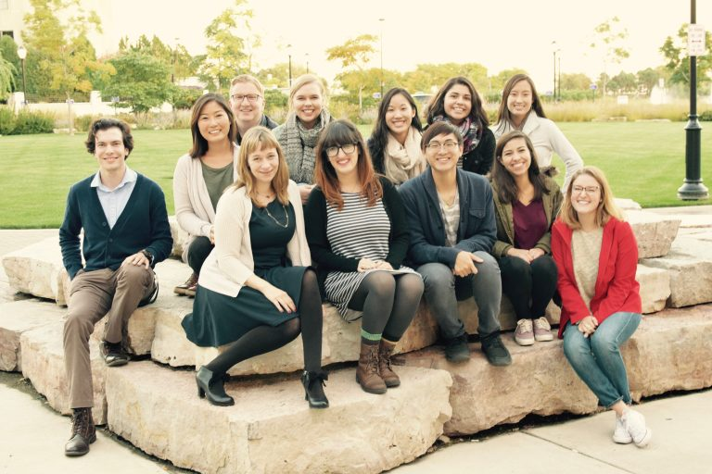
THANK YOU to…
Northwestern’s Lifespan Development Lab
PI: Dr. Claudia Haase
Jacquelyn Stephens, second coder
Office of Undergraduate Research
Notes:
I would like to thank the Lifespan Development Lab and the Office of Undergraduate Research.

