Slide 1
Agency, Access, and Action: The Enduring Legacy of Thomas L. Hodgkin
Notes:
It is using the background from https://dribbble.com/shots/1588545--Freebie-7-Low-Poly-Backgrounds-svg-png
Template modified by fppt.com

Slide 2
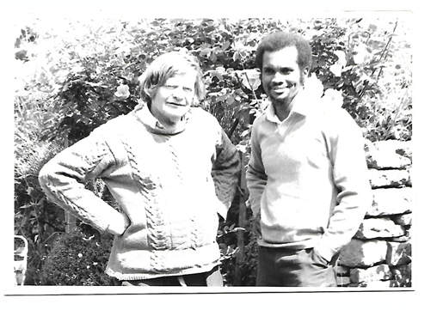
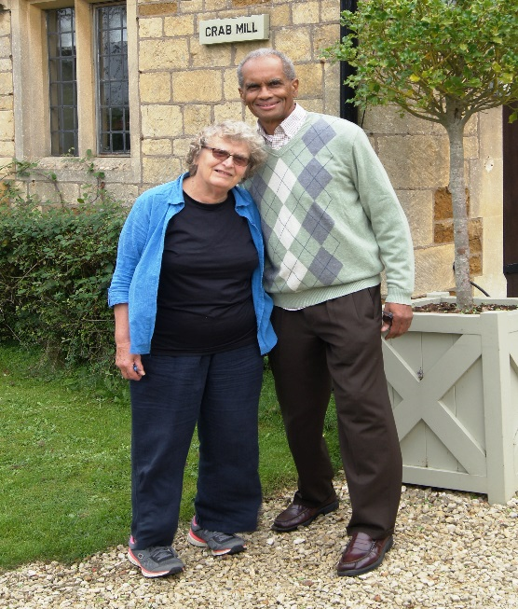
Encountering Hodgkin
Oxford University, 1966
Mississippi Freedom Democratic Party, 1965/1967
London & Oxford 1967-1968
Jennifer Chung, Stanley Shepherd, David Goldey

Slide 3
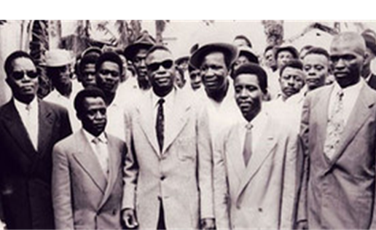
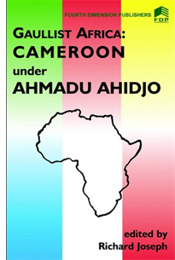
Political Struggles in Colonial and Post-colonial Africa
T. Hodgkin, Nationalism in Colonial Africa (1956), Nigerian Perspectives (1960), African Political Parties (1961)
R. Joseph, “Ruben Um Nyobé and the ‘Kamerun’ Rebellion” (1974); “National Politics in Postwar Cameroun: The Difficult Birth of the UPC” (1975); Radical Nationalism in Cameroun: Social Origins of the UPC Rebellion (1977)

Slide 4
Joseph Family at Crab Mill, Ilmington

Slide 5
Jean Allman, “African Studies and the Unfinished Business of 1968”
M. Herskovits, P. Curtin, and other white American “gatekeepers” in African Studies insisted on “scientific objectivity and neutrality” and contested the “racial production of knowledge”. They did not seek to transcend imperial interests.
“White power and privilege” were “hard-wired” into the structure of African Studies and in the African Studies Association, which ensured its replication through the careers and research that were fostered and those blocked or marginalized.
The rupture between the White power-brokers and gate-keepers and Black scholars and their allies centered on issues of racial dominance. “African Studies” reflected that dominance rather than countering and challenging it. Their critics were chastised for “Black Racism” and wanting to “racialize” and “ghettoize” the study of Africa.
Allman: “Do the numbers”; NU professors and administrators (B. Diagne, R. Ware, S. Umar/ N. Dike, T. Gunn. C. Badiane)

Slide 6
Hodgkin and the Counter-Narrative in African Studies
anti-colonial, anti-imperial, and internationalist (tier-mondiste)
“chacun à son grand-père”. (Hugh Trevor Roper) Forebears were Quakers and Abolitionists. While his work was academically grounded, it was driven by a commitment to hasten the end of colonial rule and European hegemony
the Palestine Mandate experience, 1934-36
Extra-Mural and Adult Education experiences, England and West Africa (latter from February 1947)
Immersive Learning: par le bas: lorries, camels, horses, trains, buses, ‘bush taxies’, 1947-1956. Populist – Levellers (radical political thinkers and activists; radical tradition in Islam)
Immersive Learning: directly from emergent African leaders
Critic: imperial mindset in academia; bonds between academic researchers and Western intelligence communities

Slide 7
Allman, 2013: Hodgkin and the Nkrumahist Moment in Knowledge-Production
Thwarted encounter, NK’s arrest January 1951
Nkrumah – Hodgkin friendship and alliance, 1952 – 1966
(also Busia, Danquah, Boahen, Du Bois, et al.)
Commission on University Education, Ghana, 1960-61
First Director, Institute of African Studies, Legon, 1962-64
Allman: Nkrumah called for African-centered teaching and research that enjoyed “entire freedom from the propositions and presuppositions of the colonial epoch, and from the distortions of those … who continue to make European studies of Africa the bases of this new assessment.
RJ: J. Rawlings, 1994

Slide 8
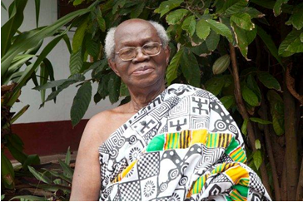
Hodgkin, Nketia, and the Nkrumahist Moment
Allman: Two very different conceptions of knowledge production about Africa. The first was the product of a colonial system of higher education, tightly bound to disciplines… In the second, “African Studies” was the site from which knowledge production in and about postcolonial Africa might be completely rethought— across disciplinary lines—from research and teaching, to textbooks, teacher-training, and publications.
RJ: Unconventional/ Blending/ Amalgam (Tyshawn Sorey) (Nigeria)
Prof. J.H. Kwabena Nketia, 1921-2019

Slide 9
Agency, Access, Action: Allman on Hodgkin
In Hodgkin’s view (Ghanaian Times, Nov. 1964), it was the job of African Studies, not only to expose racist colonial myths but to “build up systematically as comprehensive body of source material as possible” to disprove those myths and then to undertake the “process of reinterpretation of the evidence—and the making available of the results of this interpretation, not only through articles and books, but through all the various channels through which knowledge can be diffused— conferences, lectures, boycotts and the like…it is essential to develop within Africa Centres of African Studies that are liberated (as far as is humanly possible) from conventional Western presuppositions.
Allman: “a moment bursting with possibilities, in which engaged and rigorous debate, Africa-centered and Africa-based, was the prerequisite, no epistemic paradigm was hegemonic, and African Studies was envisioned as the site for a full re-imagining of higher education in an African postcolonial world.”
Ruptures, ASA 1968-69
RJ: transformative pedagogy

Slide 10
Nkrumah/Hodgkin Pan-Africanism
“I have taken note of the point you have raised in your letter regarding , in part, the establishment of the Institute of African studies which, as you know, is regarded as the one of the most important developments which the Universities of Ghana should undertake. Without it, they will not have the personality which Africa-based universities must have if they are to make any contribution at all to human knowledge and experience.” (Wolfers)
Feb. 24, 1961
[I]” did not see in the synopsis [proposed textbook] any reference to the African Abroad and to the connections and relations of Africans with the peoples of African descent in the Americas, the Caribbean and other parts of the world.” (Allman)
Feb. 27, 1961
TLH response: The textbook will cover “the activities and contributions of peoples of African descent in the Americas, the Caribbean, and other parts of the world”. [I]“had the opportunity to discuss further with Dr. Eric Williams during his visit to the Institute.” (Allman)

Slide 11
Allman: Ruptures & Continuities
Contesting: “How, where, why, and by whom knowledge about Africa was produced?”
The [Nkrumah-Hodgkin-Nketia-Davidson] moment was re-enacted in the 1968-1969 ASA rupture. A demand ‘that the study of African life be undertaken from a Pan-African perspective.”
Still (2013) “the balance of power remained and has remained remarkably constant…there was a moment, less than fifty years ago, when African Studies seemed poised to escape [its] neocolonial fate”.

Slide 12
Hodgkin’s Enduring Legacy
Immersive Learning/Archival Conservation
Freedom Work/Engaged Scholarship
Access to Knowledge/Knowledge-Production
Trans-racialism/Fanonist
Embedded Knowledge/Cultural Repertoires
All-Africa Vision - Islamic World/Diaspora
Replication of Power and Privilege/Imperial Mindset
Hodgkin Legacies: R.W. Johnson, G. Williams, J. Spiegler,
C. Stewart, S. Cross, L. Denzer, et. al.
Collaborative Learning Initiative on Governance and Development (CLI)

