Slide 1
Activity Patterns of D1/D2 Medium Spiny Neurons during Navigation
Alyssa Larios, Mark Howe, Daniel Dombeck
Notes:
I’ll be talking about the activity patterns of two neuronal populations during spatial navigation

Slide 2
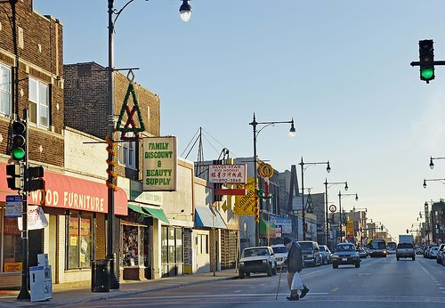
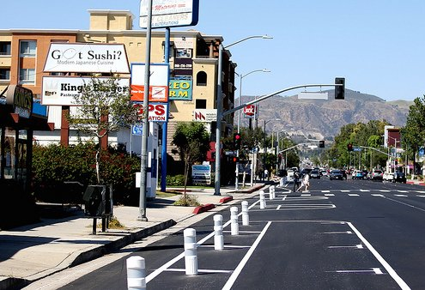
Goal-directed behavior
New Environment
Familiar Environment
Experience
Action-selection is based on the integration of sensory cues with memory from similar experiences when seeking to achieve a goal
Plan A
Sensory Stimuli
Plan B
Plan C
Action
Notes:
Imagine yo ufind yourself in a city you’ve never been to before. You don’t know the street names or where you are in relation to landmarks. However, you have been to similar-looking cities in the past, so you know things like bus stops tend to be on heavier tafficked streets and gas stations are at intersections.
You can draw from your previous experiences within this new context to act apropriately to achieve some goal – say, finding the train.
You can imagine plans

Slide 3
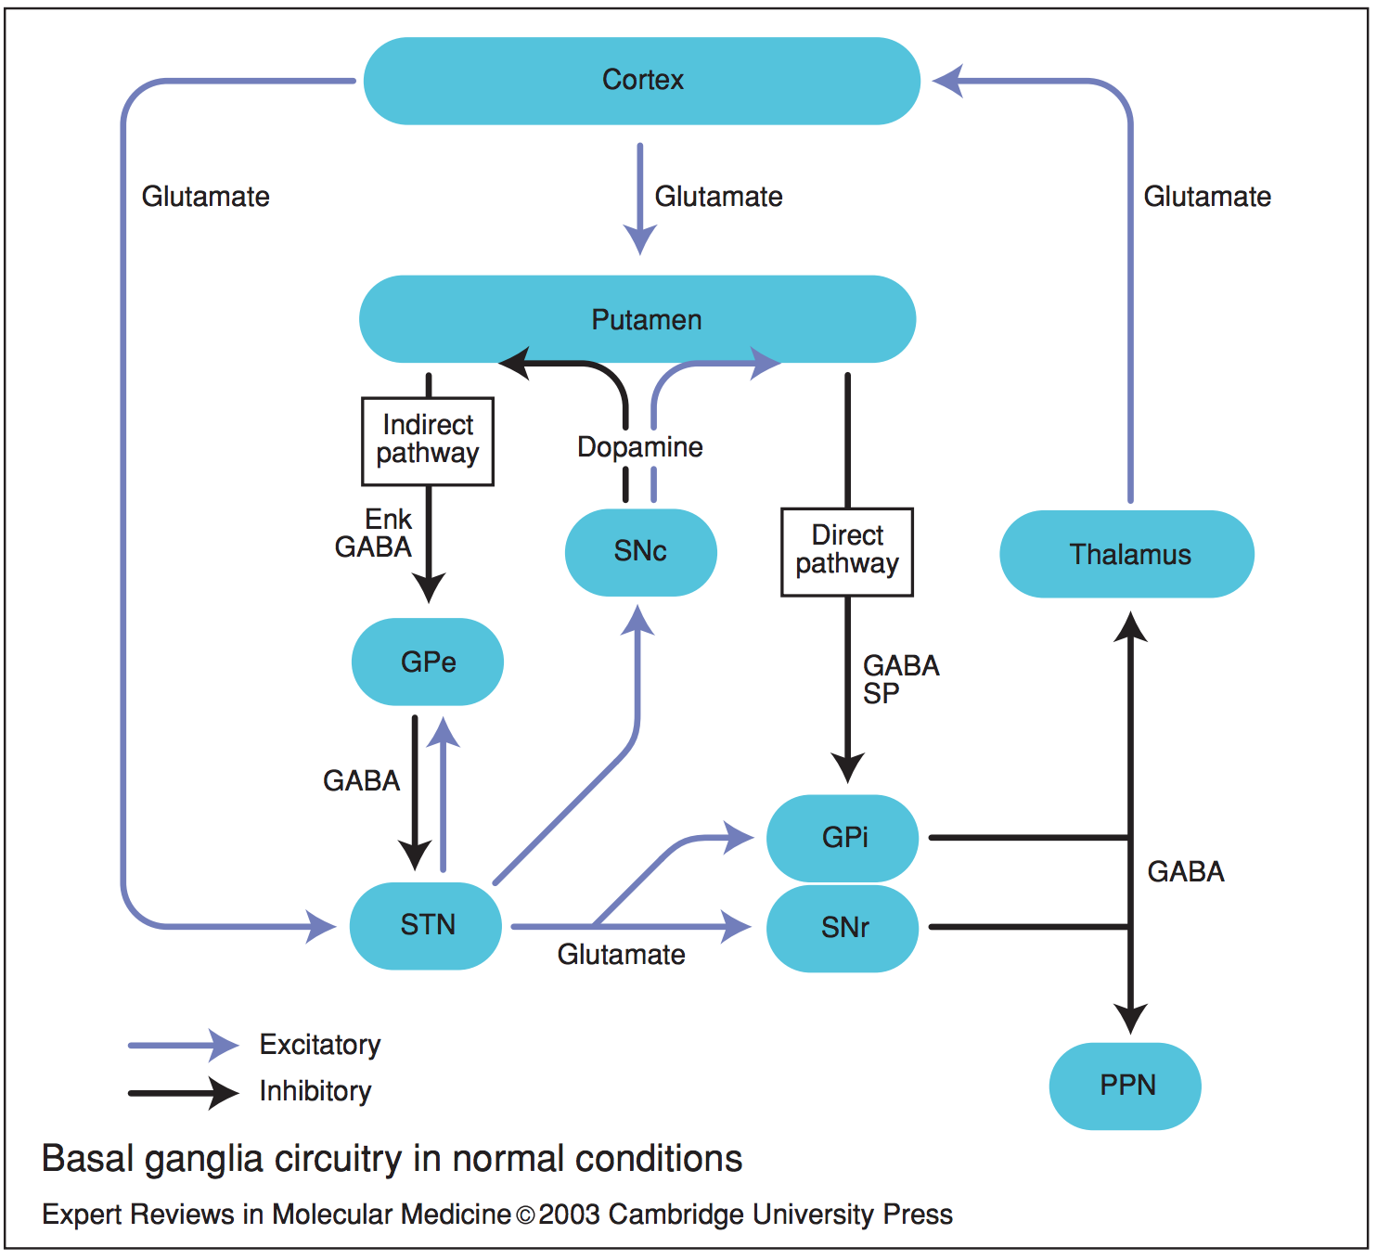
Basal Ganglia Circuitry and Striatal MSNs
Striatum
Notes:
Evidence for basal ganglias role in motivation, decision making, movement modulation
One Part that in involved
Simplified and mnore comolicatwed rhan will discuss

Slide 4
Basal Ganglia Circuitry and Striatal MSNs
Medium Spiny Neurons (MSNs)
Receive input from the cortex and midbrain
Striatum
Integration of sensory cues and memory during novel stimuli for action selection
Current Model: D1 MSNs in the direct pathway drive movement and D2 MSNs in the indirect pathway subdue movement
Do direct and indirect pathway neurons respond differently to changing environmental cues, and how do their activities influence behavior?
Notes:
Evidence for basal ganglias role in motivation, decision making, movement modulation

Slide 5
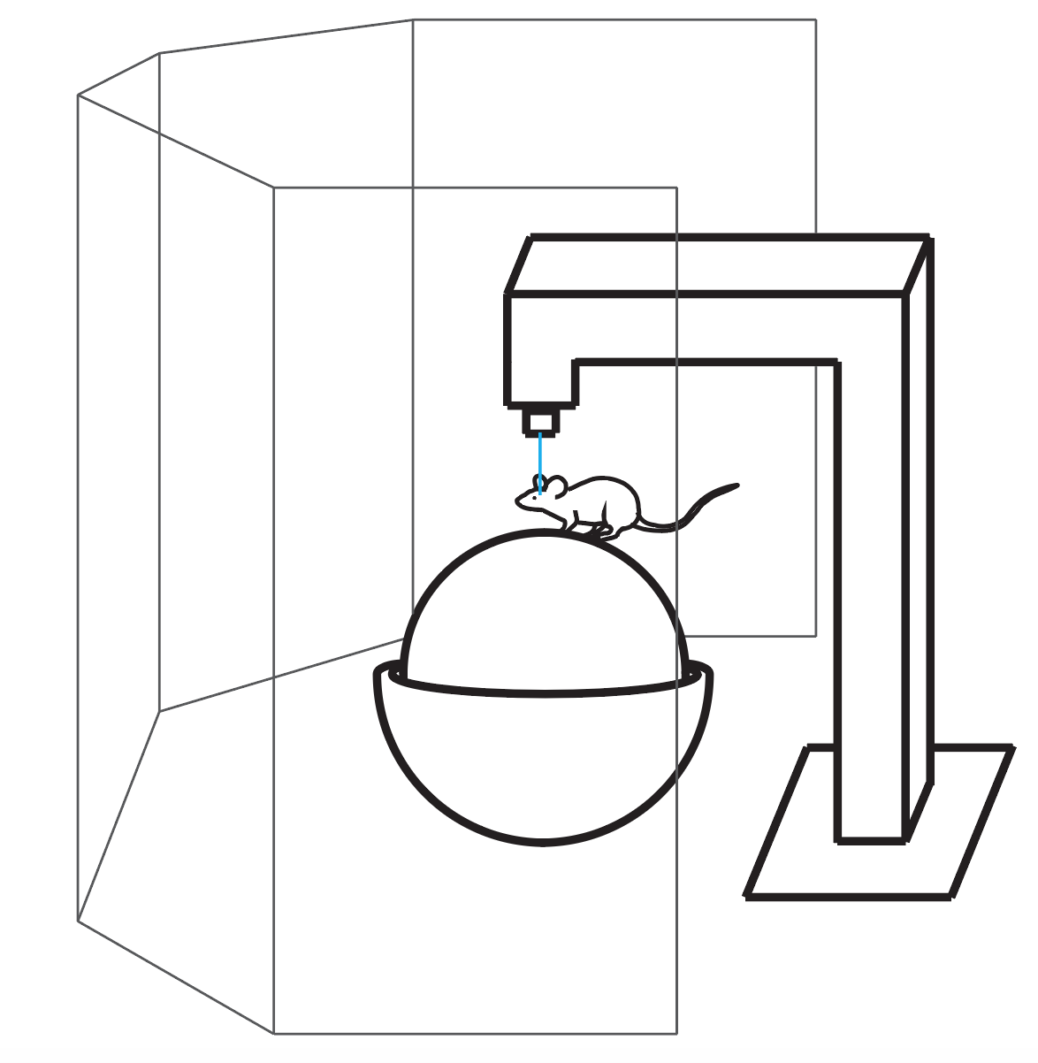
Navigation through Virtual Reality
Imaging laser or optic fiber
Conditioned Environment
5-panel monitor
Novel Environment
Treadmill

Slide 6
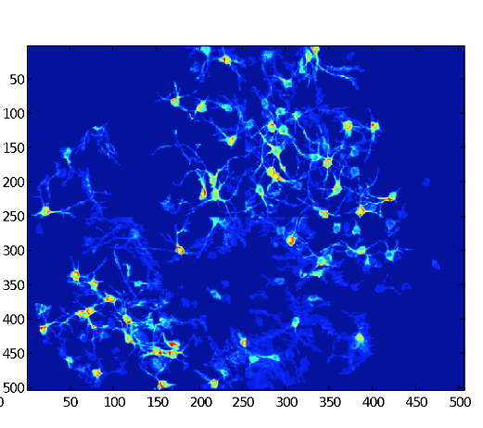
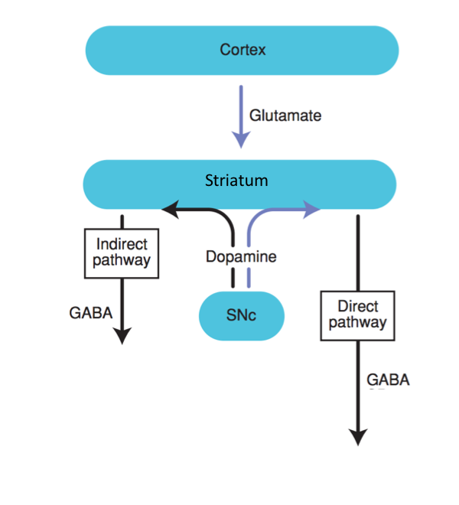
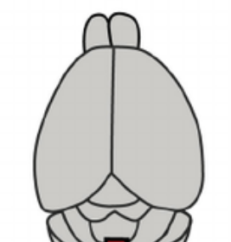
Two-photon imaging of MSNs
Direct
Reward
Indirect
Single-cell resolution
Fluorescence
Position in maze
Indirect pathway shows higher activity in novel environment, but direct pathway remains constant in average activity.
Must remove significant area of cortex to image striatum
Notes:
My project was to make recordings of these cells when cortex in intact

Slide 7
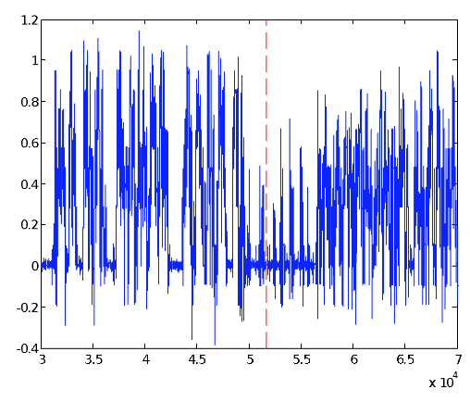
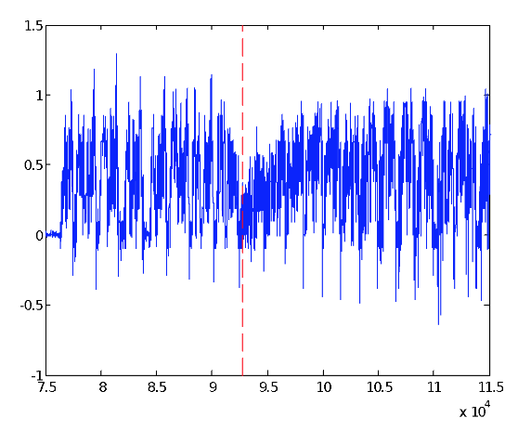
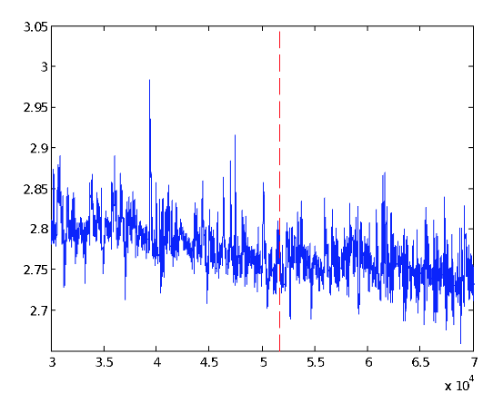
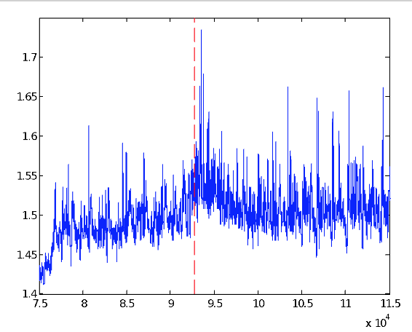
Population recording with Fiber Photometry
Direct
Indirect
Environment Switch
Velocity
Time(ms)
Raw F
Minimized cortical damage
Preliminary data suggests an increase in baseline firing in the indirect pathway network activity following contextual switch.
Behavior change is seen in both groups after switch

Slide 8
Action-Selection Model in the Striatum
Experience
Plan A
Sensory Stimuli
Plan B
Plan C
Action

Slide 9
Action-Selection Model in the Striatum
Midbrain
No-go
Cortex
No-go
Go
Action
Striatum

Slide 10
Action-Selection Model in the Striatum
Midbrain
No-go
Cortex
No-go
Go
Action
Striatum

Slide 11
Action-Selection Model in the Striatum
Midbrain
Indrect1
Cortex
Indrect2
Direct
Action
Striatum

Slide 12
Action-Selection Model in the Striatum
After Training
Midbrain
Indirect1
Cortex
Indirect2
Direct
Action
Striatum
Before Training
Midbrain
Indirect1
Cortex
Indirect2
Direct
Action
Striatum

Slide 13
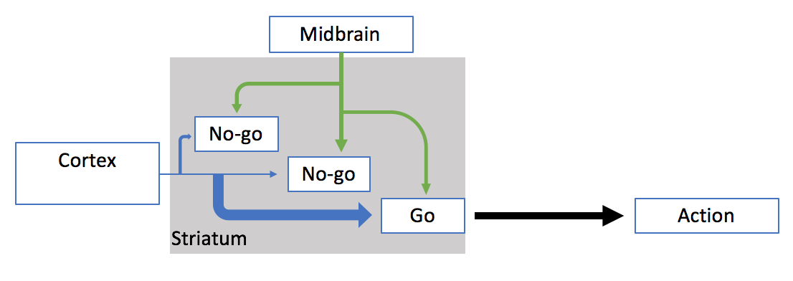
Action Selection in Changing Environments
New Environment
Familiar Environment
Direct
Indirect
Environment Switch
Raw F
Time(ms)

