Slide 1
Selection and Analysis of U.S. Election Forecasting Models
Brian Hsu
Email: brianhsu2021@u.northwestern.edu
Research Advisors: Dr. Volkening, Prof. Mangan
Support: The NU Office of Undergraduate Research, the NSF-Simons Center for Quantitative Biology, and NU QBio RTG program
https://www.vox.com/policy-and-politics/2018/12/18/18139556/republicans-democrats-partisanship-ideology-philosophy-psychology-marc-hetherington

Slide 2
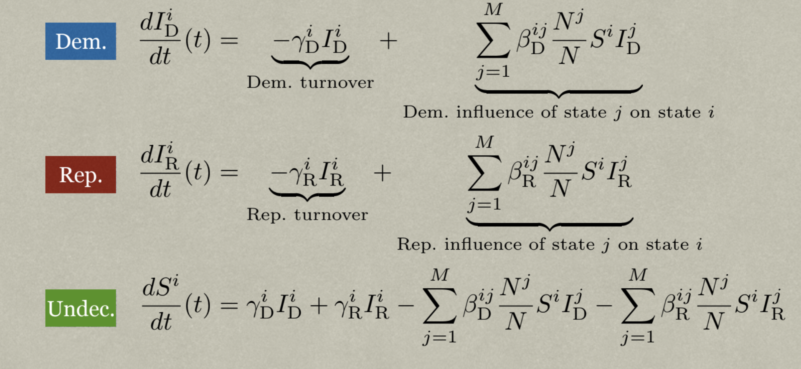
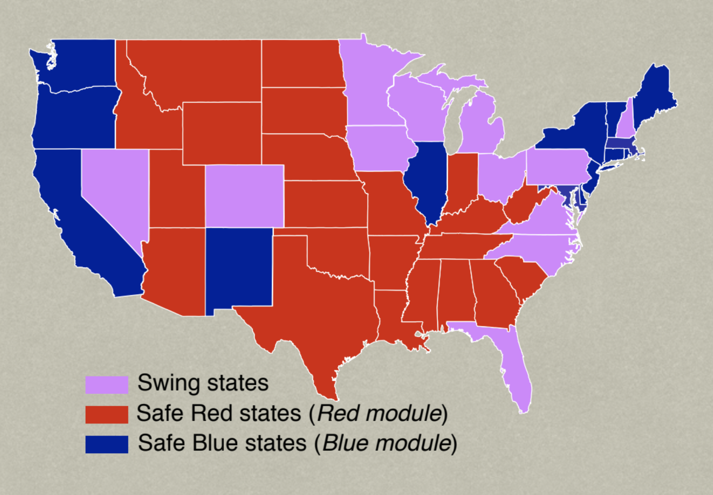
Background:
Previous research paper → simulated U.S. elections using Election “SIS” Model
Parameters of Election Model → quantify state-to-state voting relationships
Circled symbols = Parameters!
Relationship Between CO and FL From Florida’s Perspective:
$$β_{D}^{FL,CO}$$
$$β_{R}^{CO,FL}$$
$$β_{D}^{CO,FL}$$
$$β_{R}^{FL,CO}$$
https://arxiv.org/abs/1811.01831
$$γ_{R}^{FL}$$
$$γ_{D}^{FL}$$

Slide 3
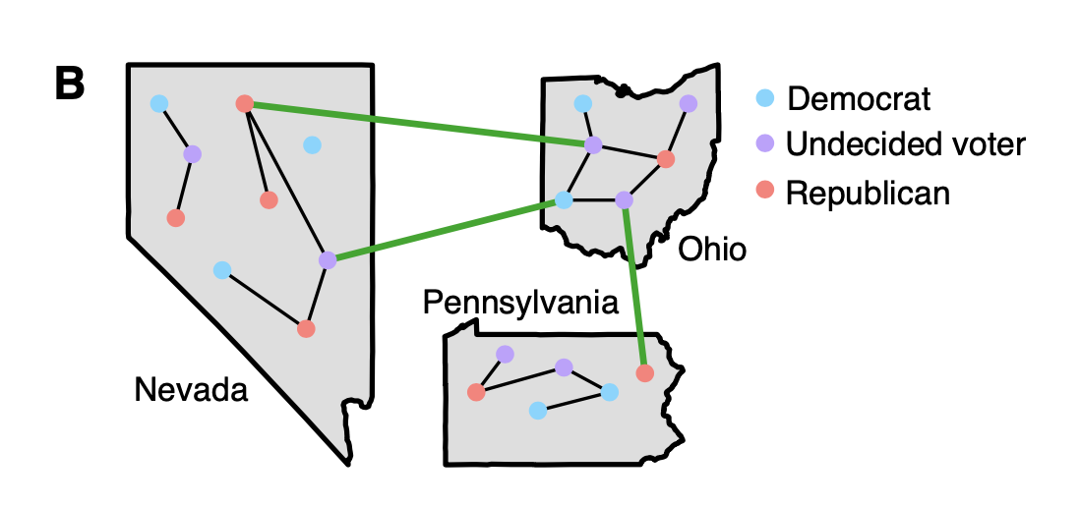
Main Goals:
https://arxiv.org/abs/1811.01831
Goal 1: Describe state-to-state relationships (by election, by state, by party, etc.)
Method: Statistical analysis of parameters → $β_{D}^{FL,CO}$, $β_{R}^{FL,CO}$, $γ_{D}^{FL}$, $γ_{R}^{FL}$
Goal 2: Test how different model selection methods impact parameters
Method: Using the SINDy model selection technique
https://royalsocietypublishing.org/doi/full/10.1098/rspa.2017.0009

Slide 4
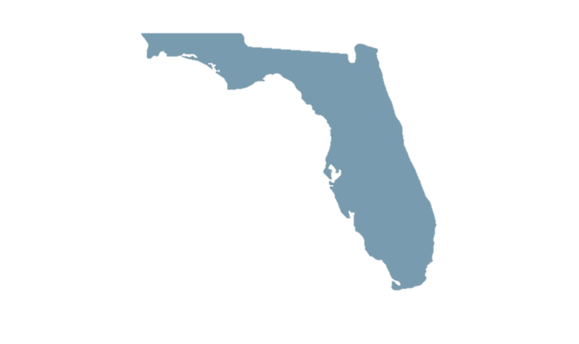
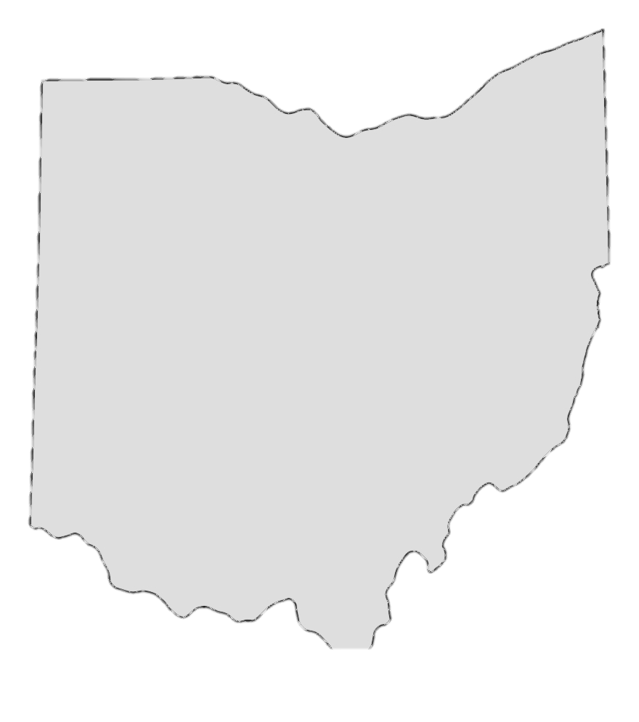
Sample of Results from Statistical Analysis:
From 2004-2016:
https://www.cartoonstock.com/directory/m/medal_podiums.asp
Election Years:
2012 and 2004 have most influential state voters
2016 is very different from other elections (smallest influence)
Turnover:
Rate of voters becoming undecided is statistically the same in all states!
2012
2004
2016
https://www.thechronicleherald.ca/opinion/local-perspectives/
2008
https://www.istockphoto.com/photo/rank-podium-gm1140190872-305029063
Swing States:
FL,OH,PA → most influential tier
NC,VA,MI → 2nd tier
Methods I Used:
Tukey’s test
Interaction testing
Factorial design
Blocking design
Etc..

Slide 5
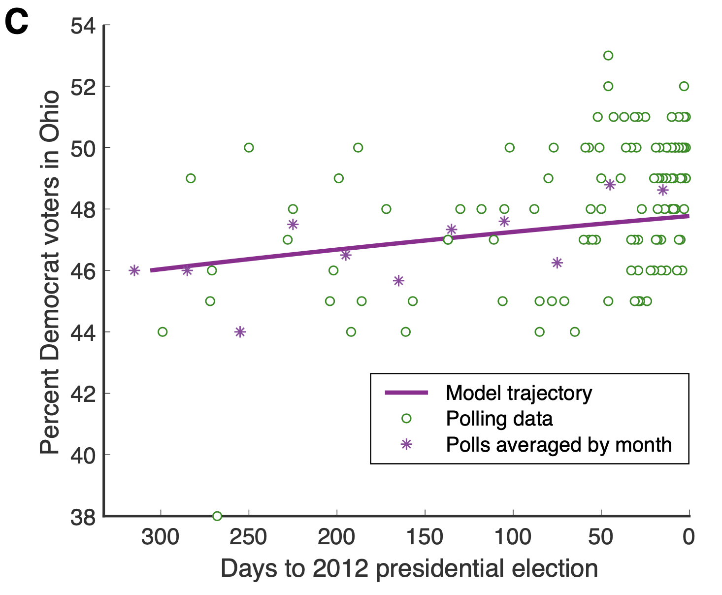
Sample of Results from Model Building:
The SINDy technique creates election model much faster!
Trade-off: Some parameters are negative → problems in predicting! Potential fix is force parameters to be positive!
$\frac{dI_{R}^{1}}{dt}$(t) = -0.6716 * $I_{R}^{1}$ + $\sum_{j=1}^{14}{\frac{N^{j}}{N}}$ *$\left(\begin{matrix}−0.0030 \\ −0.0100 \\ …. \\ −0.0885\end{matrix}\right)$*$S^{1}$*$I_{R}^{j}$
Need to make these all positive!!!!

Slide 6
Looking Ahead:
Can I refine and use the SINDy method to predict the 2020 election?
https://www.politico.com/2020-election/race-forecasts-and-predictions/
https://projects.economist.com/us-2020-forecast/president/how-this-works
2. How do the SINDy parameters compare to the original?

Slide 7
Thanks!!
Thanks Dr. Volkening and Prof. Mangan for mentoring on SINDy and the SIS Election Model!
Email: brianhsu2021@u.northwestern.edu
https://www.youtube.com/watch?v=AYZz_qYw_j4

