Slide 1

Introduction to Data Management
Cunera Buys
Data Management Librarian
RRF 2017
https://c2.staticflickr.com/1/680/21842202345 CC BY-SA 2.0
Notes:
Talk about research experience

Slide 2
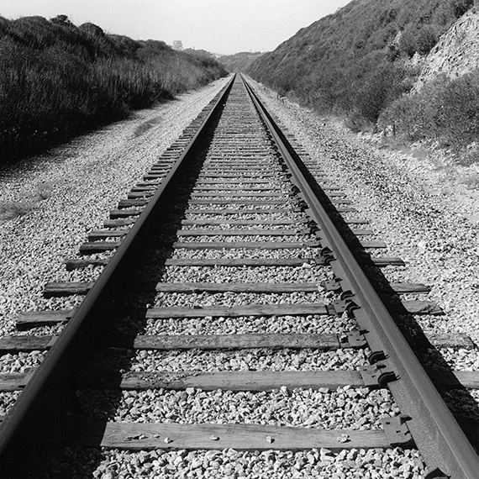
Background on data management
Why data management is important
Intro to best practices for data management
Library resources for data management.
Photo by Carl Vogtmann

Slide 3
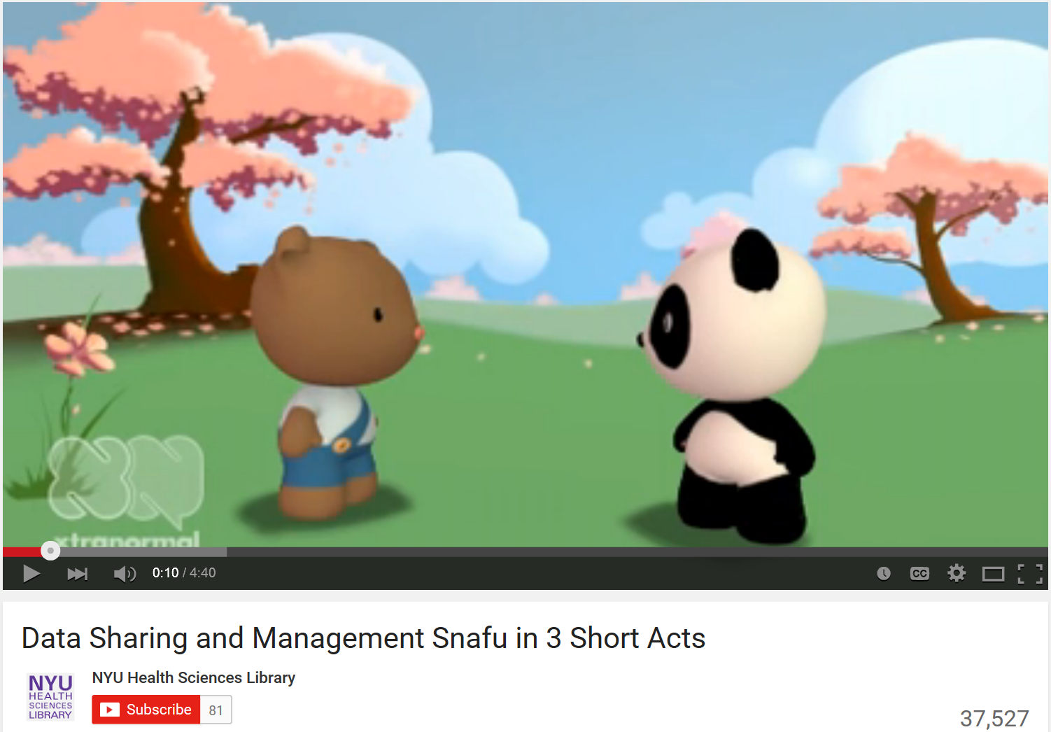
Data Snafu
Data Sharing and Management Snafu in 3 Short Acts
https://www.youtube.com/watch?v=N2zK3sAtr-4

Slide 4
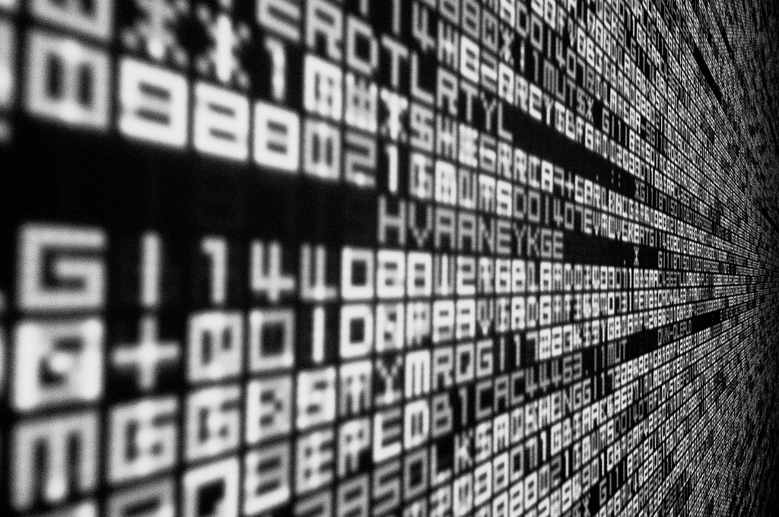
What are data?
https://www.flickr.com/photos/rh2ox/9990024683/ (CC BY-SA 2.0)

Slide 5
Data- Some Definitions
Office of Management and Budget: “Research data means the recorded factual material commonly accepted in the scientific community as necessary to validate research findings” (OMB Circular A110)
The Oxford English Dictionary (OED)defines “data” as:
Related items of (chiefly numerical) information considered collectively, typically obtained by scientific work and used for reference, analysis, or calculation.
Data can be both analogue and digital materials.

Slide 6
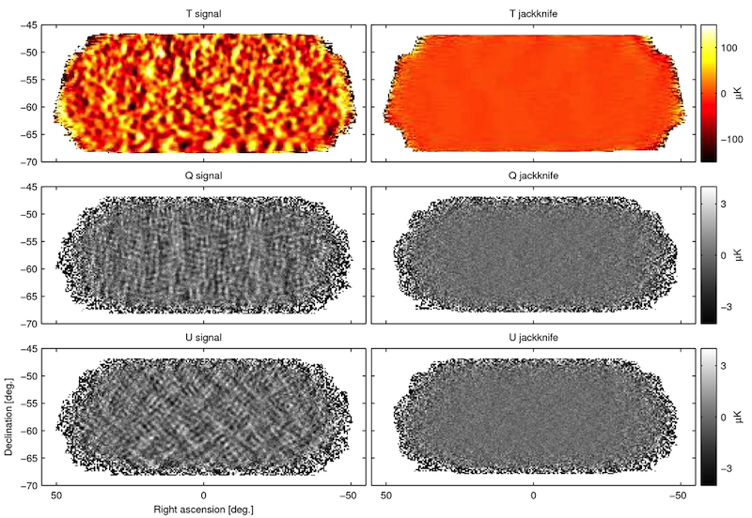
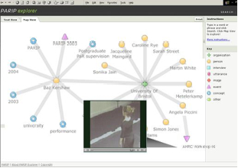
Data in the Sciences and Humanities
BICEP2 (South Pole telescope)
Performativity, Place, Space
BICEP2 Collaboration, 2014
Burgess and Hamming, 2011
Data in the Sciences and Humanities
Notes:
These definitions are intentionally very broad. And we know that there is a very broad range of data across the sciences and the humanities.
The raw data, the information coming right off of a telescope, in the case of the astrophysics project shown on the left, and the recorded video of a dance performance, as shown on the right, are both data. So, too, are the processed and embedded results – the visualizations, the semantic descriptions, all of these are versions or enhancements of the data that would be captured under this broad umbrella description.

Slide 7
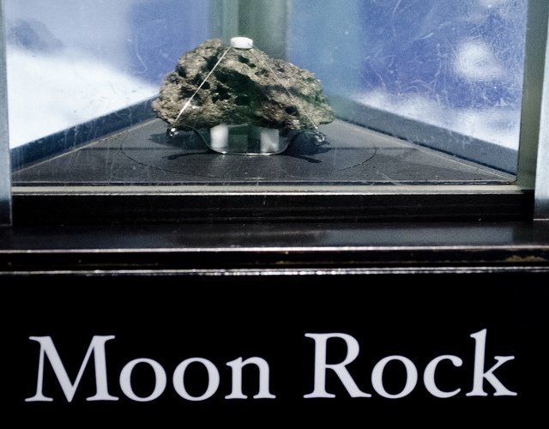
Every discipline has data!
  Types of data include:
  observational data
  laboratory experimental data
  computer simulation
  textual analysis
  physical artifacts or relics
  Examples of data include:
  Audio and video files
  Code or scripts
  Digital text
  Lab notebooks
  Geospatial images
  Instrumental data
  Photographs
  Rock samples
  Survey results
  Scanned documents
  Spreadsheets
  Video games
https://www.flickr.com/photos/23165290@N00/9338136777/(CC BY-SA 2.0)
Notes:
Just examples of the types of data. Moon rocks are data, but when people talk about big data, little big data, or just data, they are usually talking about born digital data. Born digital data is what we mean for the purposes of this presentation.

Slide 8

Why do funders and broader science community want to share and preserve data?
https://www.flickr.com/photos/uwe_schubert/3931638785/ (CC BY-SA 2.0)
Notes:
Why are funders and the broader science community interested in sharing data? What are the divers? There are several reasons:
The white house believes that federally funded research should be made publically available as soon as possible. Tax payers have the right to information paid for by taxes. By making articles and data available as soon as possible, they hope to advance science quicker, maybe solve real problems quicker, create jobs.
Other Drivers Include:

Slide 9
Brief History of Federal Data Sharing Requirements
2003 - NIH Data Sharing Policy for projects above $500K.
2011- NSF requires Data Management Plans (DMPs)
2013- White House Office of Science and Technology Policy (OSTP) Memo requiring public access to data
2016-19 Federal Departments and agencies have public access plans
Notes:
I’d like to start with a brief time line of Federal data management sharing requirements.
OSTP memo-- Granting agencies must develop a plan to make the results of federally-funded research publically available free of charge within 12 months after original publication. Includes published articles and data.
All affected funding agencies will require DMPs.
implement policies that require the deposition of research data underpinning the results described in scientific publications of federally funded scientific research in publicly accessible repositories. Optimally, such data would be made freely available in nonproprietary machine-readable formats and would allow for discoverability, reuse, and repurposing.”

Slide 10
Funding agency responses
Require Data Management Plans (DMPs)
Publications to be available to public within 12 months (Open Access)
Data supporting publications must be available in a public repository

Slide 11
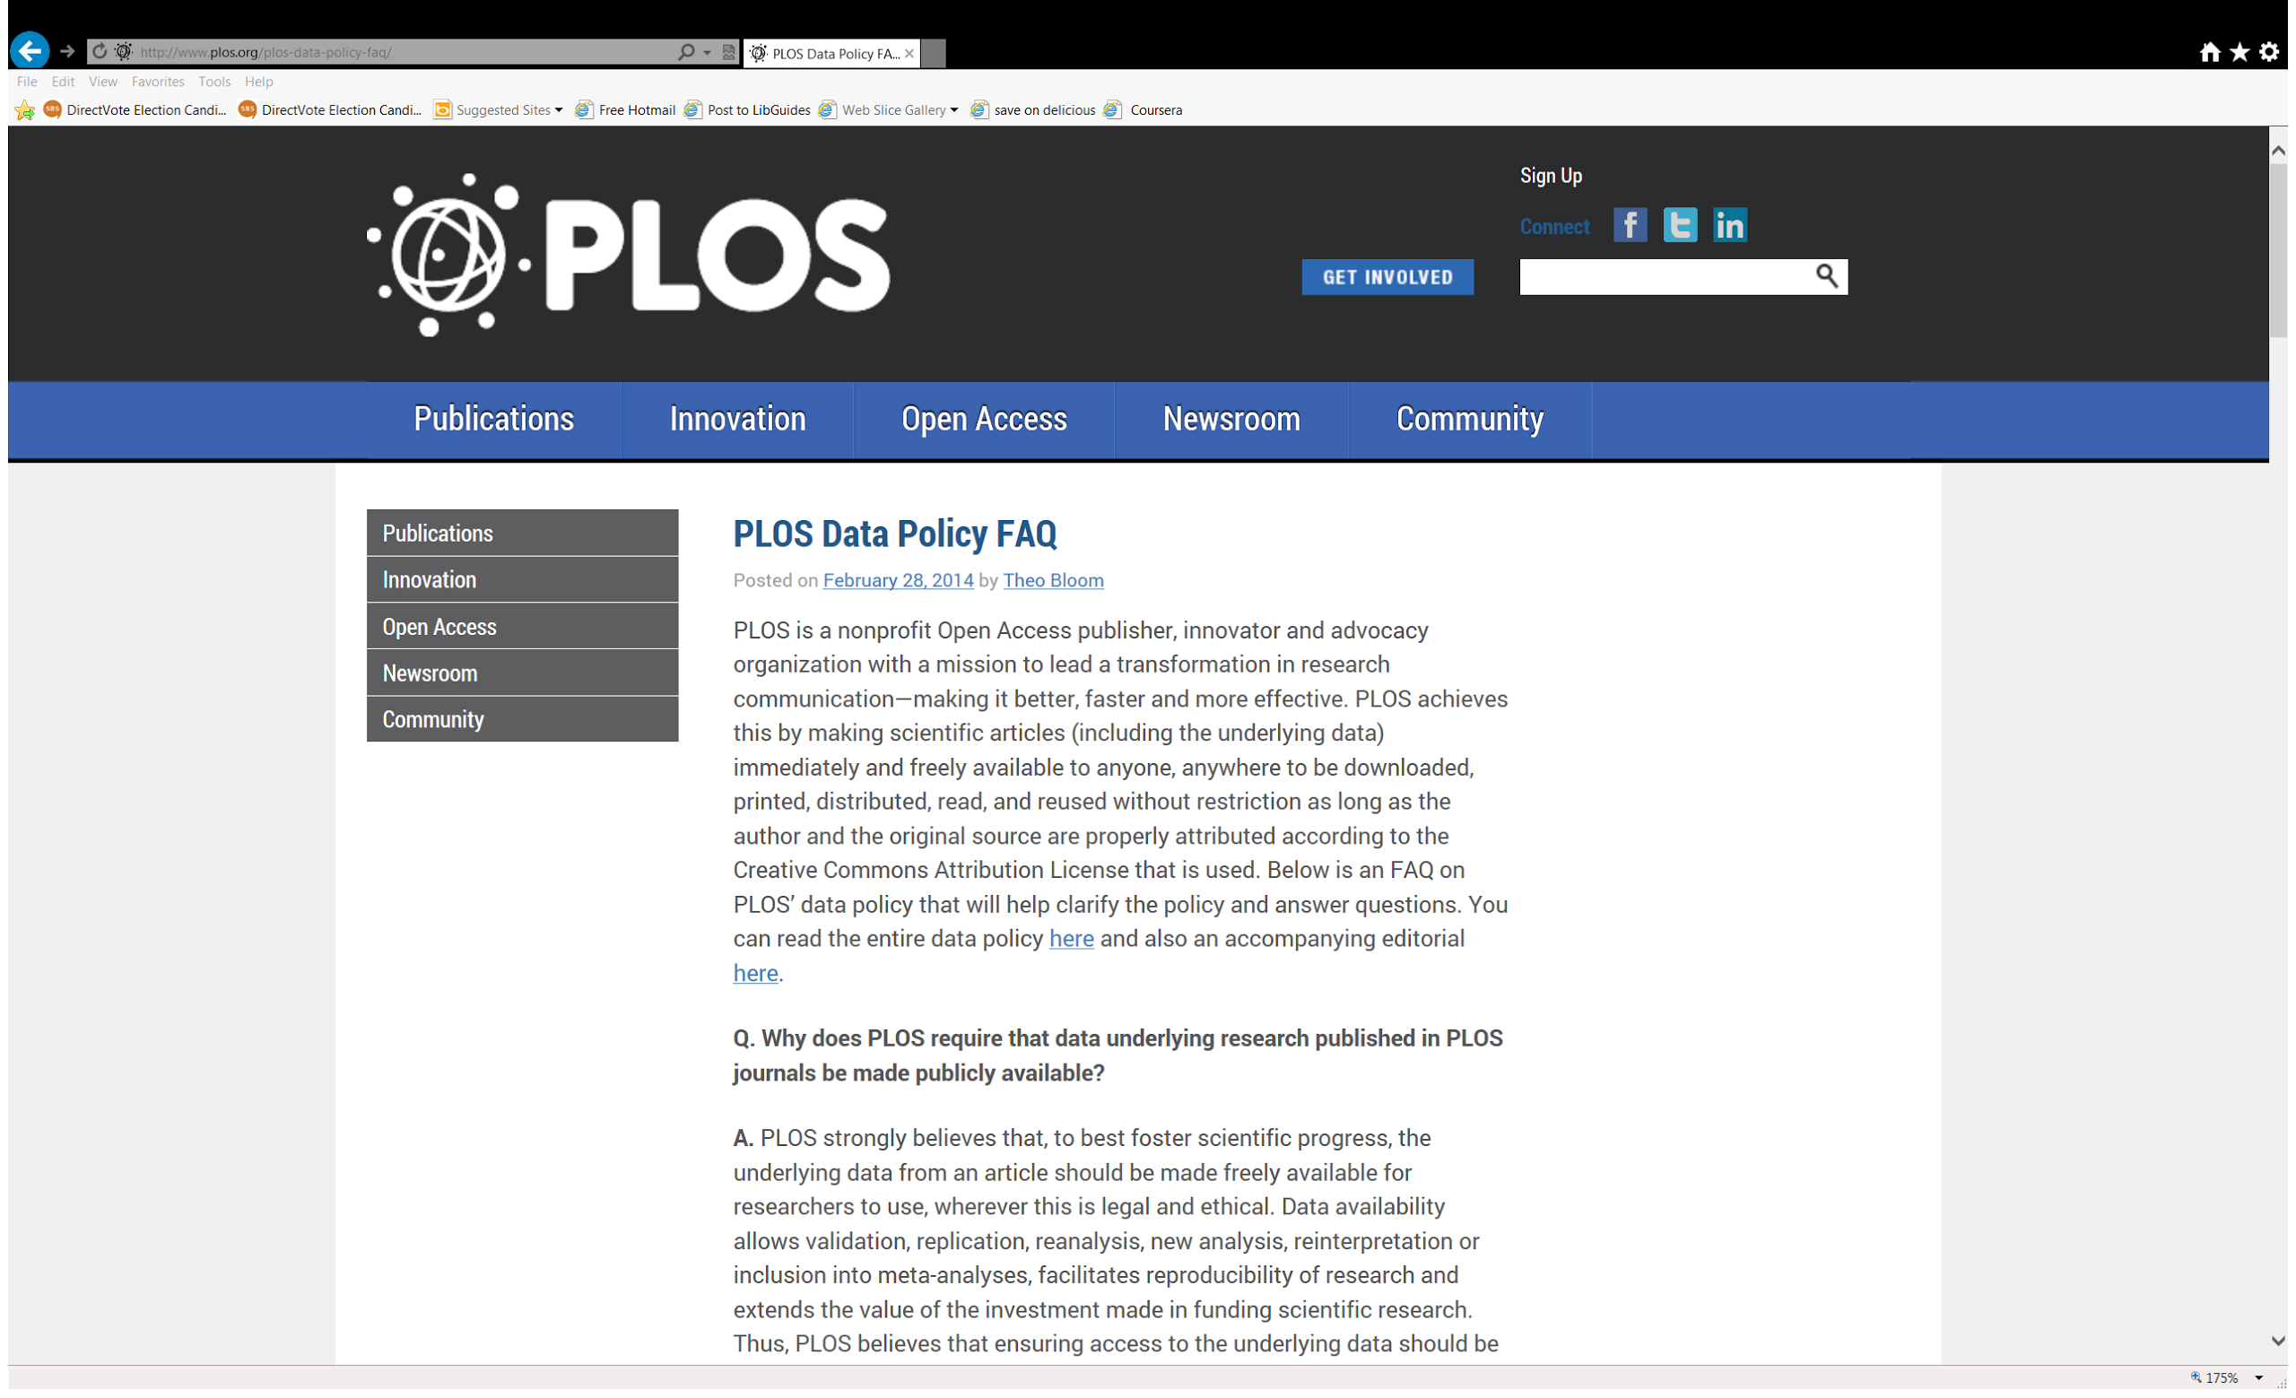
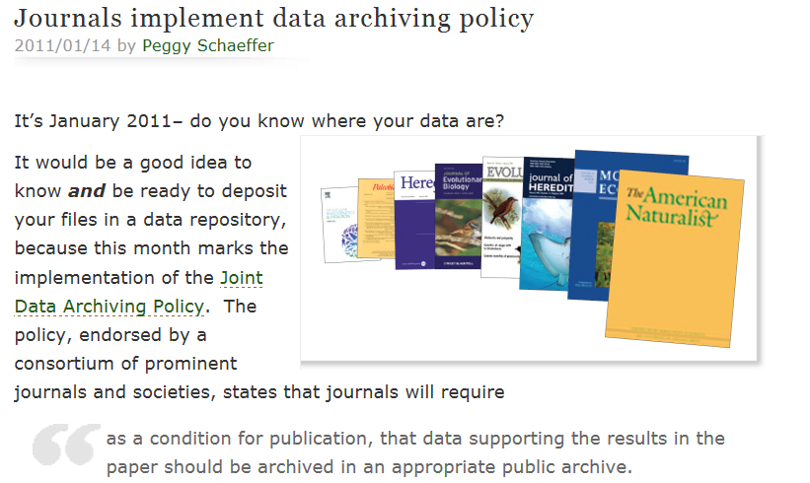


Journal Requirements
PLOS journals require authors to make all data underlying the findings described in their manuscript fully available without restriction, with rare exception.
Notes:
In addition to Federal mandates, many journals require the deposit of data underlying publications be placed in a publically accessible repository.
Some of these journal offer advice on where to deposit the data.
The Public Library of Science requires authors in PLoS Journals to have made the data supporting their arguments freely available at the time of publication, ‘with rare exception’. Some Journal publishers require or recommend that supporting data for articles be made publicly available.
The Joint Data Archiving Policy (JDAP) requires data sharing in a public archive as a condition of publication.
Journals that have adopted JDAP include: Science, Nature and Genetics
In the area of data sharing, some journals are requiring a form of data deposit upon publication. The specifics vary, each journal has a slightly different approach about whether the data may or may not be embargoed for a period of time, in most cases, it is the author’s responsibility to find an appropriate archive into which to deposit.

Slide 12
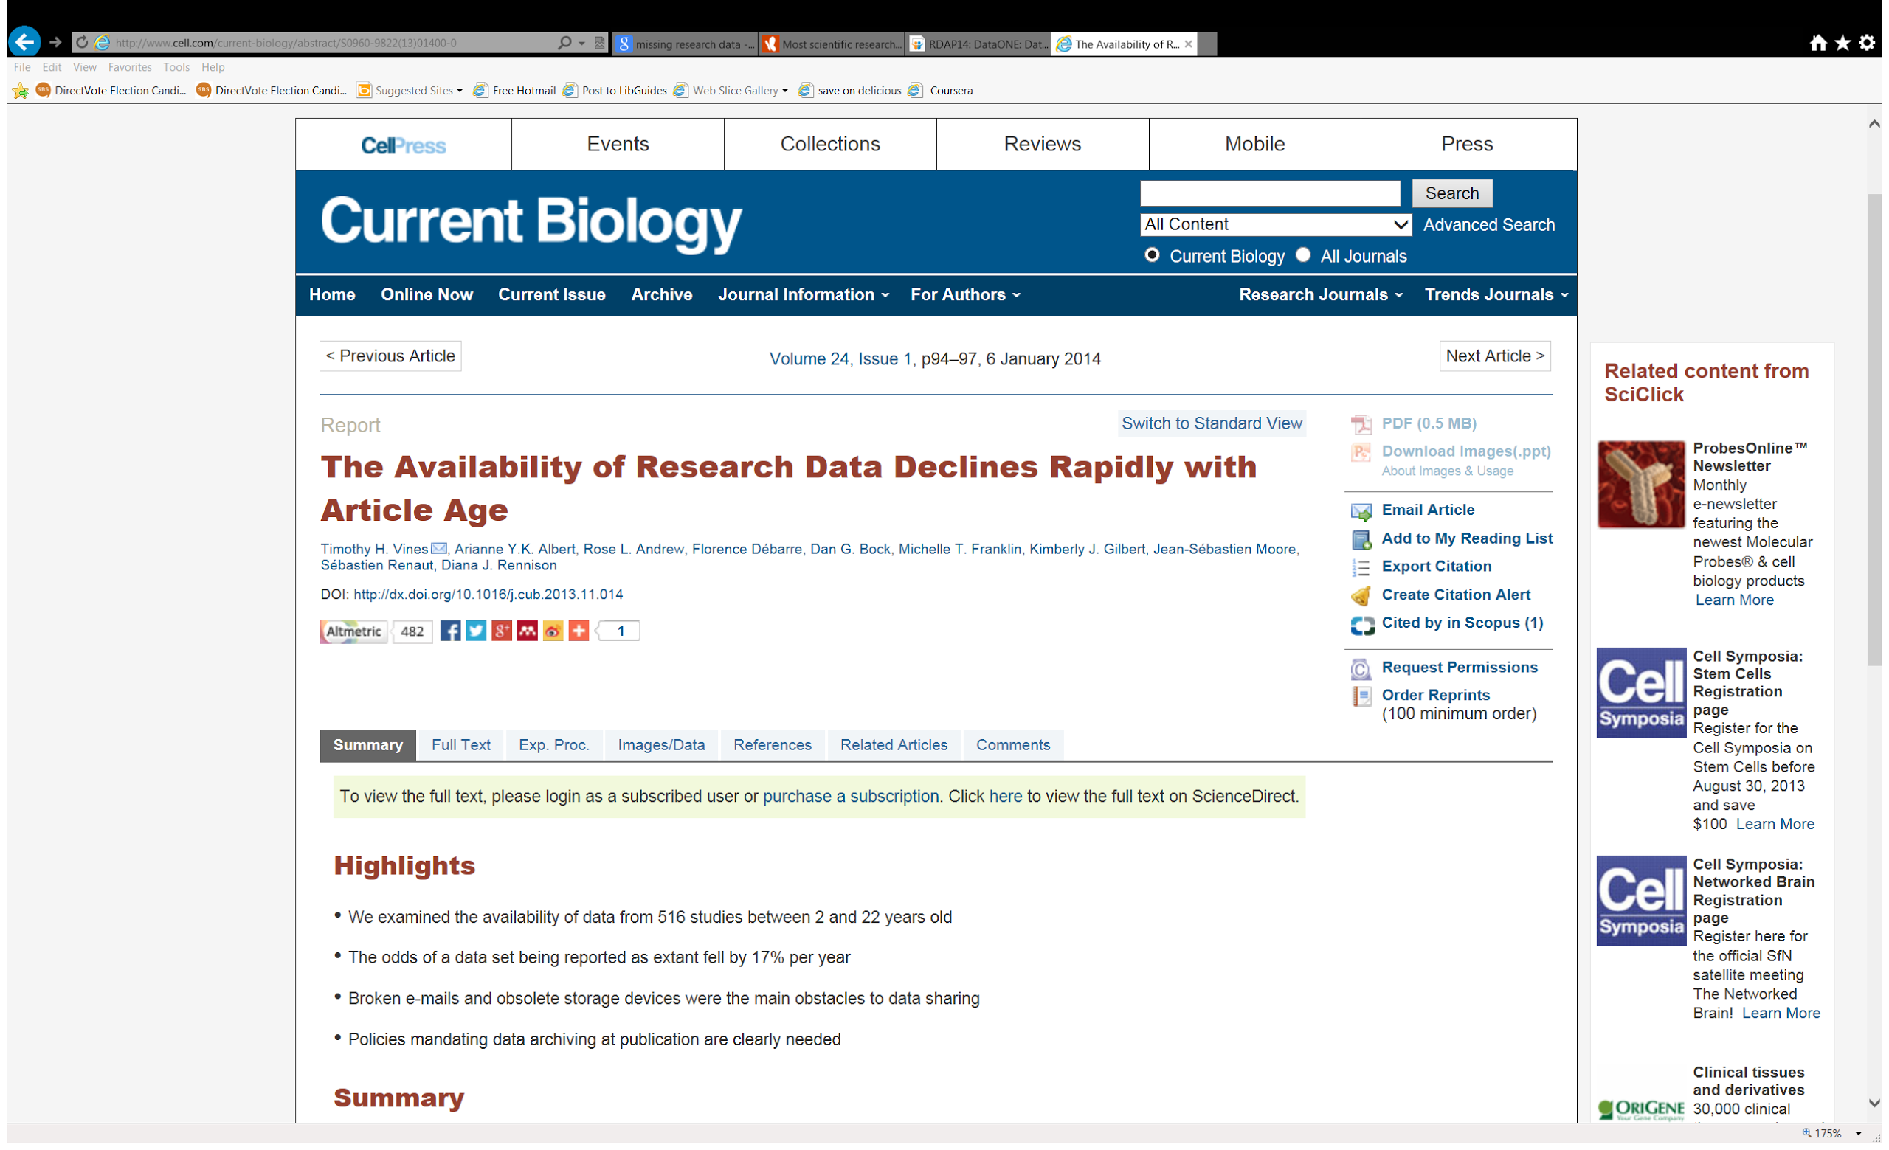
Prevent Data Loss
Notes:
Prevention of data loss. As this study published in Current Biology in January 2014 shows:
1. the availability of data decreased by 17% each year after publication
2. most raw data from scientific papers published twenty years ago is unobtainable
3. the most common obstacles to data sharing were because authors have since changed their contact information and can't be reached or because the data was stored using outdated technology, like floppy disks.

Slide 13
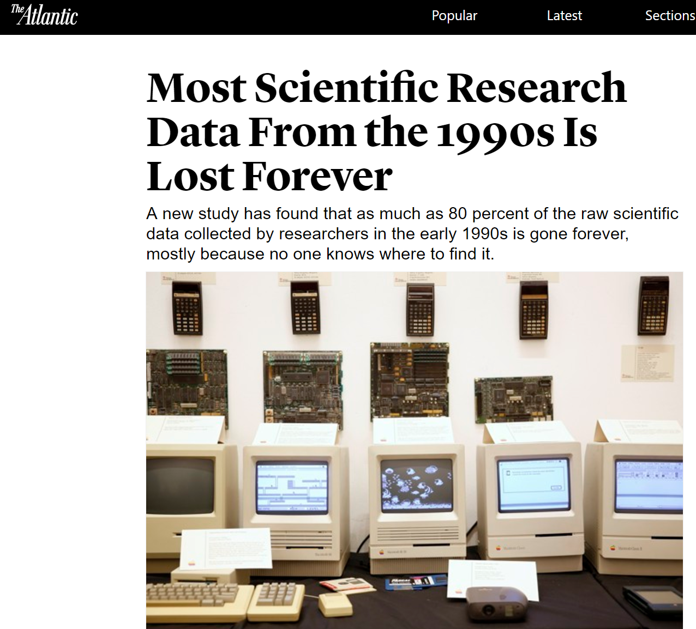
https://www.theatlantic.com/national/archive/2013/12/scientific-data-lost-forever/356422/
Notes:
A article from the Atlantic about the Current Biology study

Slide 14
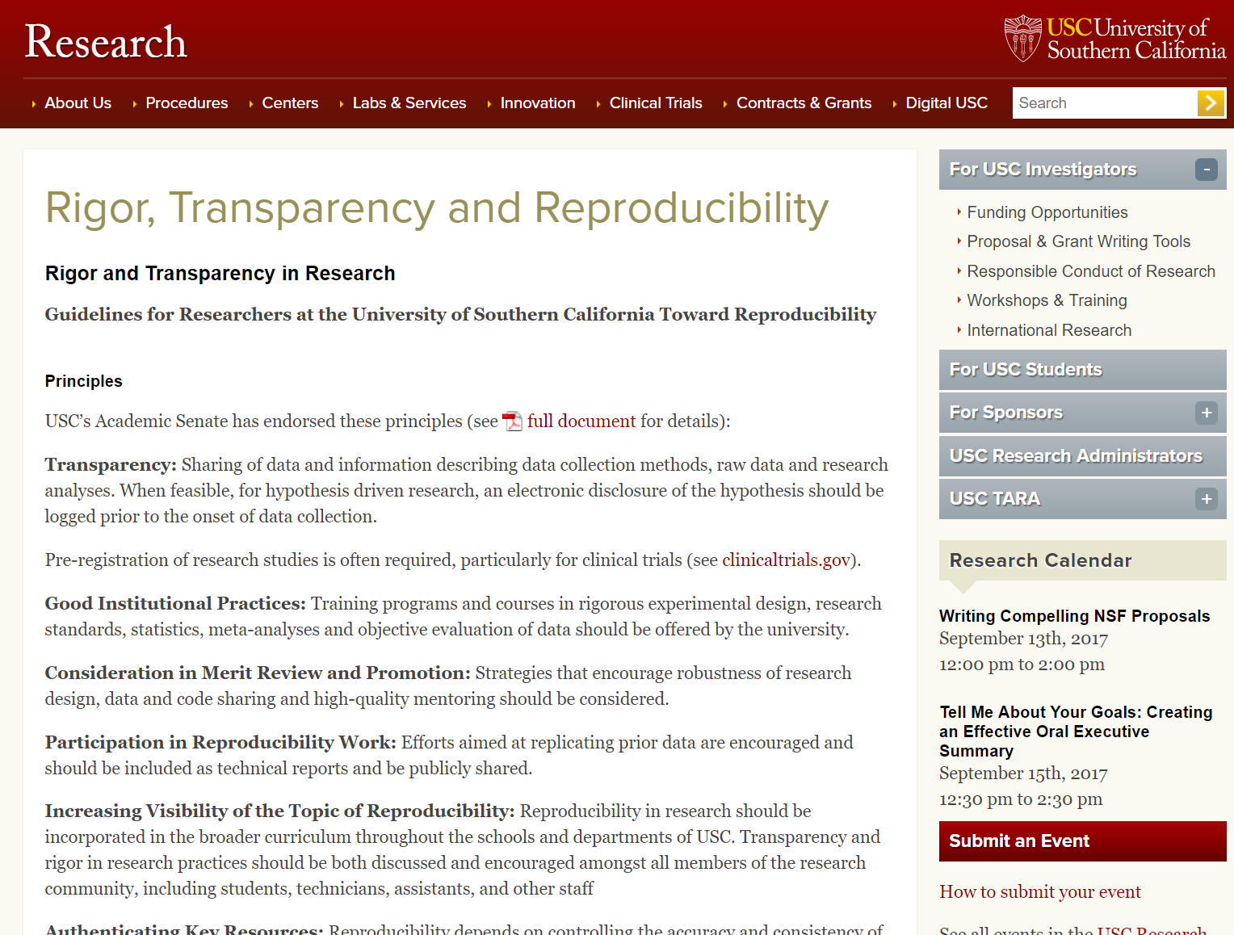
https://research.usc.edu/rigor-transparency-and-reproducibility/
Notes:
Reproducibility, rigor and transparency has been an important topic in research for the last several year. This is a sample policy from University of Southern California.

Slide 15
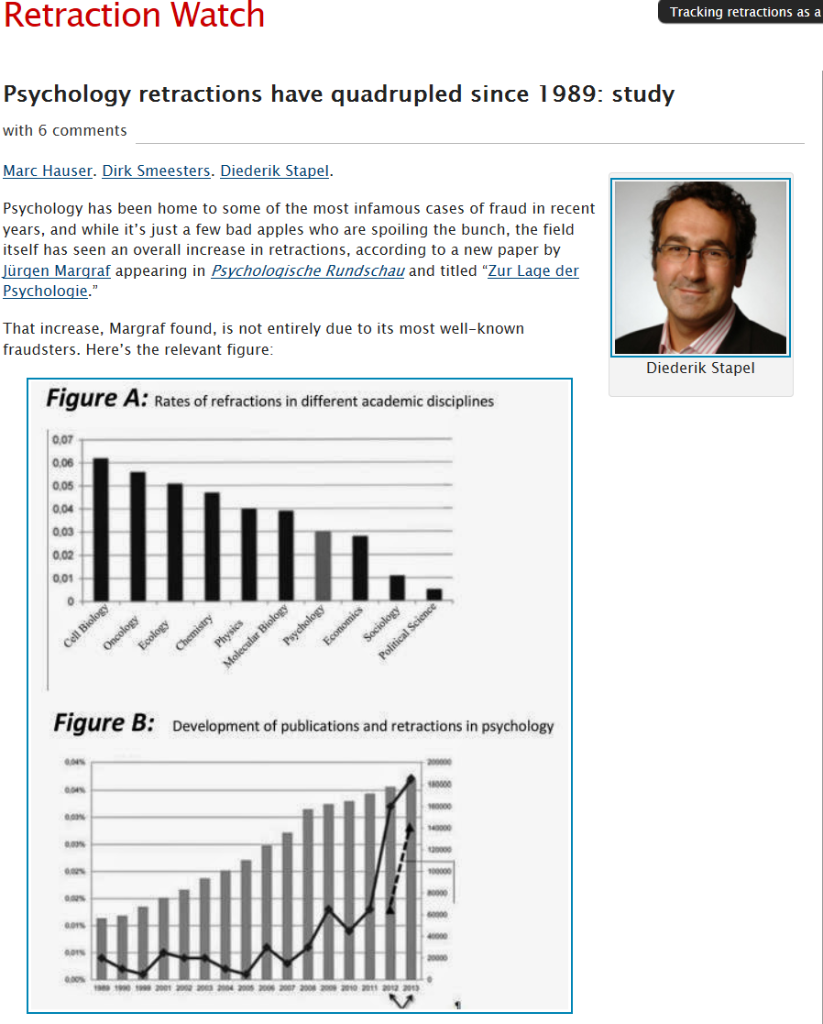
Notes:
Sometimes papers are retracted due to fraud by the researchers. However, sometimes papers are retracted because they cannot be reproduced, researchers leave out the “secret ingredient” from their papers, or researchers can’t justify results because don’t have the data sets anymore.

Slide 16
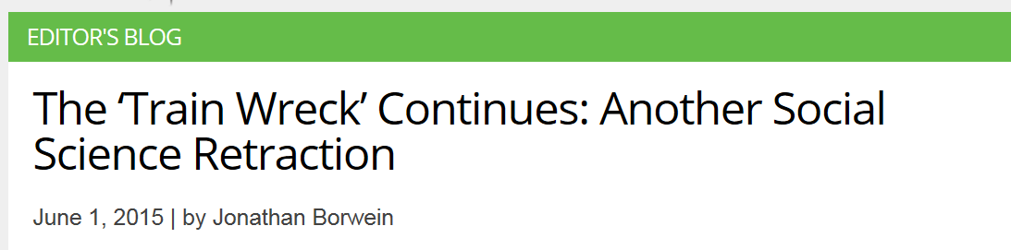
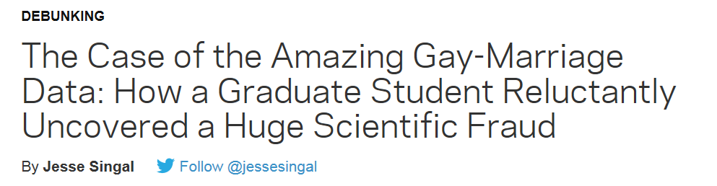
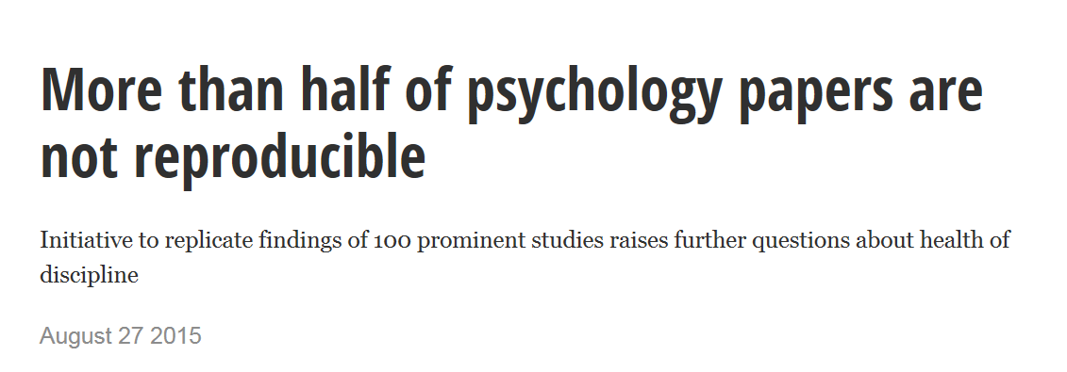

Slide 17
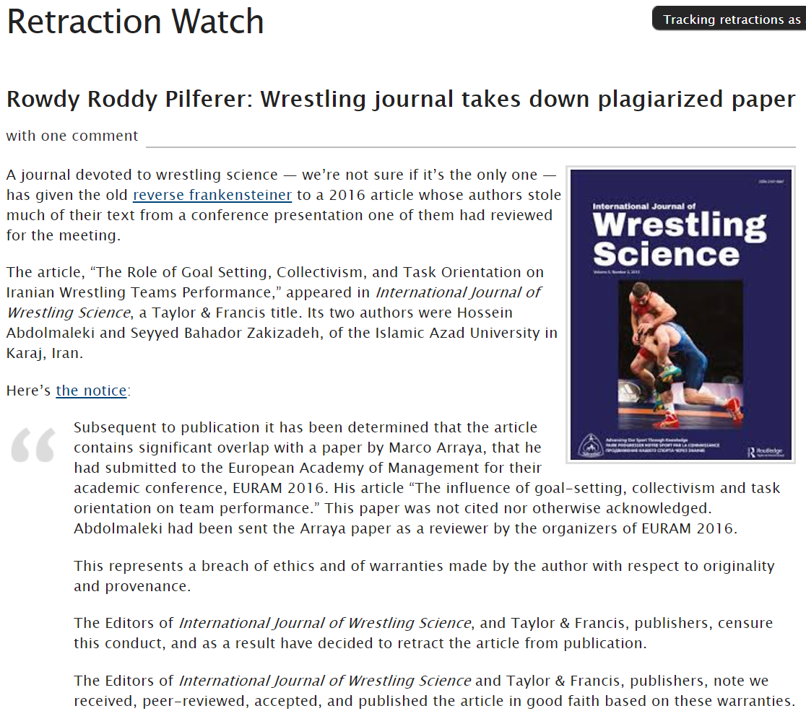

Slide 18
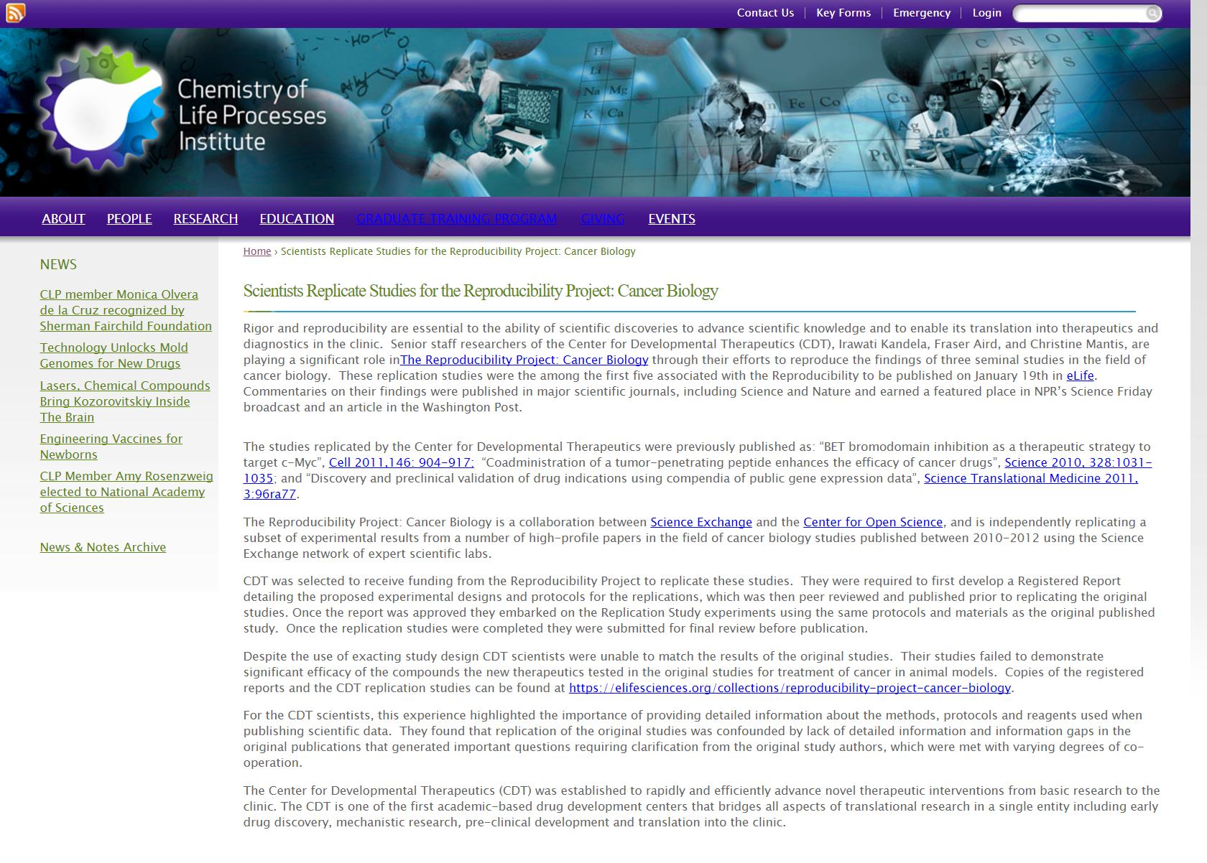
Notes:
Northwestern study- They tried to replicate the results of several high profile papers. They could not replicate the original studies.
This experience highlighted the importance of providing detailed information about the methods, protocols and reagents used when publishing scientific data. They found that replication of the original studies was confounded by lack of detailed information and information gaps in the original publications that generated important questions requiring clarification from the original study authors, which were met with varying degrees of co-operation.

Slide 19
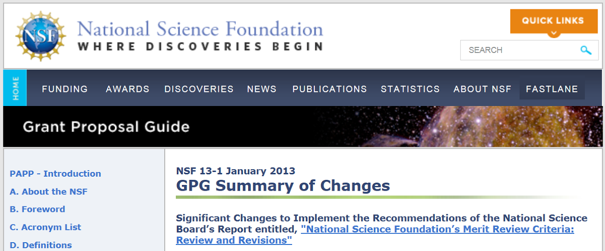
Recognition
Chapter II.C.2.f(i)(c), Biographical Sketch(es), has been revised to rename the “Publications” section to “Products” and amend terminology and instructions accordingly. This change makes clear that products may include, but are not limited to, publications, data sets, software, patents, and copyrights.
Notes:
Data sharing should allow for the owner of the data set to be cited, which can lead to greater recognition. In January 2013, the NSF amended its biographical sketch requirements to include data sets and other types of products.

Slide 20
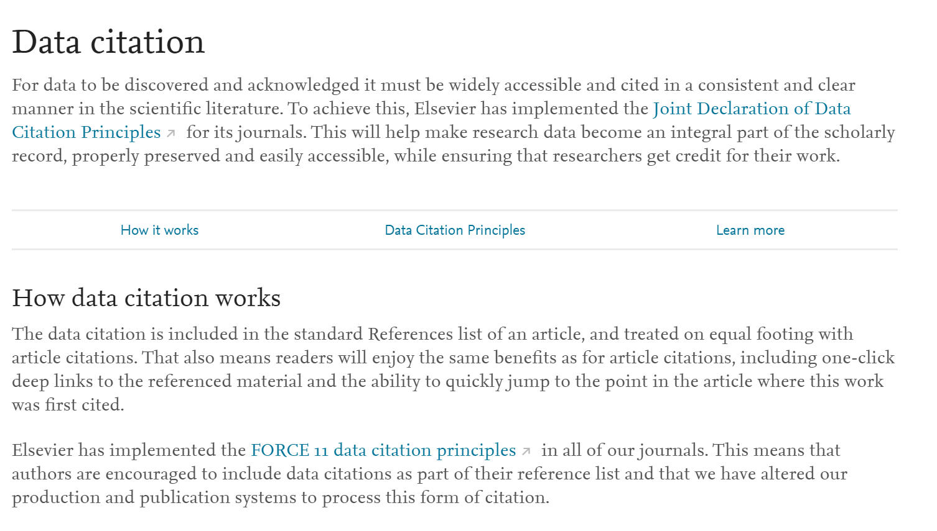
https://www.elsevier.com/about/open-science/research-data/data-citation
Notes:
Joint declaration of data citation principles. Adopted by many journal publishers. Allows that data citations will be treated the same as article citations

Slide 21
Benefits of managing and sharing your data
Saves you time and maybe money.
Increases the impact of your research through data citation.
Clearly documents and provides evidence for your research in conjunction with published results.
Meet copyright and ethical compliance (i.e. HIPAA).
Preserves data for long-term access and prevents loss of data.
Describes and shares data with others to further new discoveries and research.
Funder and Journal data sharing mandates
Adapted From: University of Minnesota Libraries Data Management web page: https://www.lib.umn.edu/datamanagement
Notes:
Data data everywhere! How will you collect, organize, back up, and store the data you will be generating with your research.
Effective data management has the potential to increase the pace of scientific discovery and promote more efficient and effective use of government funding and resources. Data management planning should be an integral part of research planning.
Sharing and preserving data are central to protecting the integrity of science by facilitating validation of results and to advancing science by broadening the value of research data to disciplines other than the originating one and to society at large. To the greatest extent and with the fewest constraints possible, and consistent with the requirements and other principles of this Statement, data sharing should make digital research data available to and useful for the scientific community, industry, and the public.
Not all data need to be shared or preserved. The costs and benefits of doing so should be considered in data management planning.
http://science.energy.gov/funding-opportunities/digital-data-management
US Agencies requiring data management plans for grants:
- DOE
- National Institutes of Health
- National Science Foundation
Etc.
http://www.library.cmu.edu/datapub/dms/planning/who
carrot/stick; Carrot “Benefits” stick: Won’t get funding from top agencies such as DOE, NSF, NIH.
Security: Keep your data safe and secure, no more concerns about overloaded servers or lost data
Citations: if your data can be found, it can be cited
Collaboration: Open u new collaborative opportunities by sharing your data
Find new data: Access other researchers’ data: save time by avoiding replicating existing results; build on top of pre-existing research
Contribute to new research: Contribute to further discoveries: When other researchers access your data for new purposes.
https://research.unsw.edu.au/benefits-good-data-management
Validation of results: Reproducibility, May 25th, 2016 Nature did an editorial regarding the concern about the problem of irreproducible research. Nature 533, 437 (26 May 2016) doi:10.1038/533437a
just a few other reasons to manage and share your data.

Slide 22
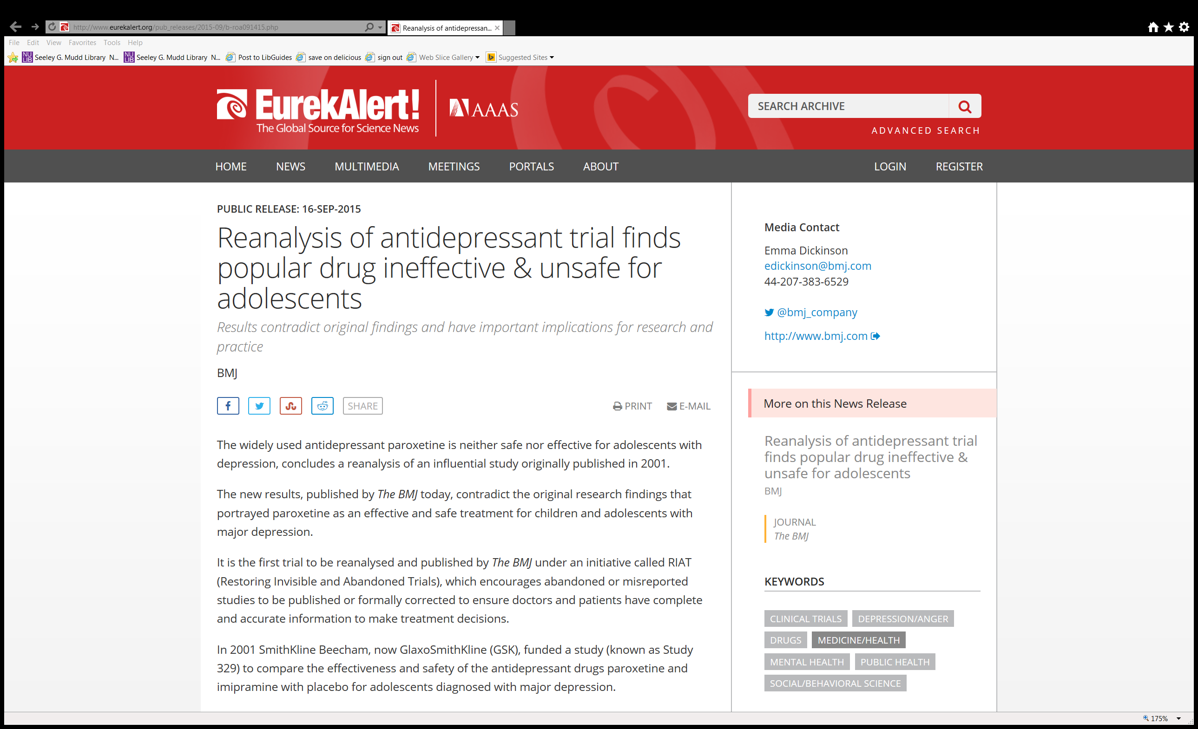
Data reuse success story # 1
Notes:
British journal of medicine.

Slide 23
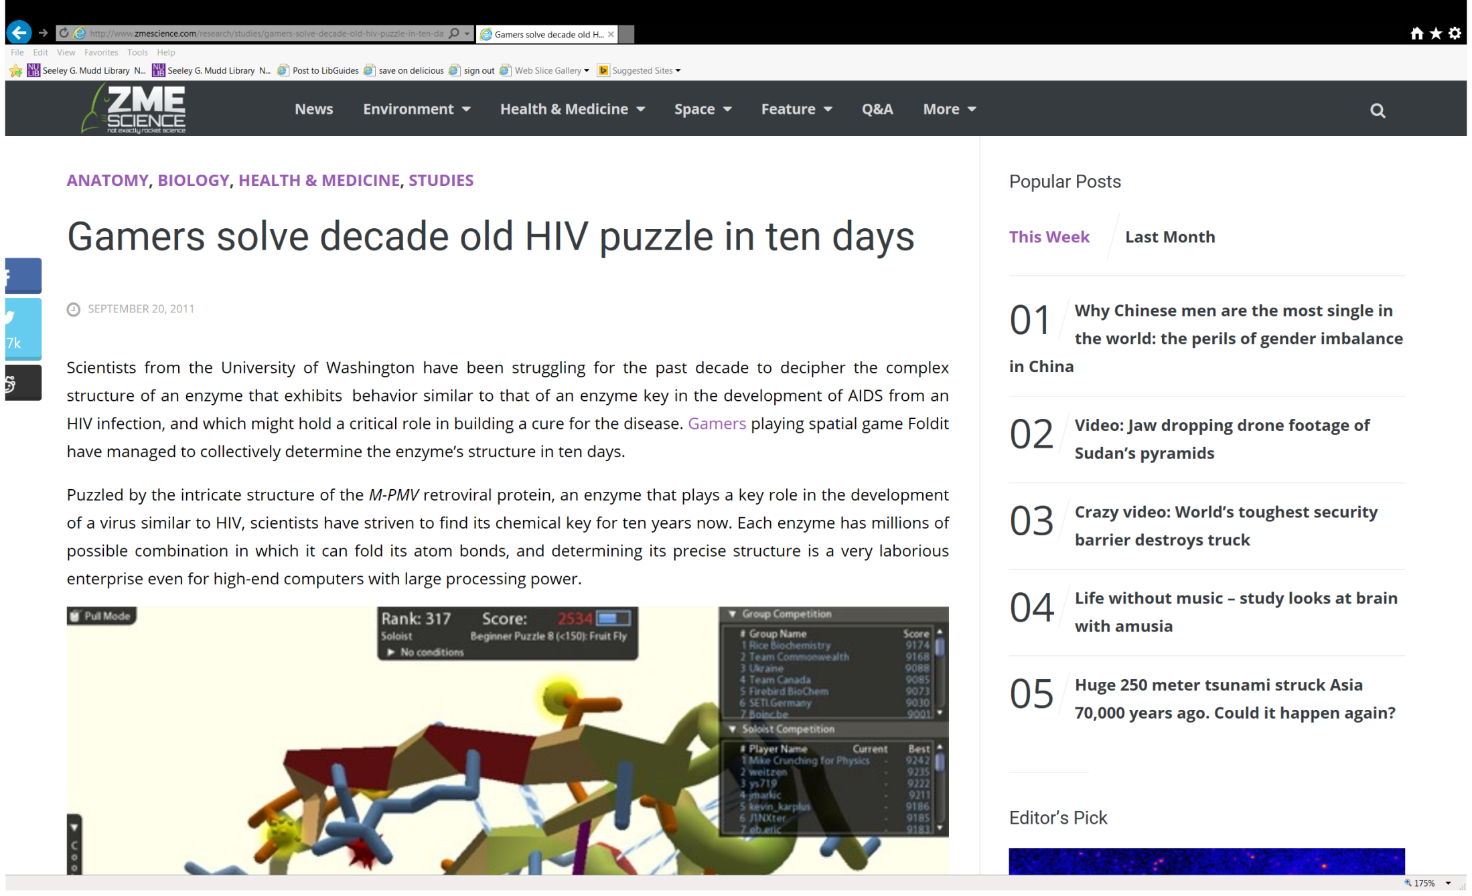
Data reuse success story # 2
Notes:
Foldit is a very simple game, which tackles biology’s biggest issue – folding proteins. To play the game you don’t need any biology background, just your native spatial reasoning skills. Motivation comes in the form of competition, and from this stand point, the game has been more than suitably designed. Basically you get scored for three factors: how well you pack the protein, how efficiently you hide the hydrophobics and how you clear the clashes. Trust me, it’s a lot simpler than it sounds.

Slide 24
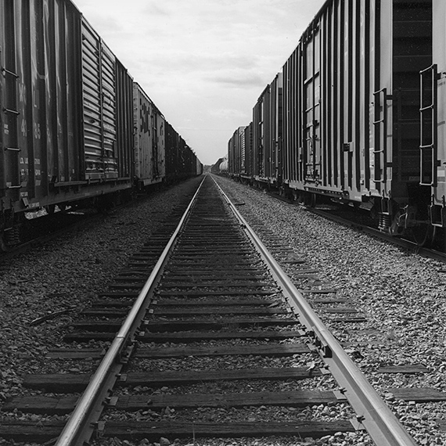
Background on data management
Why data management is important
Intro to best practices for data management
Library resources for data management.
Photo by Carl Vogtmann

Slide 25
Data Management
Managing data effectively across the data lifecycle is critical for the success of a research project
  Make a data management plan
Data management refers to all aspects of creating, housing, delivering, maintaining, and archiving and preserving data
It is one of the essential areas of responsible conduct of research
All subject areas (humanities, social science, and hard sciences) engage with data in many formats.
Absence of data documentation and management will limit the potential use of that data.
•.
Notes:
Where should a researcher begin? With good data management. Good data management is the basis of successful research.

Slide 26
The Data Life Cycle
Assure
Preserve
Discover
Integrate
Analyze
Plan
Describe
Collect
Notes:
There are many representations of the data life cycle. Just google it.
The DMP occurs at the start of the cycle, when researchers are applying for a grant. However, the information in the plan directly relates to the data life cycle as a whole.
Data management planning is the starting point in the data life cycle. However the plan should be revisited often throughout the project to ensure proper data documentation and management.
The Data Life Cycle: An Overview
The data life cycle has eight components:
Plan: description of the data that will be compiled, and how the data will be managed and made accessible throughout its lifetime
Collect: observations are made either by hand or with sensors or other instruments and the
data are placed a into digital form
Assure: the quality of the data are assured through checks and inspections
Describe: data are accurately and thoroughly described using the appropriate metadata standards
Preserve: data are submitted to an appropriate long-term archive (i.e. data center)
Discover: potentially useful data are located and obtained, along with the relevant information about the data (metadata)
Integrate: data from disparate sources are combined to form one homogeneous set of data that can be readily analyzed
Analyze: data are analyzed

Slide 27
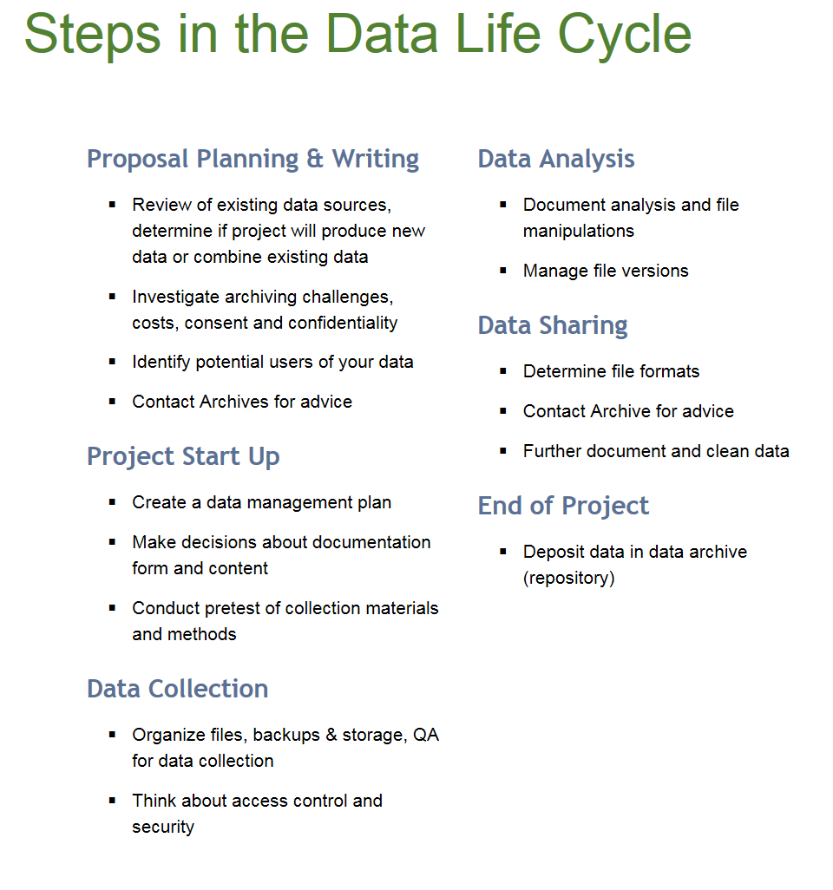
http://data.library.virginia.edu/data-management/lifecycle/

Slide 28
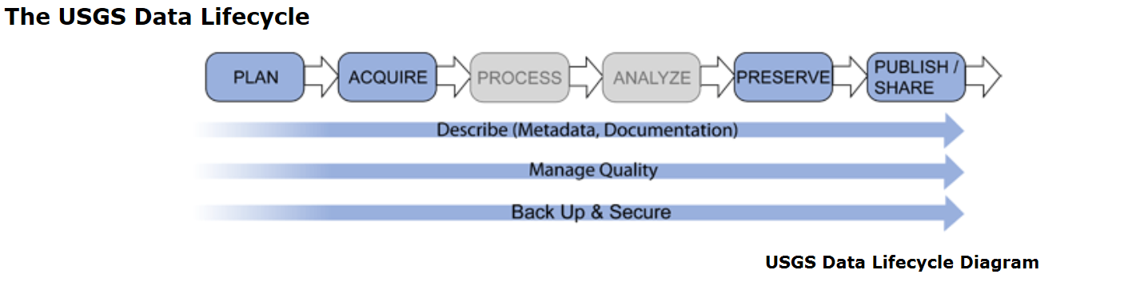

Slide 29
Aspects of Research Data Management
DMPs/Planning
File organization & naming
Documentation & metadata
Storage & backup
Legal/ethical considerations
Sharing & reuse
Preservation & Archiving
Notes:
Applies to all disciplines, but applications of these may be subject specific. Eg metadata
Some of these should be done throughout the data life cycle. (eg top 4)

Slide 30
Start with a plan…
Notes:
The place to start is with a data management plan.

Slide 31

Points to address in your Data Management Plan (DMP)
Types of data to be produced.
Standards or descriptions that would be used with the data (metadata).
How these data will be accessed and shared.
Policies and provisions for data sharing and reuse.
Provisions for archiving and preservation.
https://flickr.com/photos/inl/5097547405 (CC BY 2.0)
Notes:
There are typically 5 areas to be addressed in DMP.
Types of data to be produced.
Standards or descriptions that would be used with the data (metadata).
How these data will be accessed and shared.
Policies and provisions for data sharing and reuse.
Provisions for archiving and preservation

Slide 32
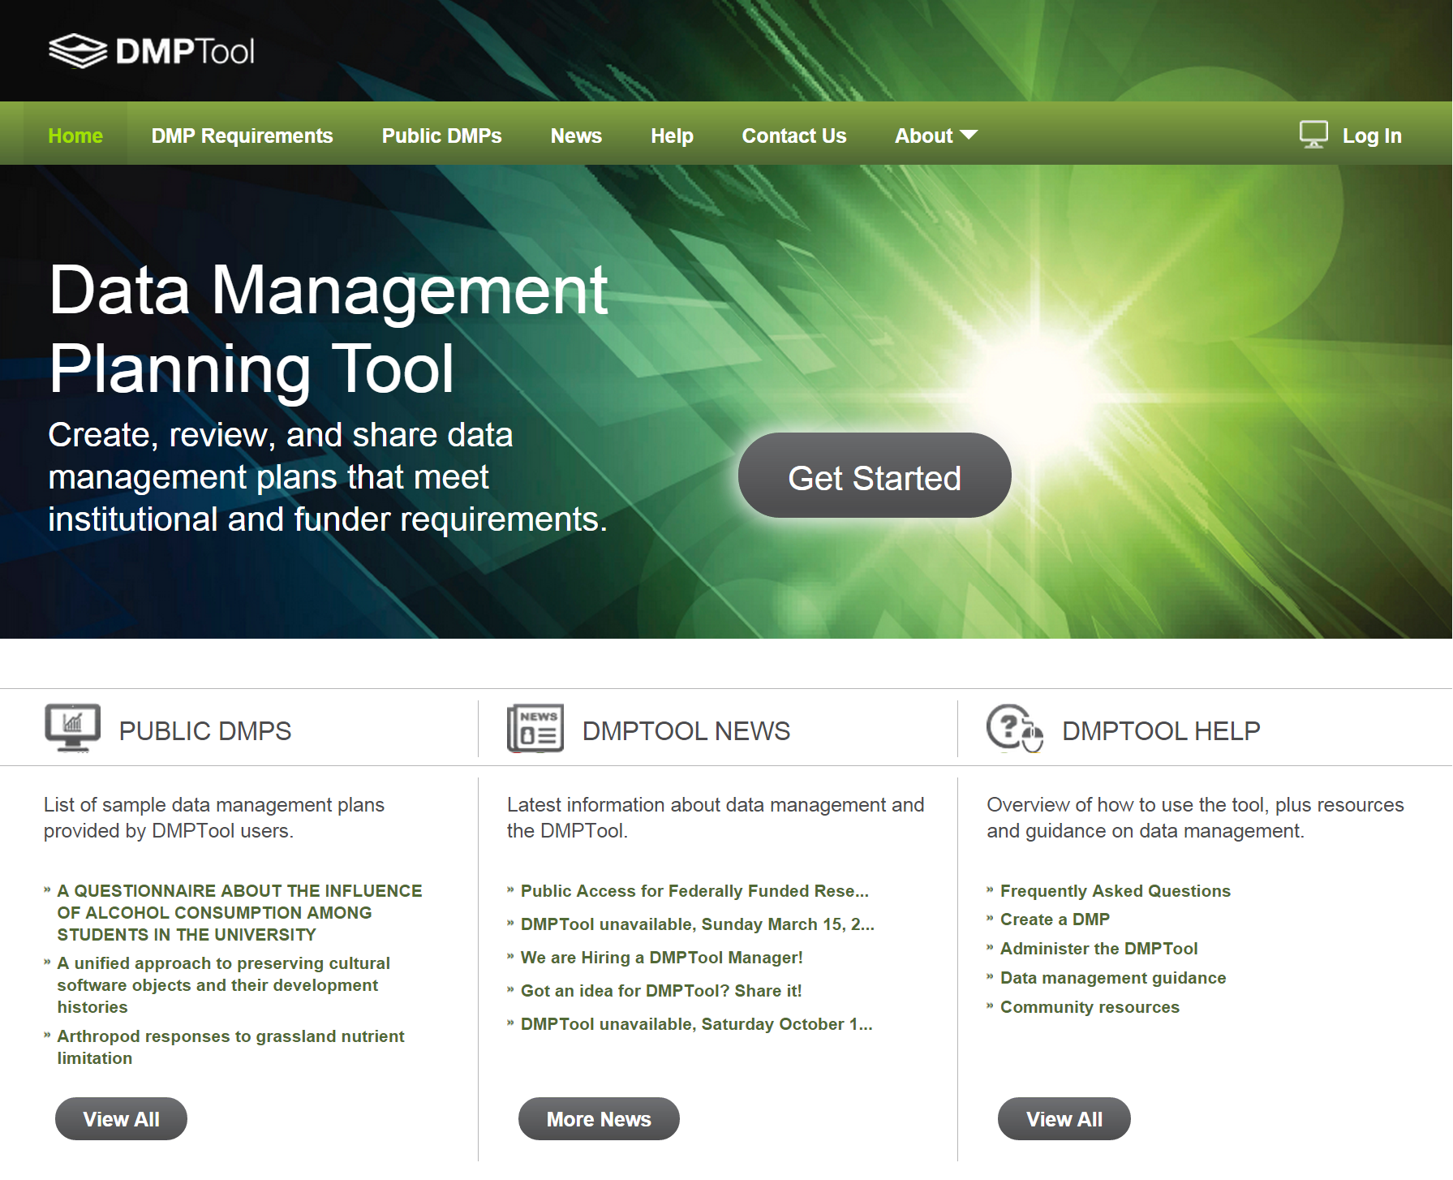

Slide 33
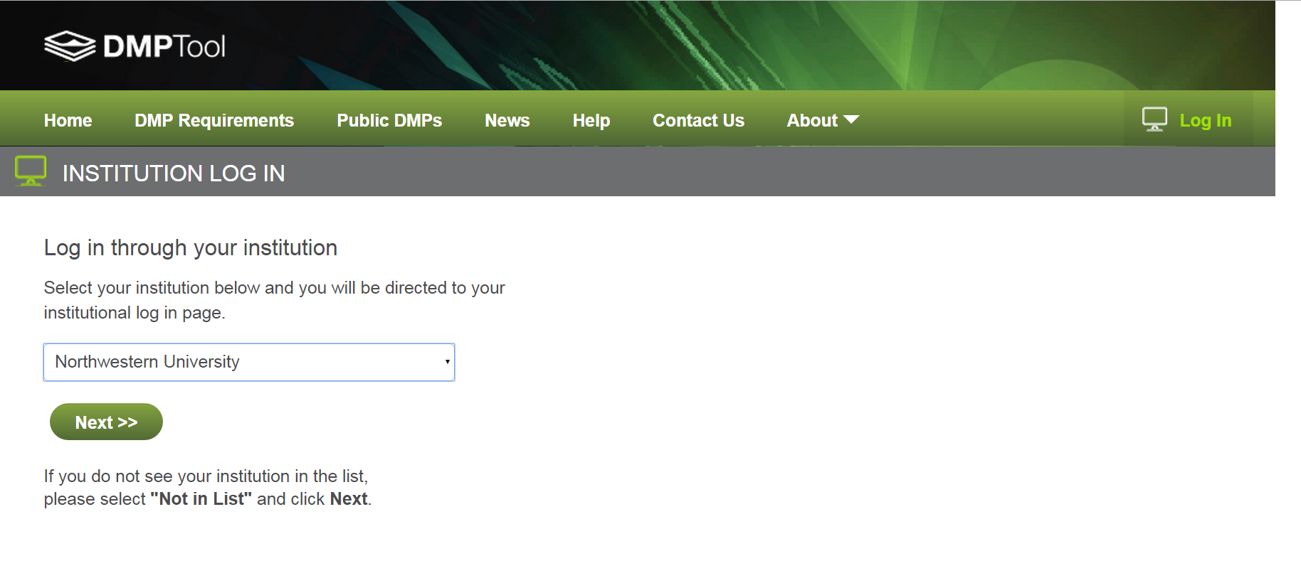

Slide 34
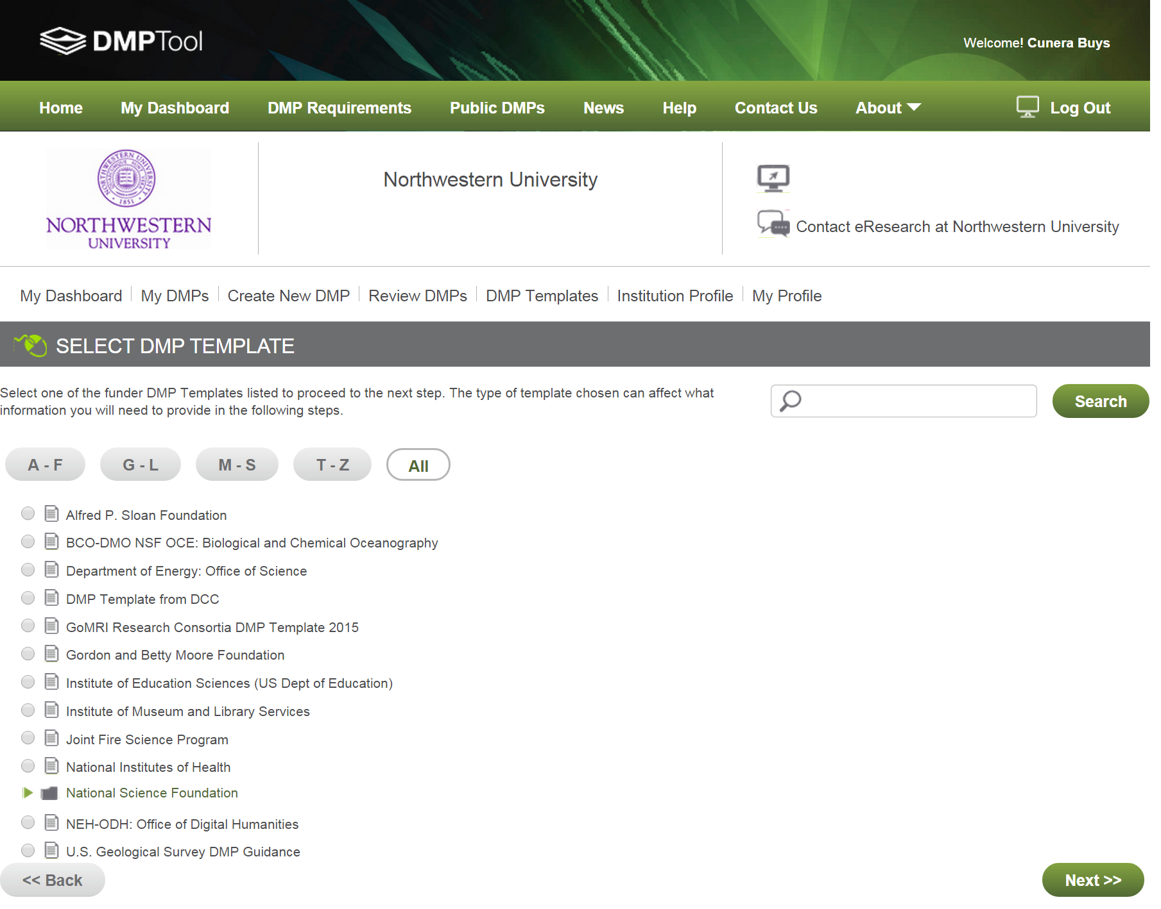

Slide 35
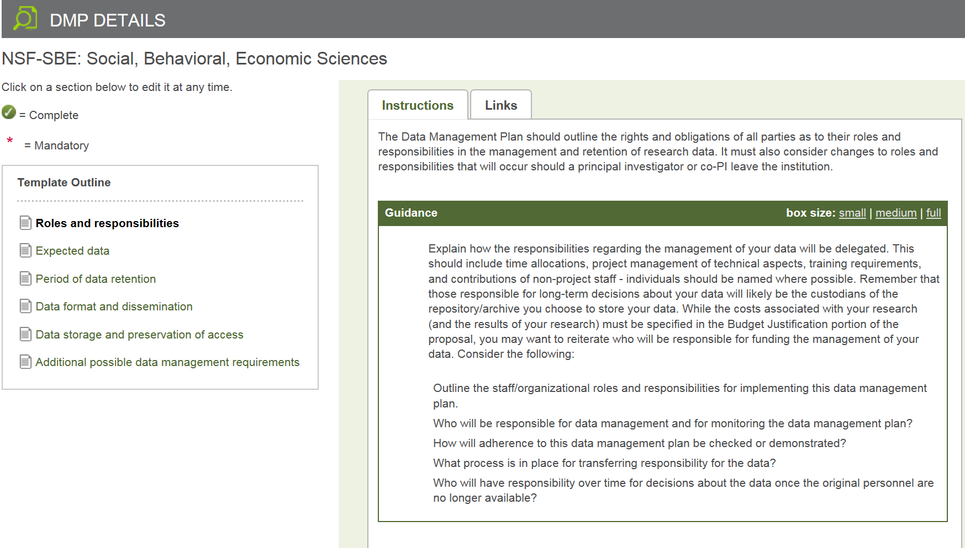

Slide 36
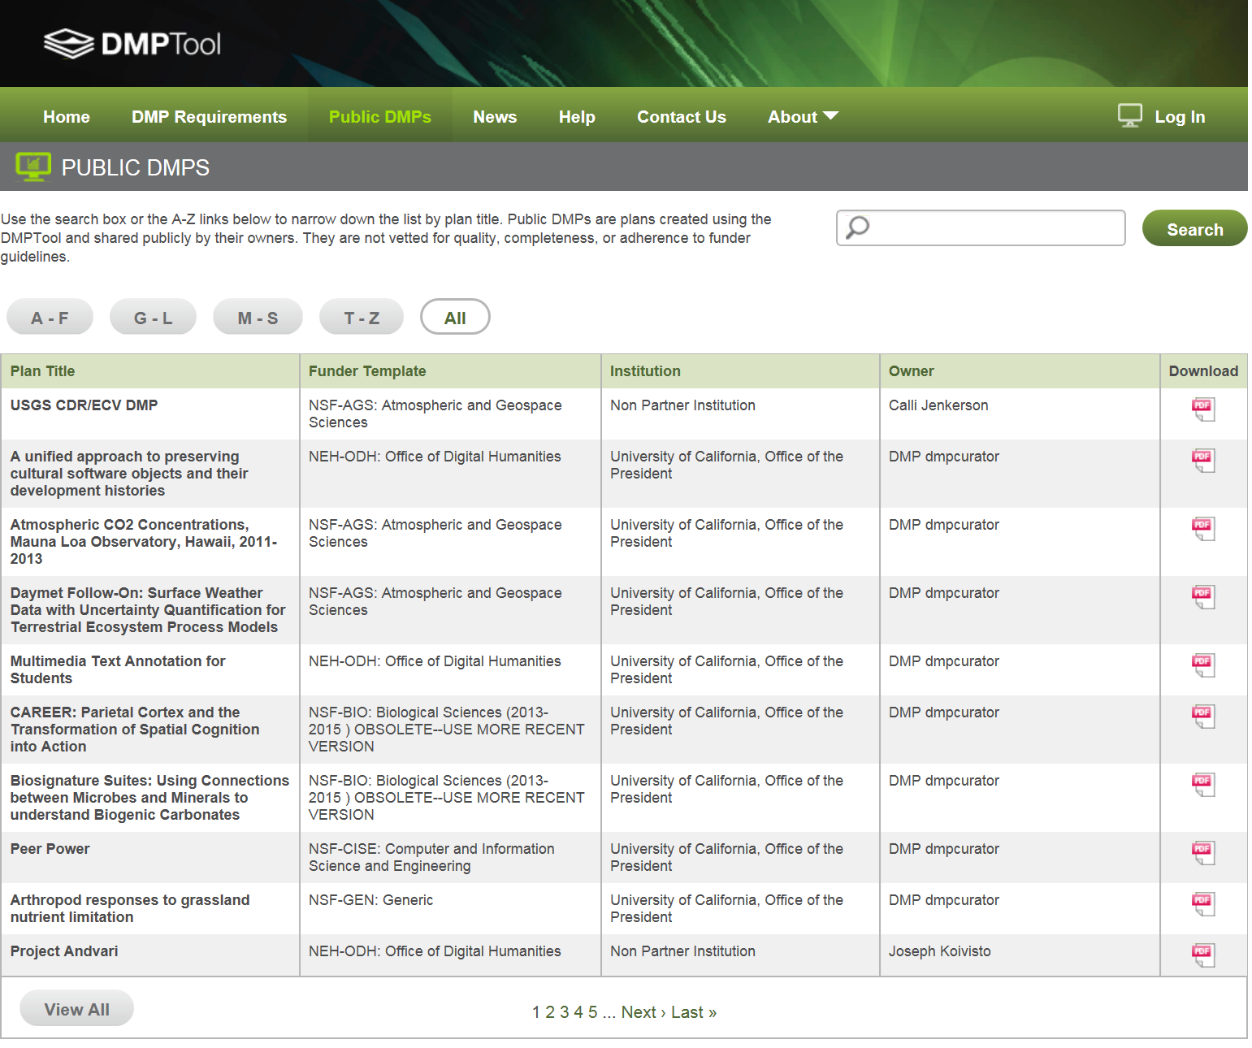
Notes:
Where can you find examples of DMPs? you can get examples from the DMPTool

Slide 37
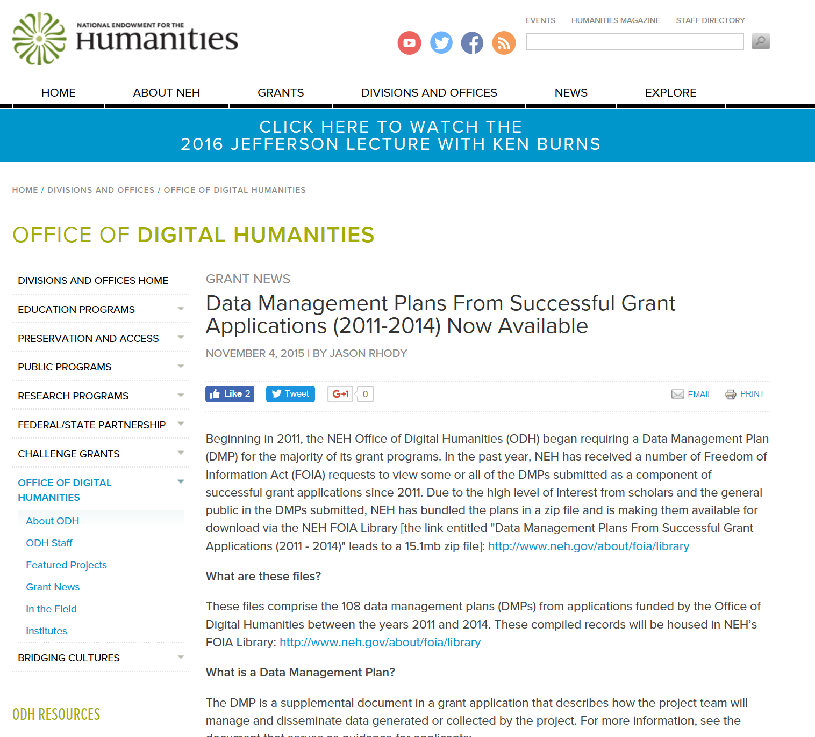
Notes:
the office of digital humanities also posts all DMPs from approved applications.

Slide 38
Aspects of Research Data Management
DMPs/Planning
File organization & naming
Documentation & metadata
Storage & backup
Legal/ethical considerations
Sharing & reuse
Preservation & Archiving
Notes:
Applies to all disciplines, but applications of these may be subject specific. Eg metadata
Some of these should be done throughout the data life cycle. (eg top 4)

Slide 39
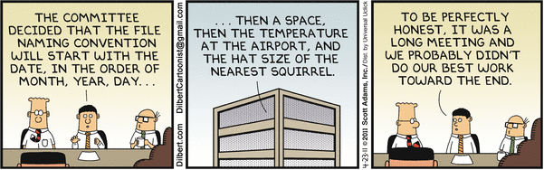
Thoughts on naming stuff and why you should care…
Find your files easier
Creates uniformity
Allows for sorting
Understand what is “under the hood”
Allows for versioning

Slide 40
Directories
Folders should be major functions/activities
Subfolders by year
Make folder names explanatory
Avoid personal names
Avoid duplication
Simple and simplistic
Source: http://bentley.umich.edu/dchome/resources/filenaming.php

Slide 41
Some good data practices
File organization and naming
Label and define the content of your data files in a systematic way
Use descriptive file names
  For example not- FIAGC (Fluffy is a great cat) but age, blood pressure etc.
Use consistent date formatting ( e.g. YYYYMMDD)
Keep file names short (no more than 25 characters)
Don’t use special characters
Use underscores instead of blank spaces
Keep track of versions
Don’t use confusing labels ( e.g. Pete’s data, final, final2, really final, really really final)
Notes:
This is the best date format to use. In the US we do month day year, but in Europe and other places they use day month year. Putting year frist will help avoid confusion.

Slide 42
Aspects of Research Data Management
DMPs/Planning
File organization & naming
Documentation & metadata
Storage & backup
Legal/ethical considerations
Sharing & reuse
Preservation & Archiving
Notes:
Applies to all disciplines, but applications of these may be subject specific. Eg metadata
Some of these should be done throughout the data life cycle. (eg top 4)

Slide 43
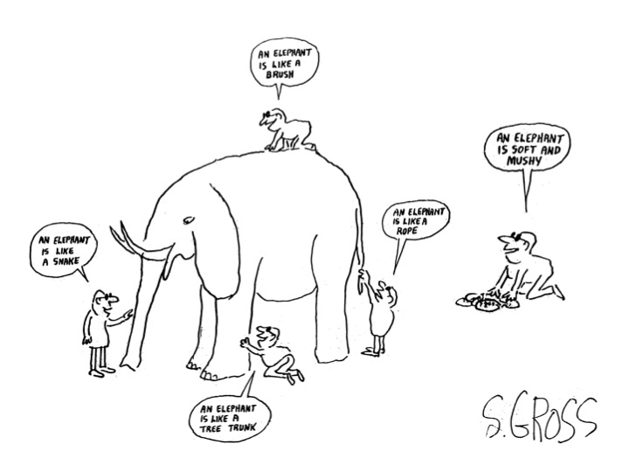
Data Description
https://www.flickr.com/photos/climateinteractive/13944682478/ (CC BY-NC-SA 2.0)
Notes:
how you describe your data is important. Good descriptions makes it easier for you and others to use the data

Slide 44
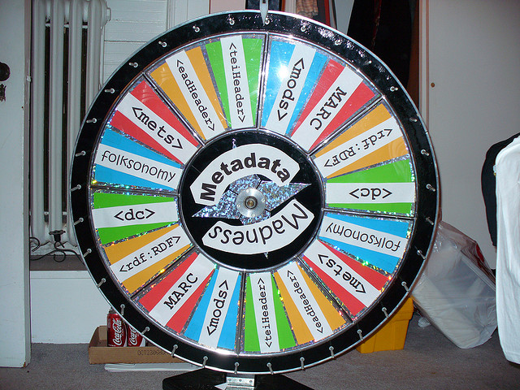
Description and Documentation (Metadata)
Commonly defined as “data about data”
It is information that describes the data
It gives you the ability to explain to your research to somebody that knows nothing about it
Provides information about one or more aspects of the data, such as:
  Means of creation of the data
  Purpose of the data
  Time and date of creation
  Creator or author of the data
  Location on a computer network where the data
  were created
  Standards used
https://www.flickr.com/photos/musebrarian/3289649684/ (CC BY-NC-SA 2.0)
Notes:
Essentially a controlled vocabulary to make data more discoverable even for the researcher

Slide 45
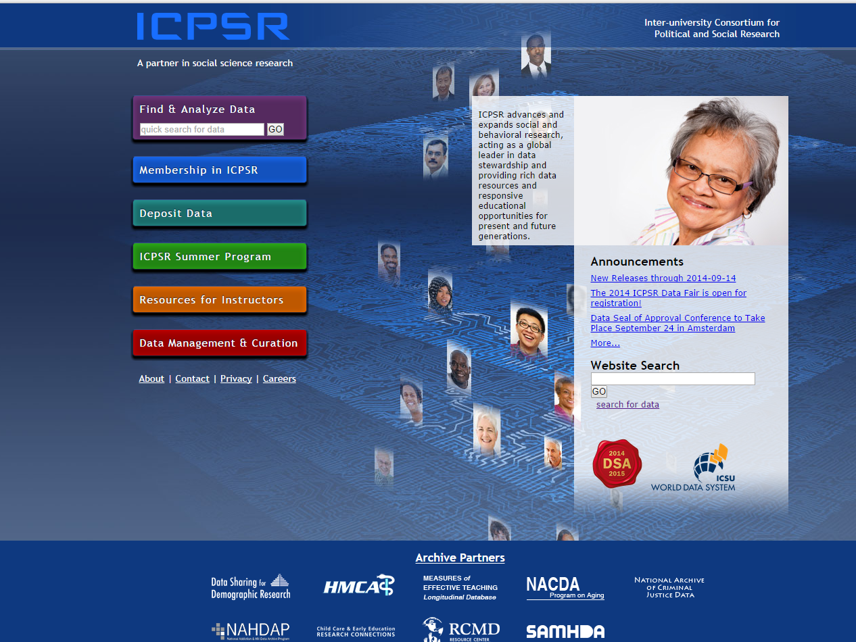
Metadata according to ICPSR…
A number of elements should be included in metadata, including, but not limited to:
Principal investigator
Funding sources
Data collector/producer
Project description
Sample and sampling procedures
Weighting
Substantive, temporal, and geographic coverage of the data collection
Data source(s)
Unit(s) of analysis/observation
Variables
Technical information on files
Data collection instruments
Notes:
Inter-university Consortium for Political and Social Research
ICPSR maintains a data archive of more than 250,000 files of research in the social sciences. It hosts 16 specialized collections of data in education, aging, criminal justice, substance abuse, terrorism, and other fields.

Slide 46
Aspects of Research Data Management
DMPs/Planning
File organization & naming
Documentation & metadata
Storage & backup
Legal/ethical considerations
Sharing & reuse
Preservation & Archiving
Notes:
Applies to all disciplines, but applications of these may be subject specific. Eg metadata
Some of these should be done throughout the data life cycle. (eg top 4)

Slide 47


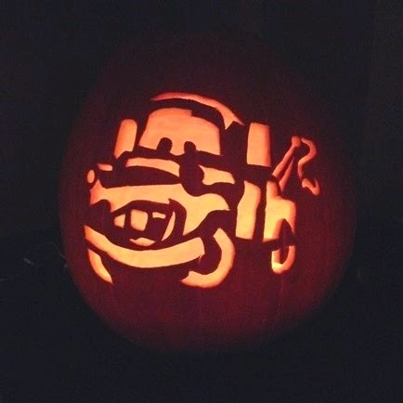

Data nightmares

Slide 48
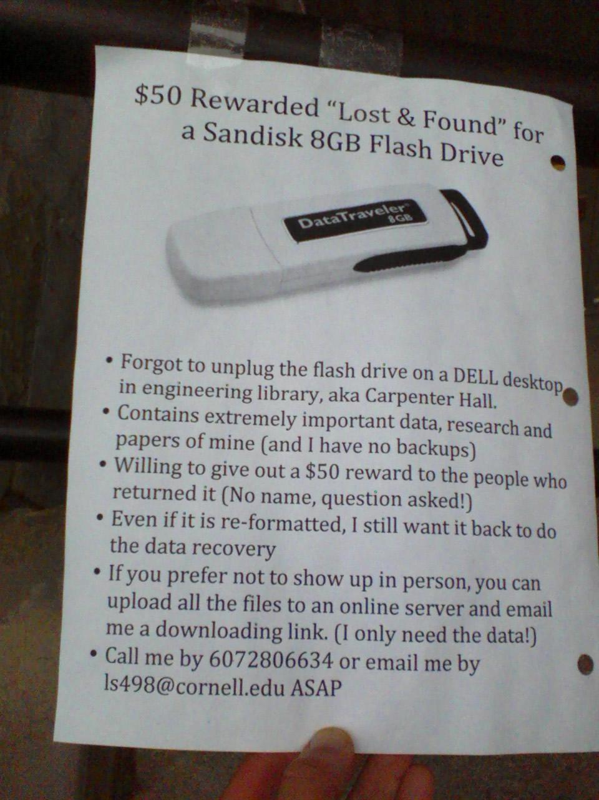
Data nightmares
Tweeted in 2012 by Gail Steinhart, Head of Research Services, Mann Library, Cornell University

Slide 49
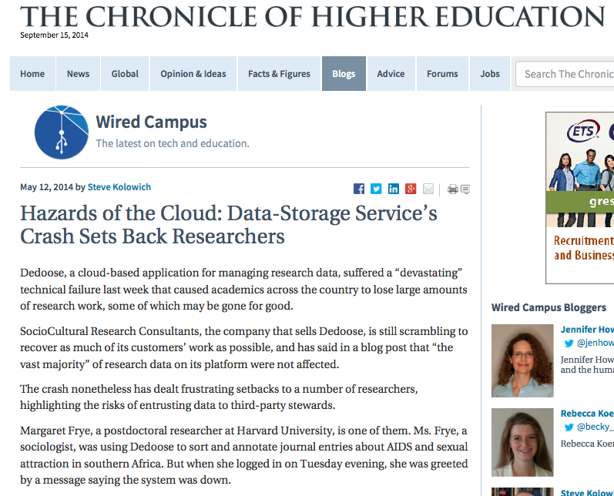
Data nightmares

Slide 50
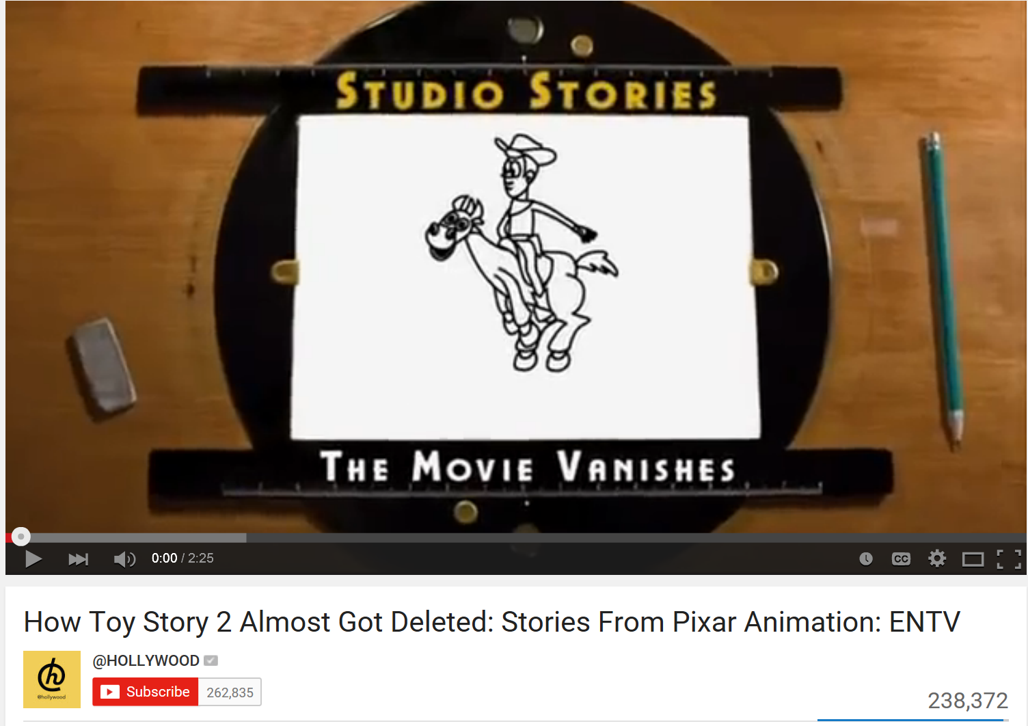
Toy Story 2
How Toy Story 2 Almost Got Deleted: Stories From Pixar Animation: ENTV
https://www.youtube.com/watch?v=8dhp_20j0Ys

Slide 51
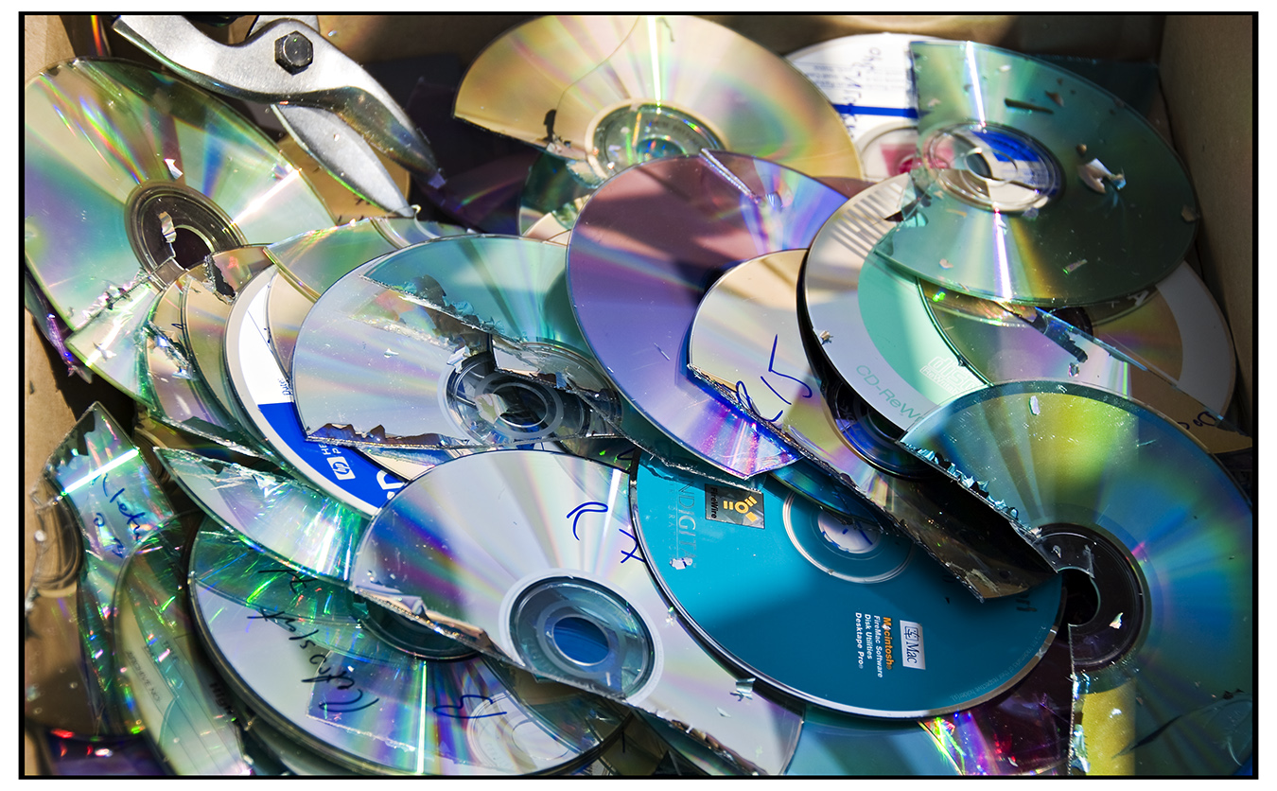

Storage, back up and securing data
Have at least 3 copies of your data- 2 local and 1 distant if possible
Don’t use your personal computer, data sticks or CDs if you can avoid it
  They break, get lost, lose data over time
Use a hard drive if you can
Use cloud storage if you can (but be aware of sensitive data)
flickr.com/photos/s_w_ellis/3877534599 (CC By 2.0)
Notes:
Hopefully by now you understand that data backups and storage are very important . These are a few best practices.
Opportunities may vary depending on the researchers situation

Slide 52
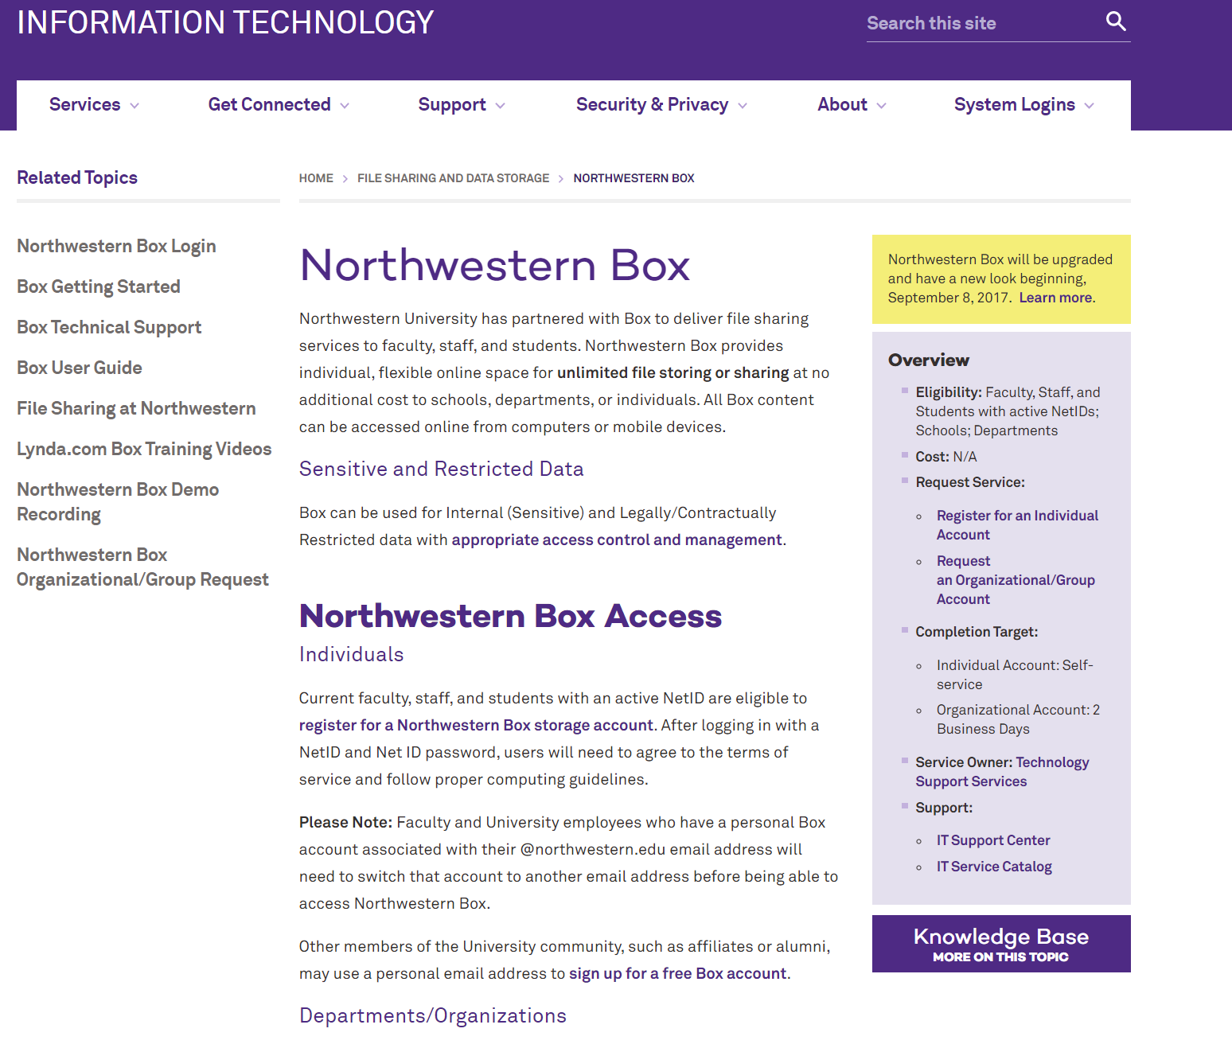
http://www.it.northwestern.edu/file-sharing/box.html

Slide 53
Aspects of Research Data Management
DMPs/Planning
File organization & naming
Documentation & metadata
Storage & backup
Legal/ethical considerations
Sharing & reuse
Preservation & Archiving
Notes:
Applies to all disciplines, but applications of these may be subject specific. Eg metadata
Some of these should be done throughout the data life cycle. (eg top 4)

Slide 54

Legal Concerns
Intellectual property rights
Copyright- see the NU policy on copyright
http://invo.northwestern.edu/policies/copyright-policy
Patents
Trade secrets
Licensing
Creative Commons
Monetary charges for data usage
Open source versus proprietary software
Data retention

Slide 55
Aspects of Research Data Management
DMPs/Planning
File organization & naming
Documentation & metadata
Storage & backup
Legal/ethical considerations
Sharing & reuse
Preservation & Archiving
Notes:
Applies to all disciplines, but applications of these may be subject specific. Eg metadata
Some of these should be done throughout the data life cycle. (eg top 4)

Slide 56
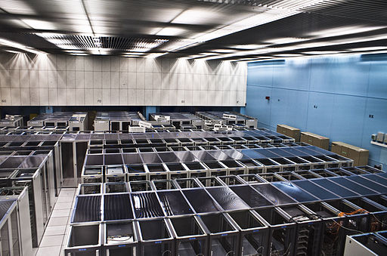
Preservation and Sharing data
Some options for preserving and sharing data
  Self-archive
  Institutional repository
  Open data repository
  National or international data archive or repository
By Florian Hirzinger - www.fh-ap.com (Own work (Florian Hirzinger)) [CC BY-SA 3.0 (http://creativecommons.org/licenses/by-sa/3.0) or GFDL (http://www.gnu.org/copyleft/fdl.html)], via Wikimedia Commons
Notes:
NU Libraries, currently don’t have a public facing IR. However, liaisons can help researchers find appropriate subject specific repositories and in some cases this will be the preferred solution, even if we have an IR.

Slide 57
We can help you
Create or advise on DMPs for granting agencies
Help with describing your data
Help with best practices in data management
Find an appropriate repository for your data
Deposit your data in a repository
Consultations
Workshops

Slide 58
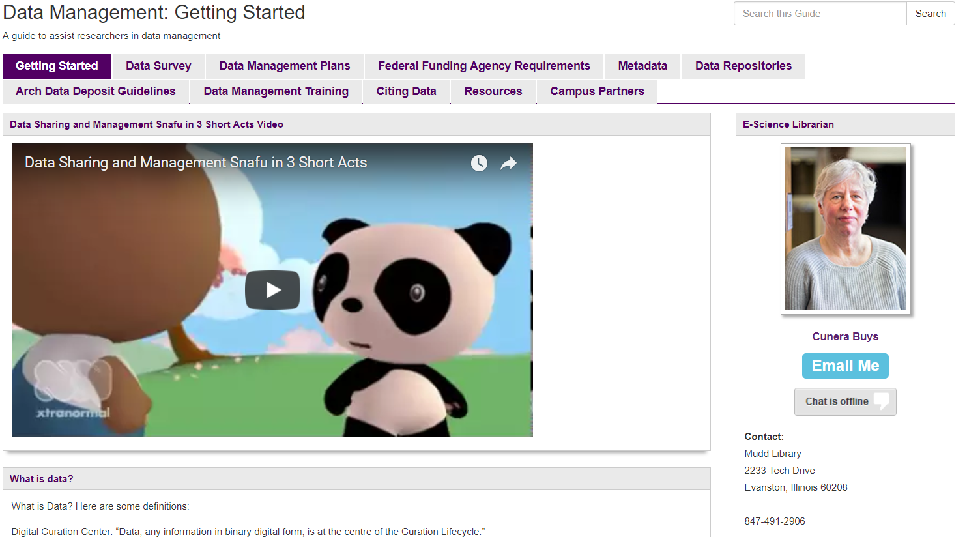
http://libguides.northwestern.edu/datamanagement

Slide 59
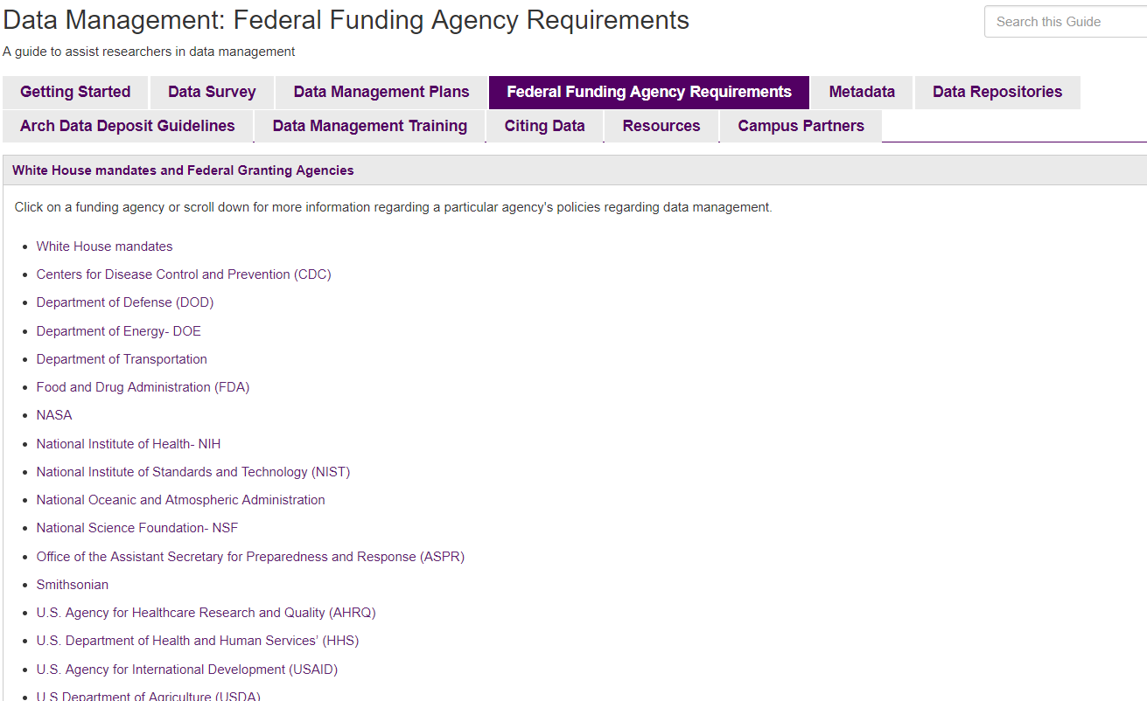

Slide 60
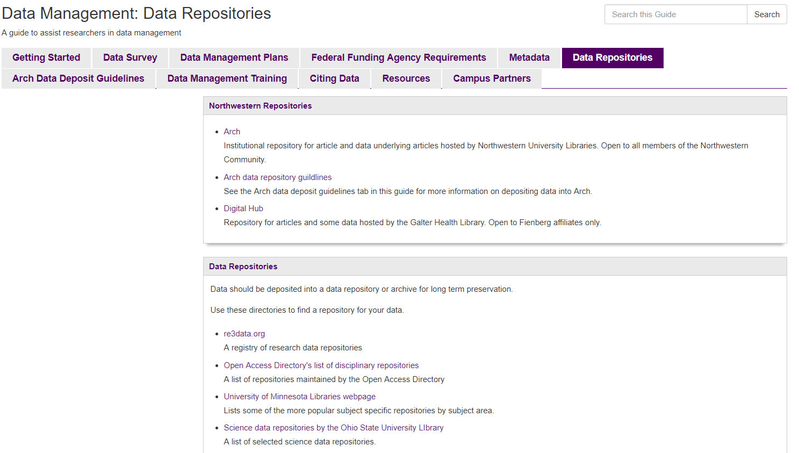

Slide 61

NORTHWESTERN UNIVERSITY LIBRARIES INSTITUTIONAL REPOSITORIES
Galter Health Sciences Library Repository:
https://digitalhub.northwestern.edu/
For Feinberg affiliates only
Accepts some data sets
Northwestern Libraries Repository: ARCH- Gateway to discovery
https://arch.library.northwestern.edu
Open to Northwestern faculty, staff, students, or researchers
Will accept data sets underlying publications
Notes:
Open to Northwestern faculty, staff, student, or researcher at Northwestern University, with a current Northwestern University NetID and password.
The content must be in digital form.
The content must be permanent. The NULR is an archive that preserves scholarly output, not a place to store works in process. If you require this kind of service, please visit http://box.northwestern.edu.
Scholarly publishers often allow researchers to upload either the pre-print (before submission to the journal) or the post-print (after submission and peer-review) versions of journal articles to institutional repositories
As part of deposit you must choose a license. NULR prefers but does not require that materials be made available with a Creative Commons license. We recommend CC BY for articles and CC0 for data sets.

Slide 62
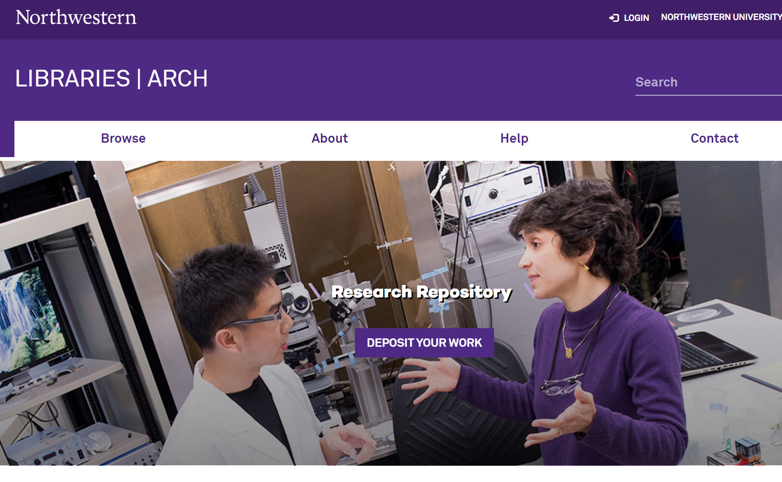

Slide 63
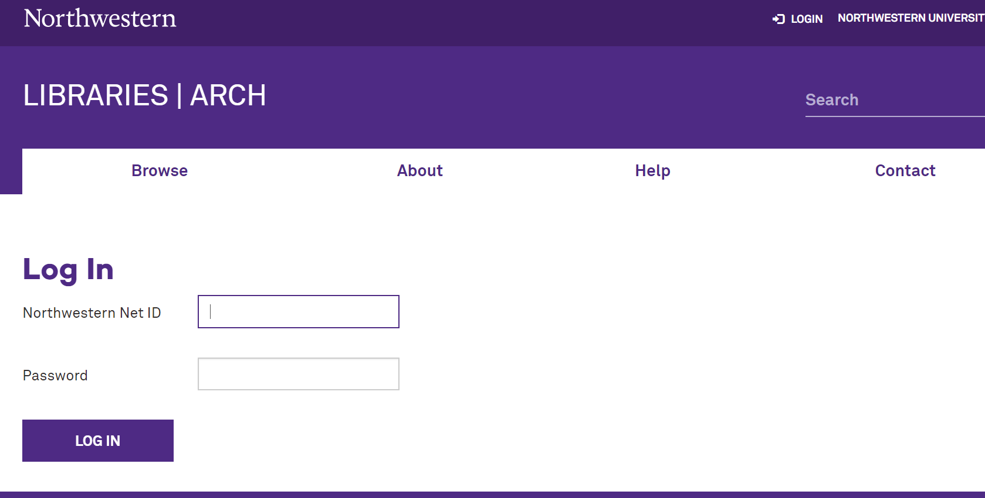

Slide 64
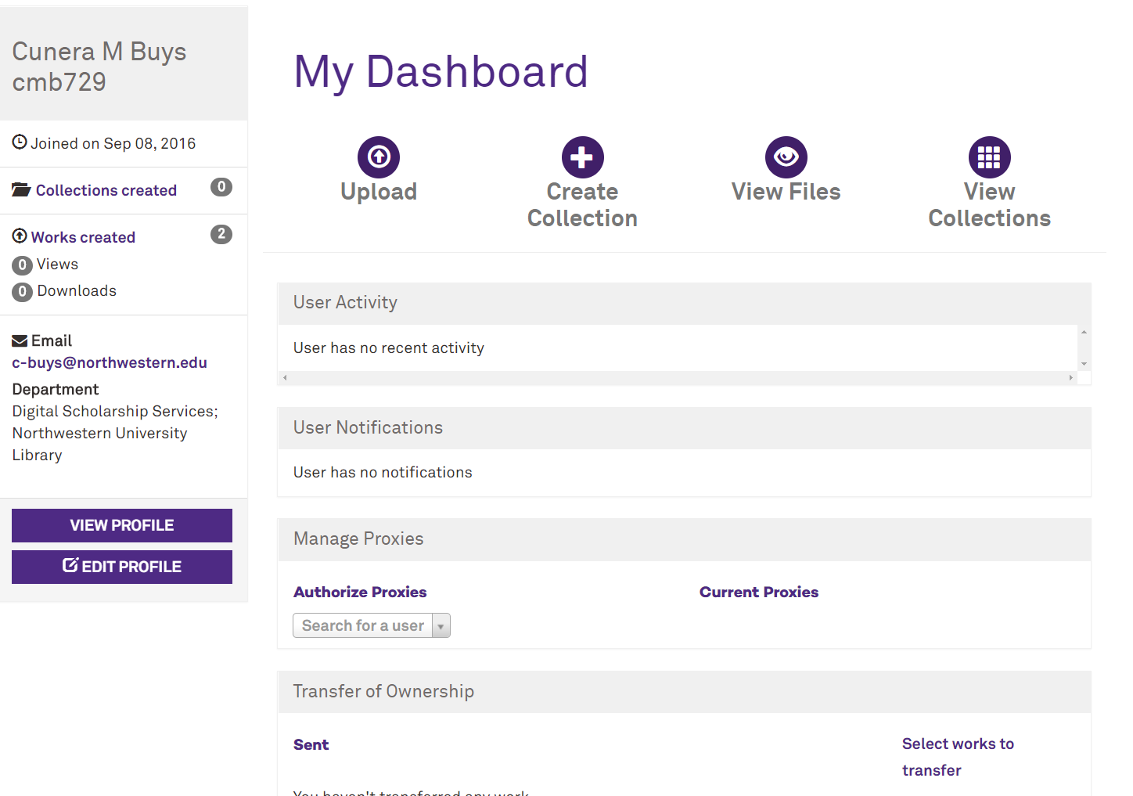

Slide 65
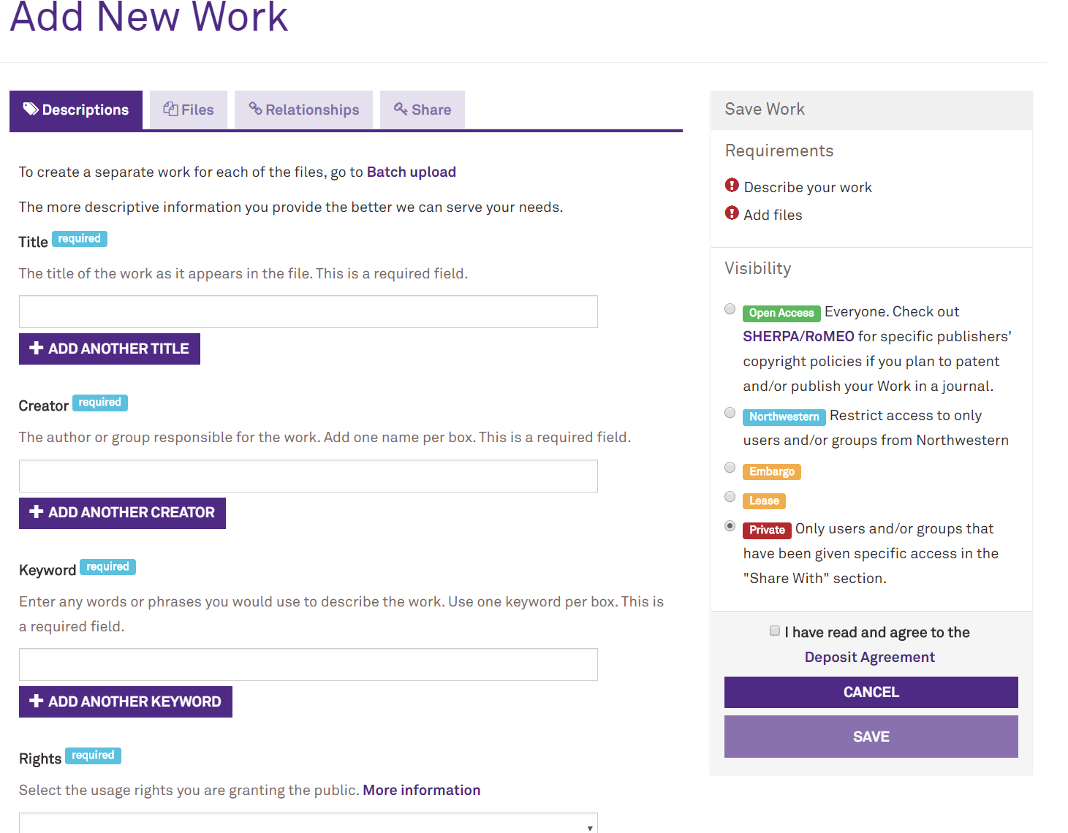

Slide 66
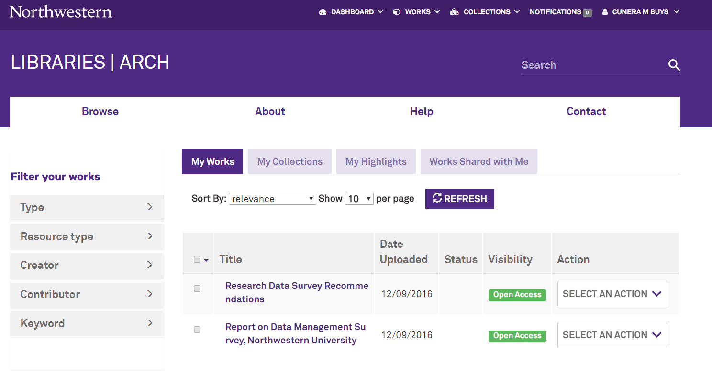

Slide 67
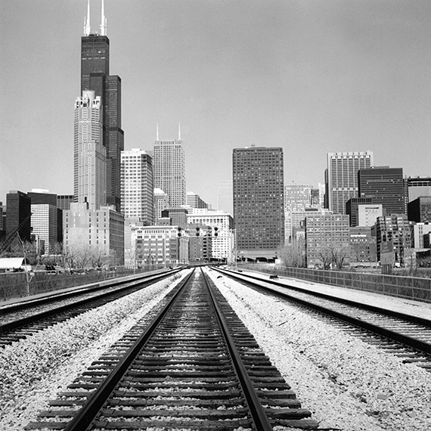
Background on data management
Why data management is important
Intro to best practices for data management
Library resources for data management.
Photo by Carl Vogtmann

Slide 68
Aspects of Research Data Management
DMPs/Planning
File organization & naming
Documentation & metadata
Storage & backup
Legal/ethical considerations
Sharing & reuse
Preservation & Archiving
Notes:
Show of hands- would more in-depth for each of these be useful to you.

Slide 69

Need Help?
Contact me:
Cunera Buys
c-buys@northwestern.edu
https://www.flickr.com/photos/49889874@N05/5645164344 (CC BY 2.0)

Slide 70

RESOURCES:
Northwestern University Library Data Management LibGuide: http://libguides.northwestern.edu/datamanagement
DMPTool: https://dmp.org/
Northwestern University's Research Data: Ownership, Retention and Access Policy: http://www.research.northwestern.edu/policies/documents/research_data.pdf
Cunera Buys- Data Management librarian: c-buys@northwestern.edu
Notes:
Will post to slideshare and DM training section of the DM libguide.

