Slide 1
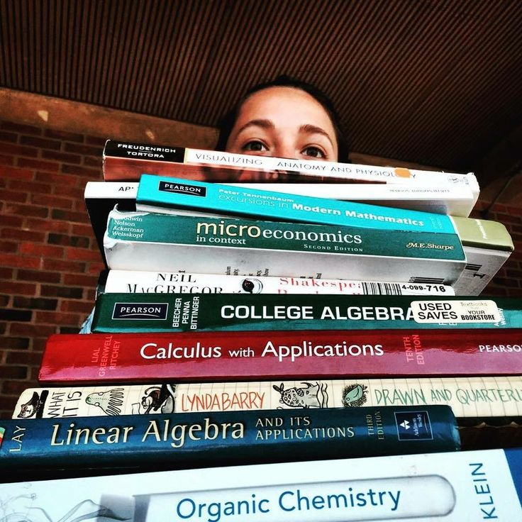
College Textbook costs Does socioeconomic status affect Student’s Behavior Regarding College Textbooks?
Javier Moreno

Slide 2
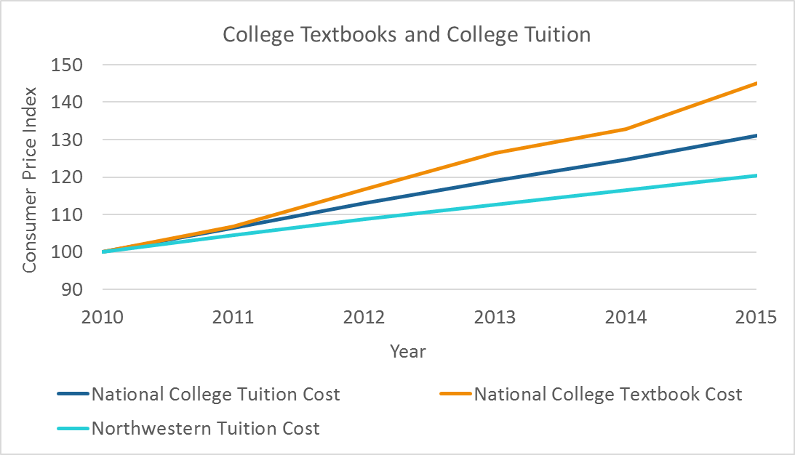
College Textbook Costs are increasing more than College Tuition Costs
Bureau of Labor Statistics
Notes:
I started by looking national data regarding college textbook costs and college tuition costs from 2011-2015 to see how they compared.
Northwestern Tuition has been a increasing at a lower rate than national tuition cost. Both have been relatively constant whereas, national textbook cost has been fluctuating and has been increasing at a greater rate than college tuition meaning it is a problem for many students.

Slide 3
Number of Student Responses Varied across Income Brackets
Most of the responses come from low-income students
Won’t include Prefer not to answer responses in the data
Required Textbooks, Used Textbooks, Free Textbooks, Old Edition Textbooks, Methods of Purchase
Household Income | Number of students
$0-$49,999 | 45
$50,000-149,000 | 24
$150,000+ | 13
Prefer not to answer | 3
Total | 85
Notes:
I designed a survey and sent it out to QuestBridge list server, a community for low income students, and to Professor Ogawa’s economics course and statistics course. I received 85 responses.

Slide 4
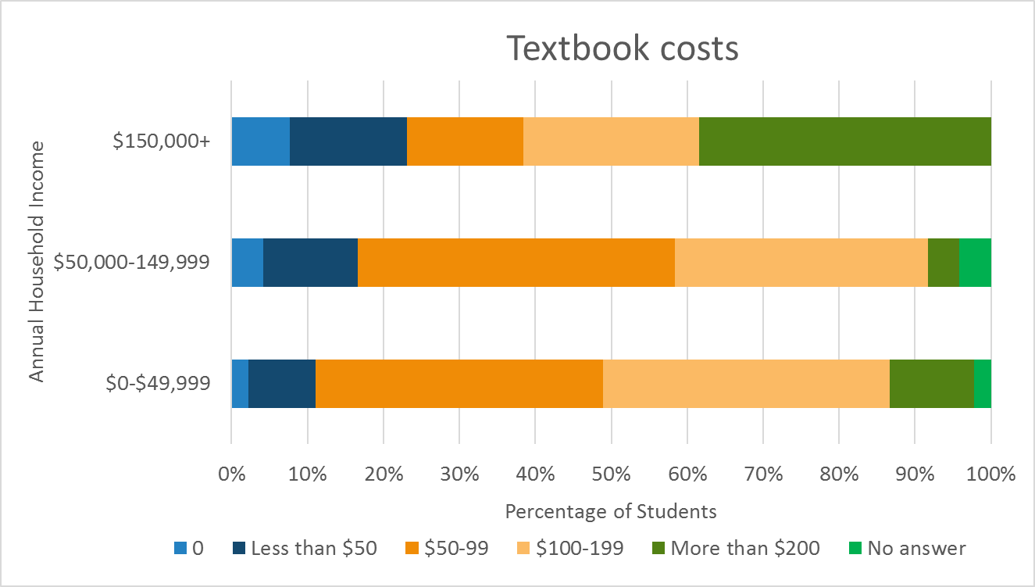
Higher Income Students Spend More on Textbooks
Notes:
I asked students how much they spent on textbooks per quarter and here are the results. We can see similar behavior amongst low income students and middle income students where there is a normal distribution centering around $50-99 and $100-199, whereas higher income students showed an upward trend where 38% of higher income students spent over $200

Slide 5
Free Resource available For many Classes
16 Most Popular Courses | Uborrow Availability
Chemistry 101-0 | Primary Text Available Only
Chemistry: 210-1 | 2 of 3 Available
Earth and Planetary Sciences: 101-0
Biological Sciences: 217-0 | No
Biological Sciences: 220-0
General Engineering: 205-1 | All Available
General Engineering: 205-4 | All Available
Elect Engineering & Comp Sci:111-0 | All Available
Economics: 201-0 | 2 of 4 Available
Psychology: 110-0 | 1 of 3 Available
Slavic Languages & Literature: 210-2 | All Available
Spanish: 121-1
Mathematics: 230-0 | 1 of 3 Available
Mathematics: 224-0 | 1 of 3 Available
Personal Development:396-0
General Liberal Arts: 354-0
Efforts from Northwestern currently to alleviate costs
UBorrow is a borrowing service between the Big Ten schools allowing students to have priority when requesting books from these universities
Notes:
Taking a closer look at Northwestern, we can see their current efforts to alleviate costs. This resource for free textbooks made me wonder if this was a common method of obtaining textbooks

Slide 6
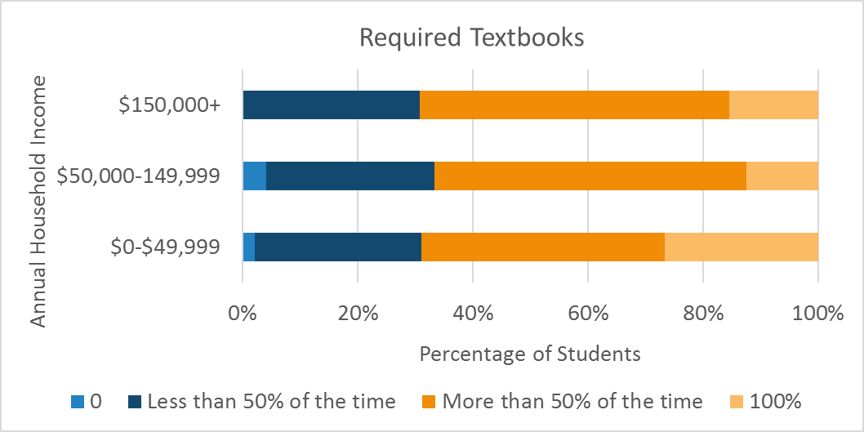
Most Students generally obtain required Textbooks
Notes:
When asked about how often they obtain required textbooks 0% less than 50% of the time more than 50% of the time or 100% of the time, low income students were more likely to obtain required textbooks100%, but there were no noticeable differences in general behavior regarding required textbooks as we can see that the peach side for each group is relatively the same meaning students typically obtained required textbooks.

Slide 7
No Negative Impact on Learning
The three students who reported obtaining required textbooks were asked a follow up question:
Did it negatively impact your learning in the classroom?
They reported that there was no negative impact on their learning experience
“Textbooks have never been a necessity for me”
“To learn material, I used other online resources”

Slide 8
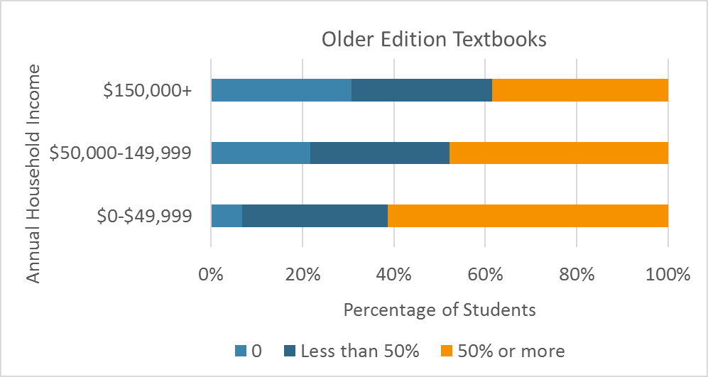
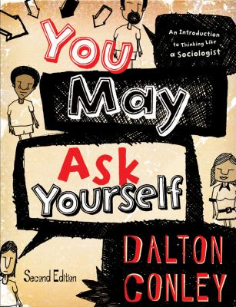
Higher Income Students are less likely to buy older edition textbooks
Students’ responses to Accommodation from Professors were Fairly split
Notes:
I also asked students how often they obtained the older edition of textbooks, and as we can see in the peach side which is 50% of the time or more, more than 60% of low income students reported obtaining older editions 50% of the time or more compared to 50% of middle income students and 41% of higher income students.

Slide 9
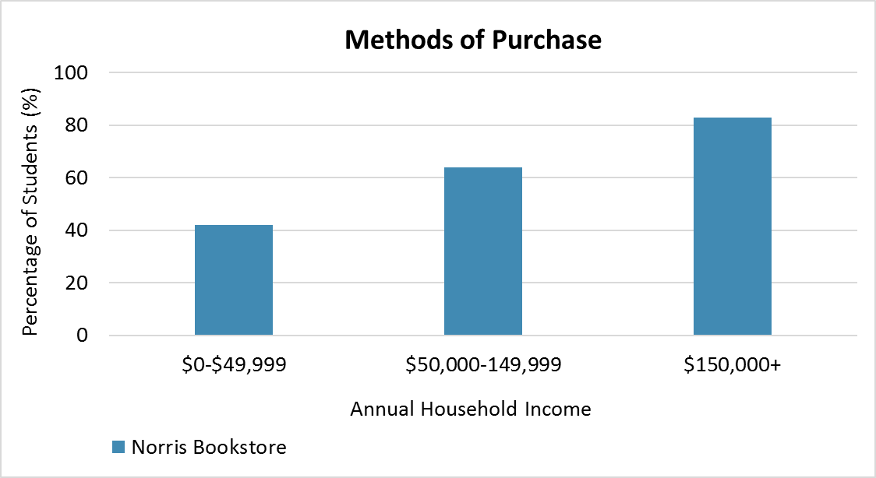
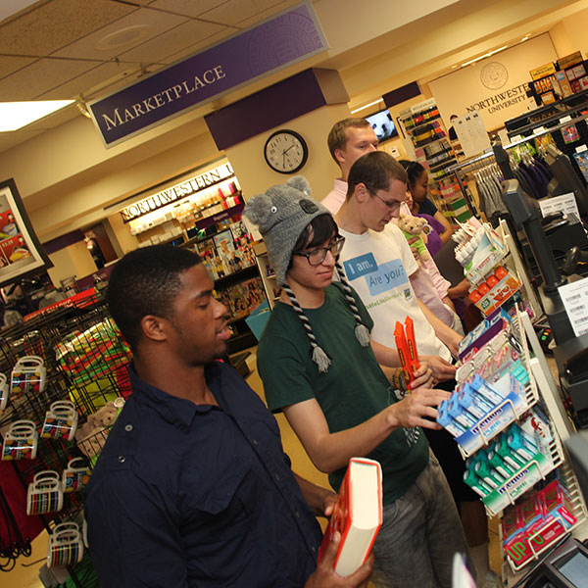
Purchasing Textbooks from Norris is more common amongst higher income students
Notes:
I asked students the methods with which they have bought or rent textbooks. They were able to choose more than one method. For the lower income and middle income groups, online methods and student methods the most common option and didn’t differ much between those two methods compared to Norris being the least common methodwith a 20% difference between Norris and the next common option.

Slide 10
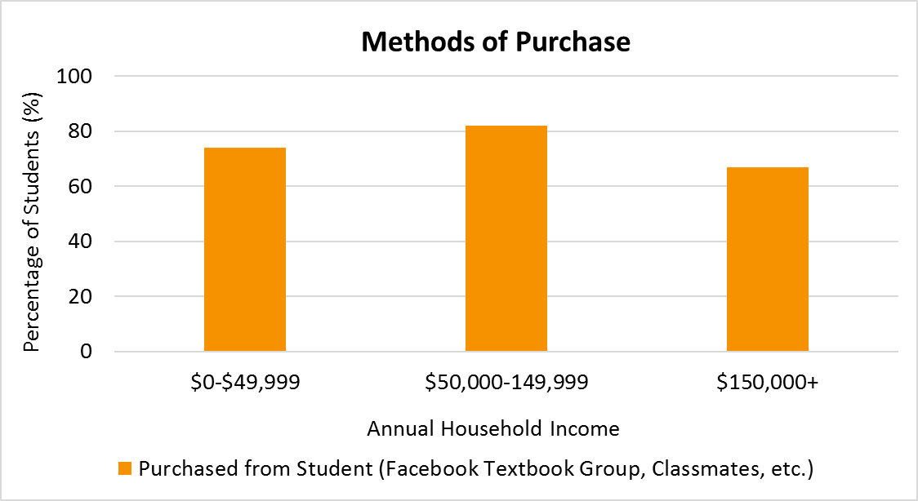
No substantial Differences in Other Methods of Purchase

Slide 11
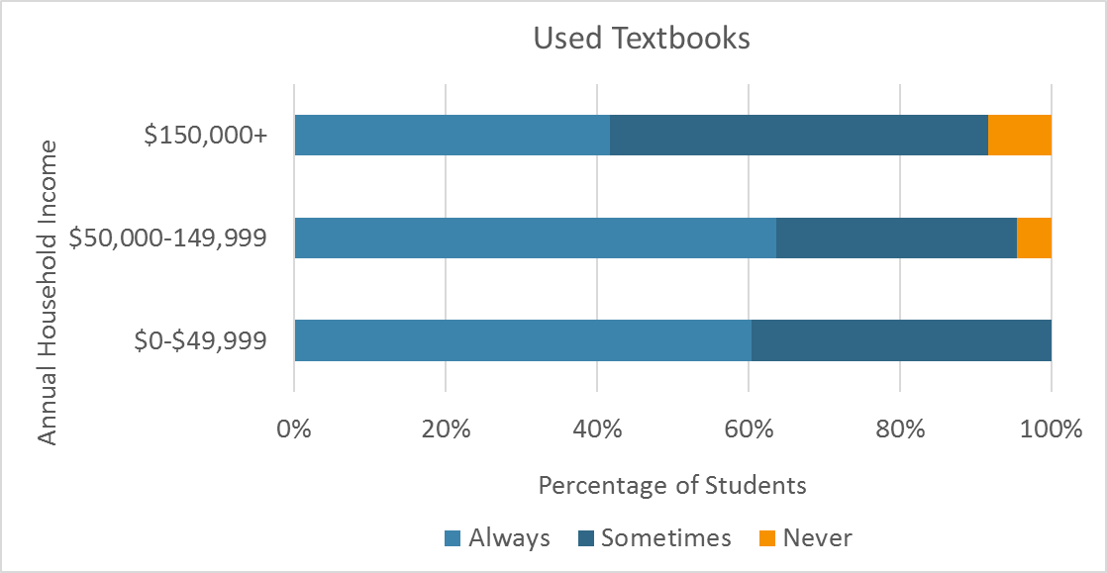
Most Students Have Obtained Used Textbooks

Slide 12
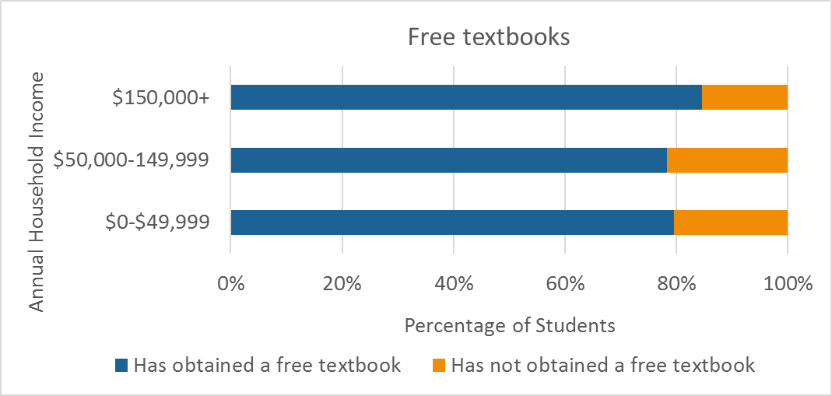
Experiences with Free Textbooks
Relatively around 80% for each income bracket
Experiences Ranked in Frequency:
1. Online version (pdfs, google drive)
2. Classmates
3. loan programs (Interlibrary Loan and Arch Scholars Loan Program)
4. Professors
5. Donation Bins and Sorority
Notes:
When asked about if they have ever obtained a textbook for free, each group had around 80% of the responses reporting yes. Talk about the common methods of obtaining free textbooks

Slide 13
Implications
It is inconclusive whether or not socioeconomic status affects student behavior regarding College Textbook Costs based on the survey data
Look into Actual Textbook costs Here at Northwestern and look at different majors and courses
Potential to connect to a bigger question: should there be college textbook subsidies?

Slide 14
Acknowledgements
Professor Ogawa
Professor Hornsten
Dean Finn
Ms. Kockrell
Mr. Hannen
Ms. Castenada
Northwestern University
Posner Fellowship

