Slide 1

Research Data Management and Data Sharing
Cunera Buys
Data Management Librarian
RRF 2019
https://c2.staticflickr.com/1/680/21842202345 CC BY-SA 2.0
Notes:
Talk about research experience

Slide 2

Background on data management/ data sharing
Why data management/ data sharing is important
Intro to best practices for data management
Library resources for data management/ sharing
Photo by Carl Vogtmann

Slide 3
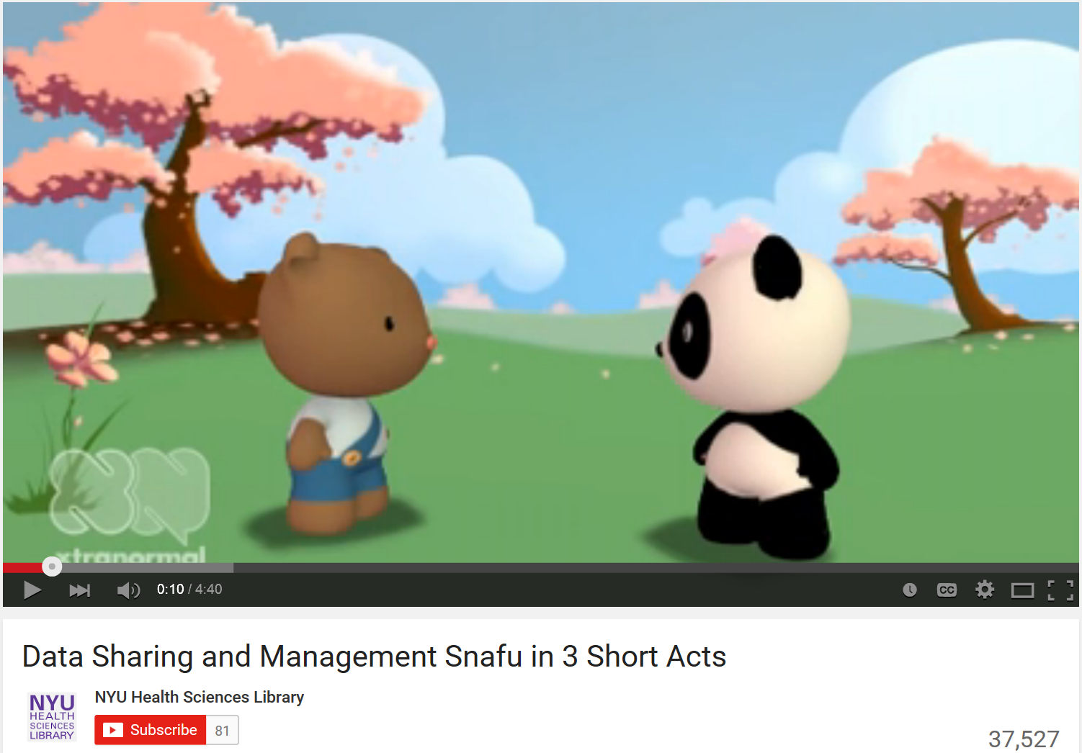
Data Snafu
Data Sharing and Management Snafu in 3 Short Acts
https://www.youtube.com/watch?v=N2zK3sAtr-4

Slide 4
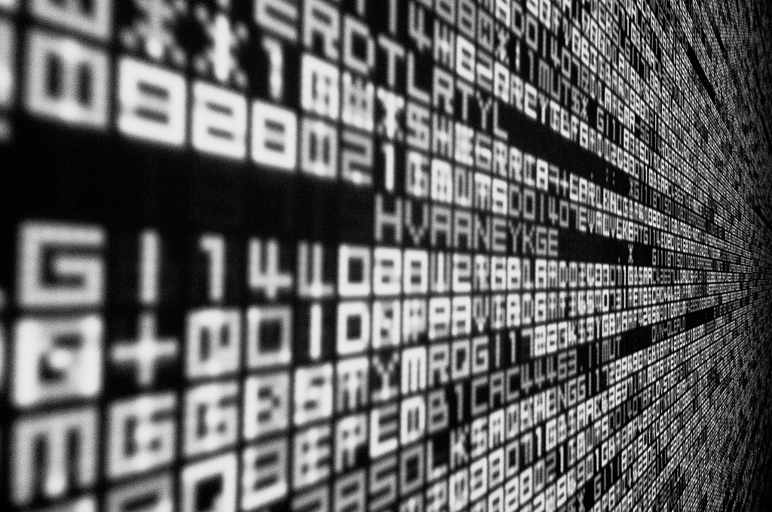
What are data?
https://www.flickr.com/photos/rh2ox/9990024683/ (CC BY-SA 2.0)

Slide 5
Data- Some Definitions
Office of Management and Budget: “Research data means the recorded factual material commonly accepted in the scientific community as necessary to validate research findings” (OMB Circular A110)
The Oxford English Dictionary (OED)defines “data” as:
Related items of (chiefly numerical) information considered collectively, typically obtained by scientific work and used for reference, analysis, or calculation.
Data can be both analogue and digital materials.

Slide 6

Every discipline has data!
  Types of data include:
  observational data
  laboratory experimental data
  computer simulation
  textual analysis
  physical artifacts or relics
  Examples of data include:
  Audio and video files
  Code or scripts
  Digital text
  Lab notebooks
  Geospatial images
  Instrumental data
  Photographs
  Rock samples
  Survey results
  Scanned documents
  Spreadsheets
  Video games
https://www.flickr.com/photos/23165290@N00/9338136777/(CC BY-SA 2.0)
Notes:
Just examples of the types of data. Moon rocks are data, but when people talk about big data, little big data, or just data, they are usually talking about born digital data. Born digital data is what we mean for the purposes of this presentation.

Slide 7
Research Data Management
Research Data Management is the care and maintenance of data and helps to ensure data is properly organized, described, preserved, and shared. It includes practices for collecting, organizing, backing up, and storing data.
Notes:
Where should a researcher begin? With good data management. Good data management is the basis of successful research.

Slide 8
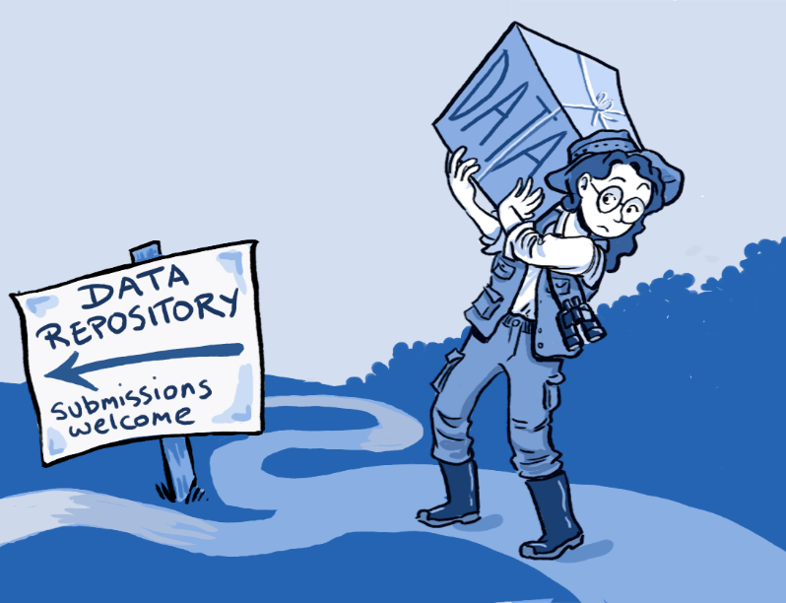
Why share data?
https://upload.wikimedia.org/wikipedia/commons/6/65/To_deposit_or_not_to_deposit%2C_that_is_the_question_-_journal.pbio.1001779.g001.png

Slide 9
Data management
Good data management allows you to:
  Disseminate and archive your data
  Enable reproduction of your research
  Enables data reuse
Notes:
An article from the Atlantic about the Current Biology study
Prevention of data loss. As this study published in Current Biology in January 2014 shows:
1. the availability of data decreased by 17% each year after publication
2. most raw data from scientific papers published twenty years ago is unobtainable
3. the most common obstacles to data sharing were because authors have since changed their contact information and can't be reached or because the data was stored using outdated technology, like floppy disks.
Reporducibility-
Big issue in social sciences, especially psychology
One study showed that 80% of cancer papers were irreproducible
Data Reuse
How important is old climate data today?

Slide 10
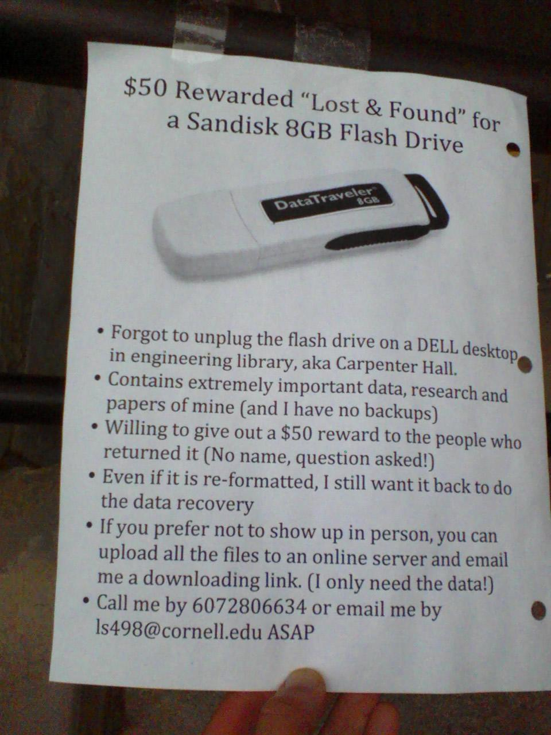
Data nightmares
Tweeted in 2012 by Gail Steinhart, Head of Research Services, Mann Library, Cornell University

Slide 11
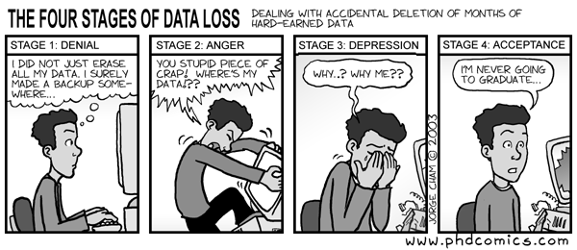

Slide 12
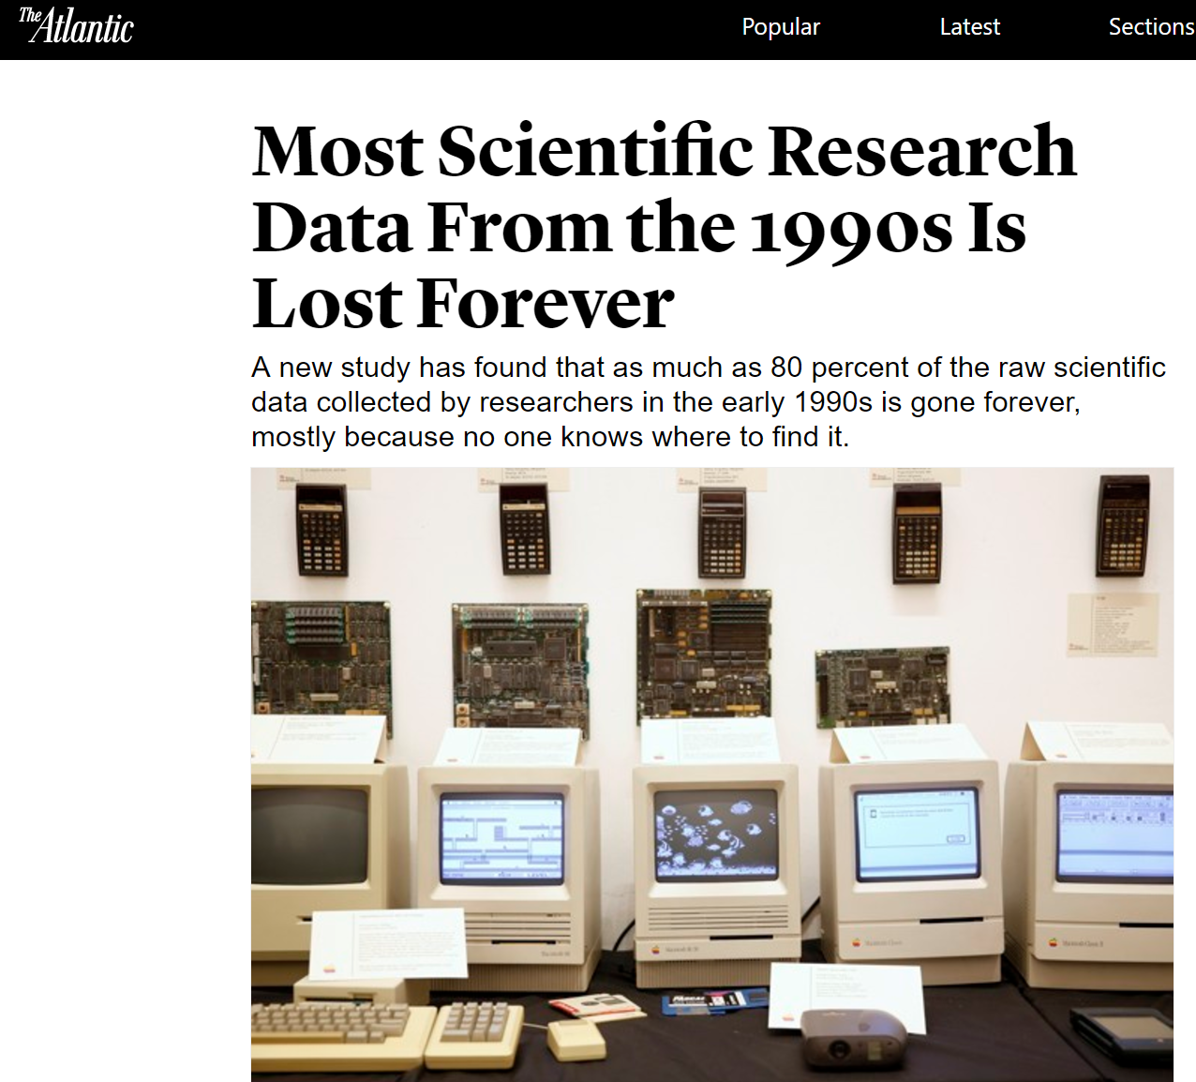
https://www.theatlantic.com/national/archive/2013/12/scientific-data-lost-forever/356422/
Notes:
An article from the Atlantic about the Current Biology study
Prevention of data loss. As this study published in Current Biology in January 2014 shows:
1. the availability of data decreased by 17% each year after publication
2. most raw data from scientific papers published twenty years ago is unobtainable
3. the most common obstacles to data sharing were because authors have since changed their contact information and can't be reached or because the data was stored using outdated technology, like floppy disks.

Slide 13
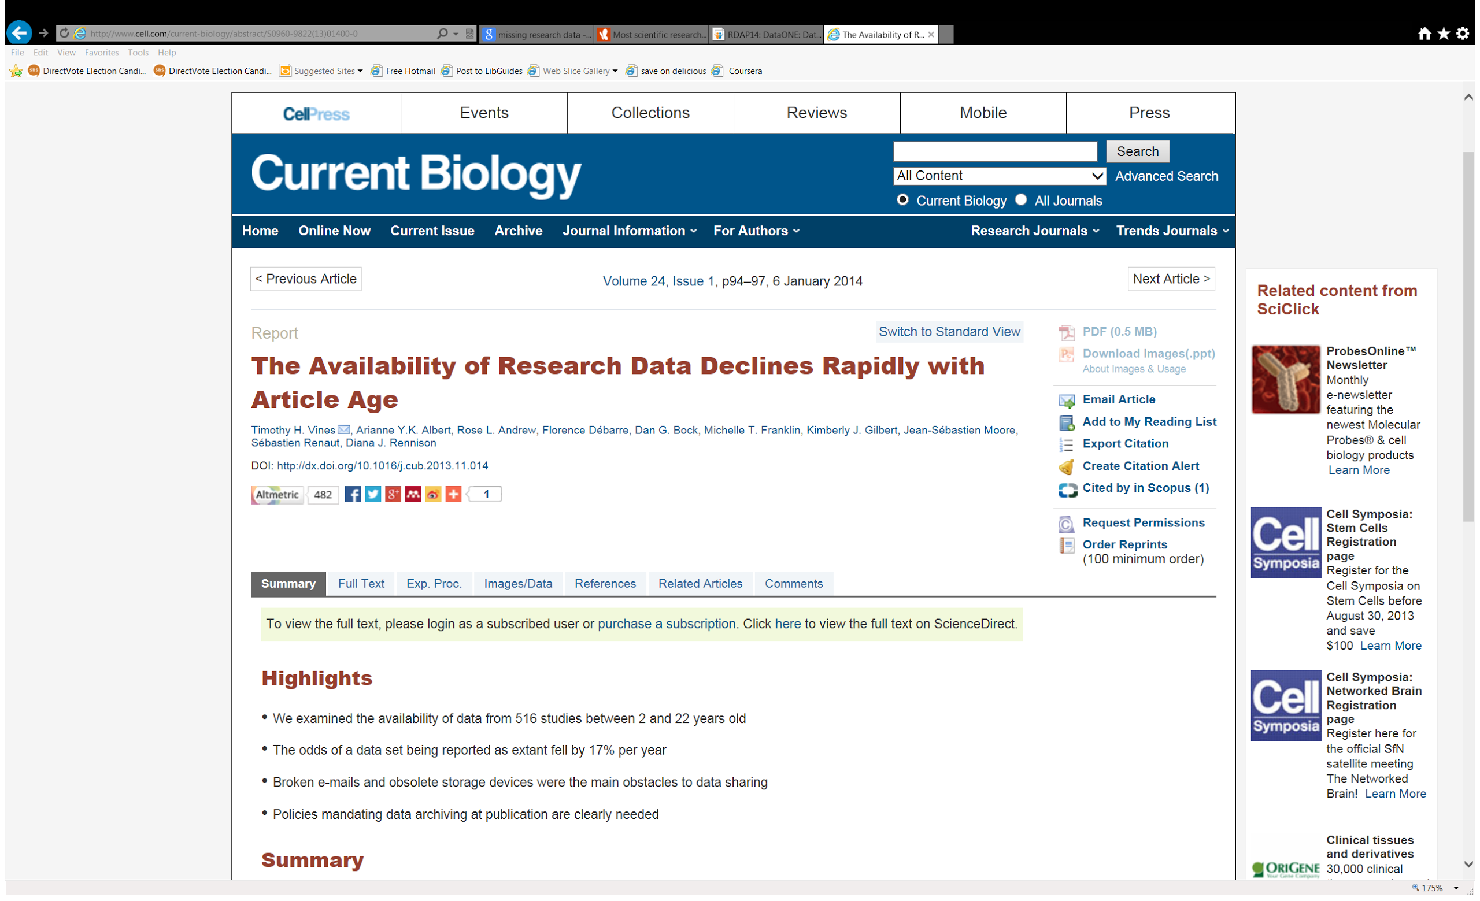
Prevent Data Loss
Notes:
Prevention of data loss. As this study published in Current Biology in January 2014 shows:
1. the availability of data decreased by 17% each year after publication
2. most raw data from scientific papers published twenty years ago is unobtainable
3. the most common obstacles to data sharing were because authors have since changed their contact information and can't be reached or because the data was stored using outdated technology, like floppy disks.

Slide 14
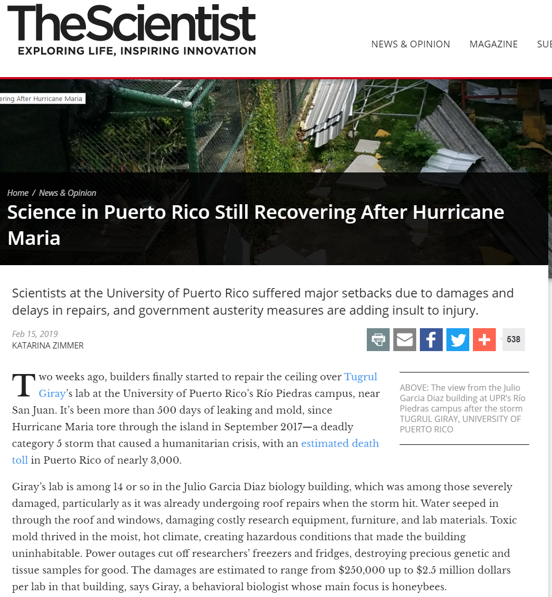

Slide 15
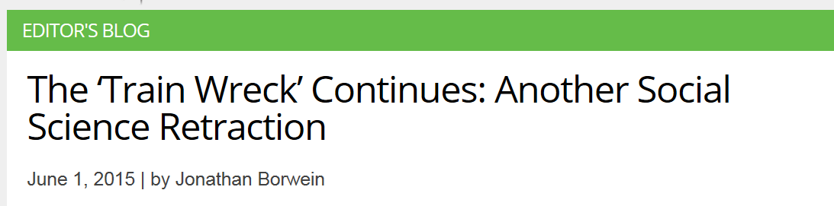
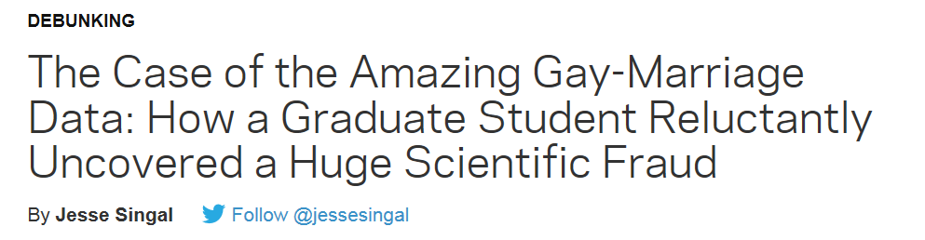
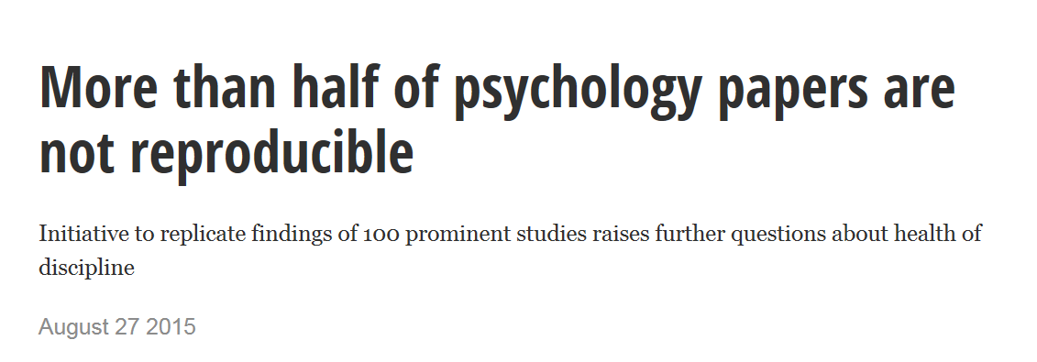

Slide 16

Data Management & Data Sharing
Makes your data easily accessible by you and others
Can save you time and perhaps money
Data sharing increases recognition of your work
May help you find collaborators more easily
Helps further new discoveries and research
https://www.flickr.com/photos/mbiddulph/3240818979/ (CC BY-SA 2.0)

Slide 17
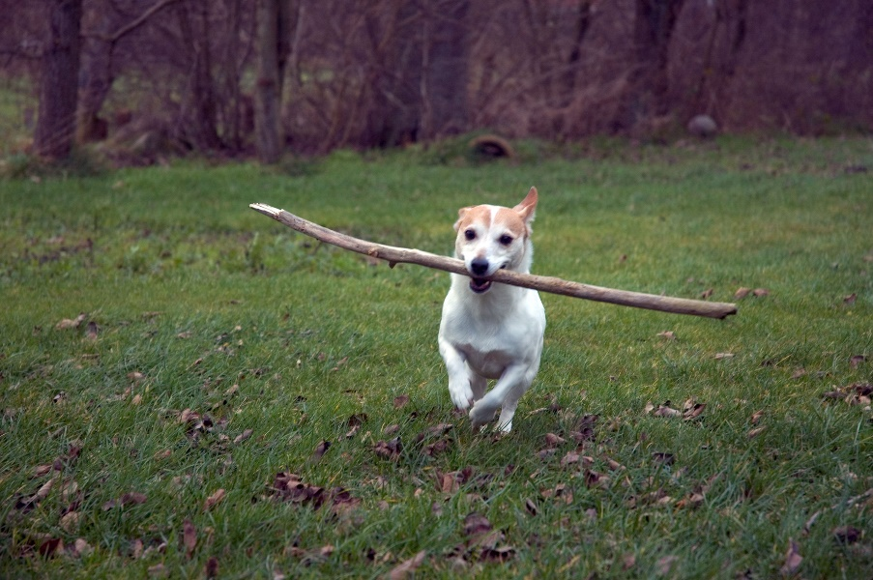
Data Management & Data Sharing
Federal and other funding agencies require data management plans and data sharing
Journals require deposit of data underlying the articles in public repositories
https://www.flickr.com/photos/guerito/3107019/ (CC BY-NC 2.0)

Slide 18
Brief History of Federal Data Sharing Requirements
2003 - NIH Data Sharing Policy for projects above $500K.
2011- NSF requires Data Management Plans (DMPs)
2013- White House Office of Science and Technology Policy (OSTP) Memo requiring public access to data
2016-19 Federal Departments and agencies have public access plans
Notes:
I’d like to start with a brief time line of Federal data management sharing requirements.
OSTP memo-- Granting agencies must develop a plan to make the results of federally-funded research publically available free of charge within 12 months after original publication. Includes published articles and data.
All affected funding agencies will require DMPs.
implement policies that require the deposition of research data underpinning the results described in scientific publications of federally funded scientific research in publicly accessible repositories. Optimally, such data would be made freely available in nonproprietary machine-readable formats and would allow for discoverability, reuse, and repurposing.”

Slide 19
Funding agency responses
Require Data Management Plans (DMPs)
Publications to be available to public within 12 months (Open Access)
Data supporting publications must be available in a public repository

Slide 20
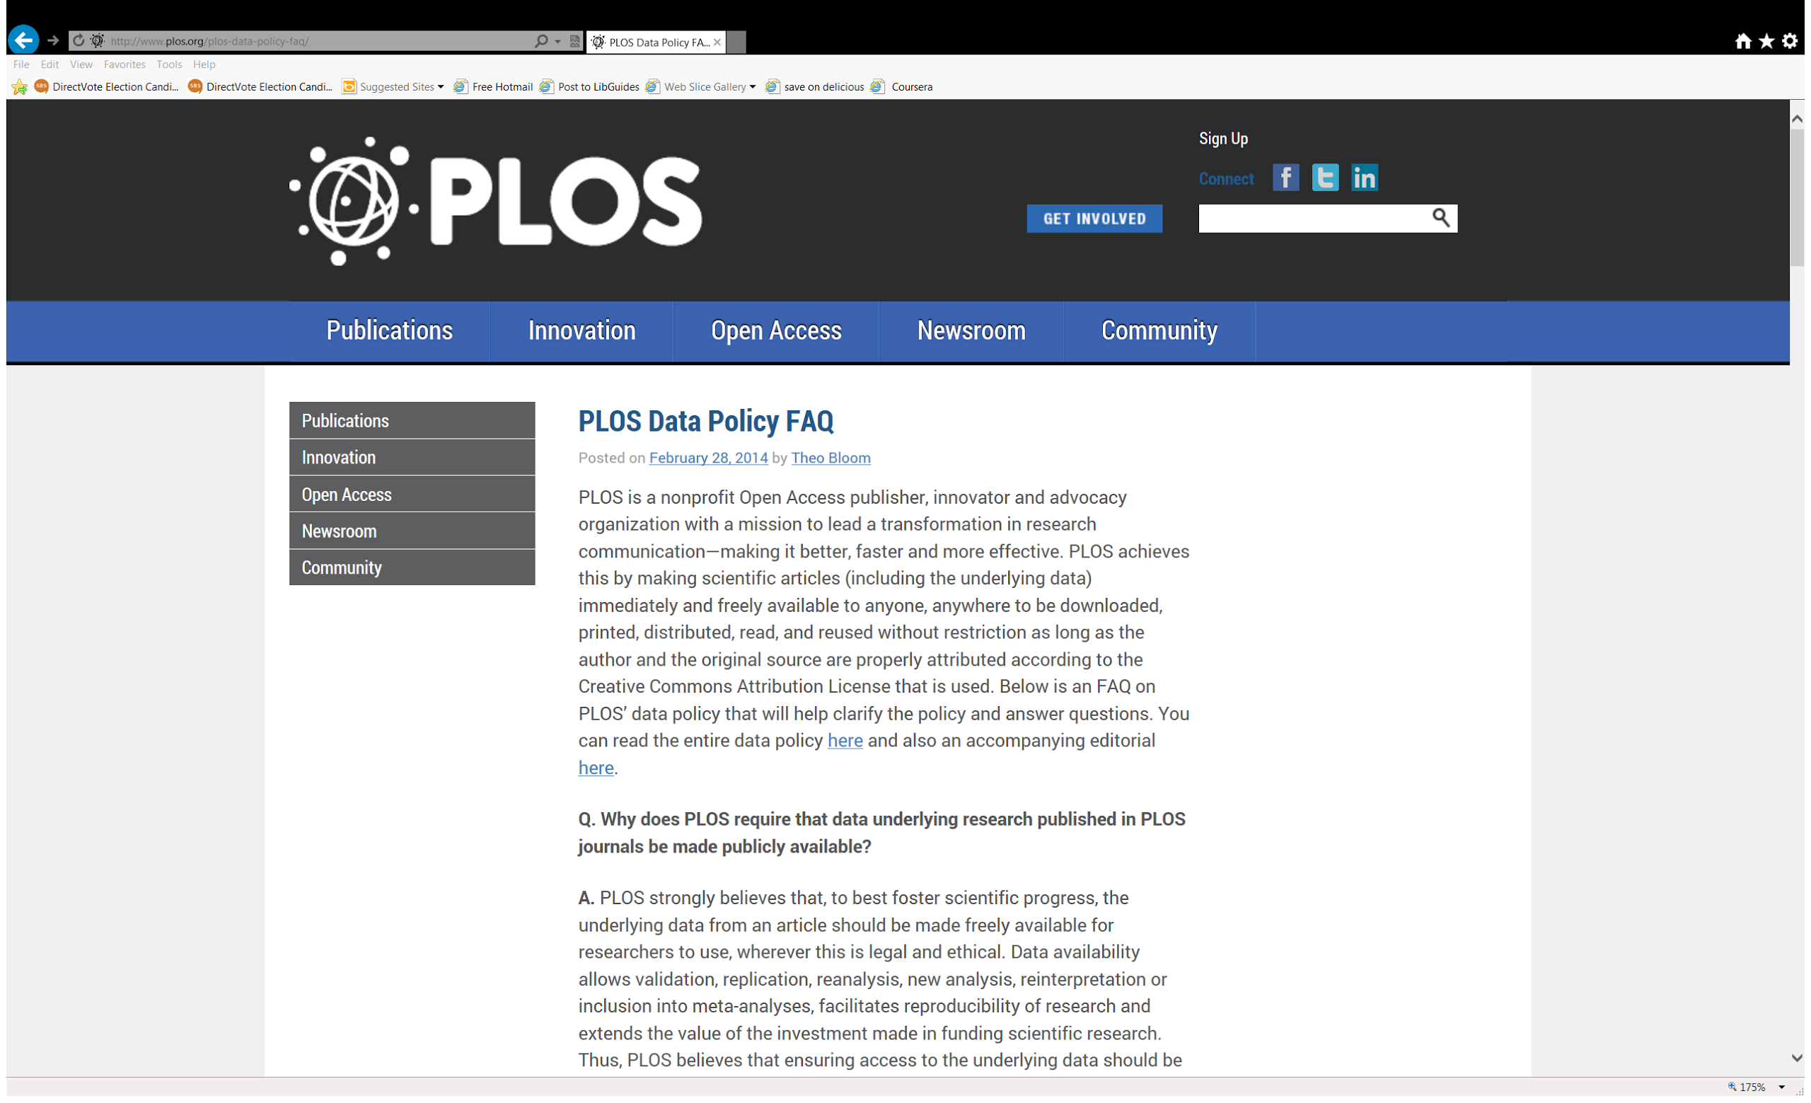
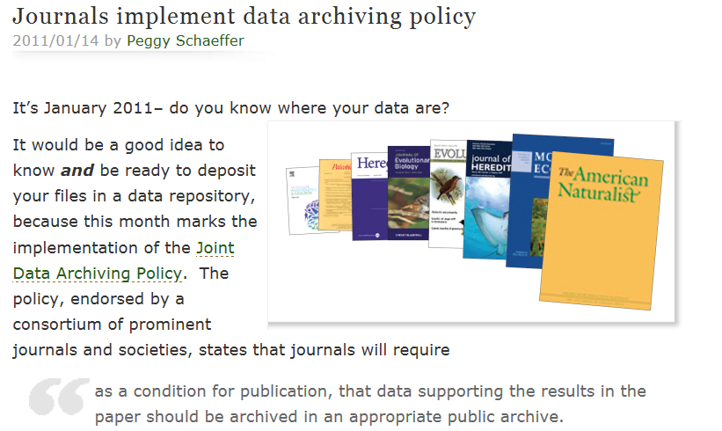

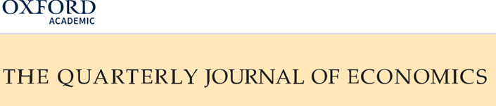
Journal Requirements
PLOS journals require authors to make all data underlying the findings described in their manuscript fully available without restriction, with rare exception.
Notes:
In addition to Federal mandates, many journals require the deposit of data underlying publications be placed in a publically accessible repository.
Some of these journal offer advice on where to deposit the data.
The Public Library of Science requires authors in PLoS Journals to have made the data supporting their arguments freely available at the time of publication, ‘with rare exception’. Some Journal publishers require or recommend that supporting data for articles be made publicly available.
The Joint Data Archiving Policy (JDAP) requires data sharing in a public archive as a condition of publication.
Journals that have adopted JDAP include: Science, Nature and Genetics
In the area of data sharing, some journals are requiring a form of data deposit upon publication. The specifics vary, each journal has a slightly different approach about whether the data may or may not be embargoed for a period of time, in most cases, it is the author’s responsibility to find an appropriate archive into which to deposit.
Each journal has different requirements when it comes to data sharing, so you will need to pay close attention to your particular journal. Their requirements can range from:
An associated data file is required with your manuscript submission. This often takes the form of a file of figures used in the paper, sometimes with the backing data required.
Data available upon request: If your journal allows this method of sharing, your only requirement is to supply contact information and answer the requests for data as they come in.
Minimum dataset: From your stockpile of project data, only the minimum set necessary to support the claims made in the current paper must be deposited.
Full Data Deposit and Sharing: In these cases, the journal will require a full deposit of your research data in an appropriate repository. This can include, in the case of Nature, data, code, and associated protocols.
Things to keep in mind:
Publisher agreement: your level of sharing can be negotiable! Before signing your publication agreement, get confirmation on the terms of sharing and ask for any amendments that you would like.
Data Availability Statement: Many journals require a data availability statement, or a clear outline of exactly how you will make the data available, early in the manuscript submission process. Keeping in mind your agreement and the realities of what you are able to share, write your Data Availability Statement accordingly.

Slide 21
FAIR Principles for scientific data management
Data that is stored, curated, and shared according to the FAIR principles (a set of guiding principles) to make data
Findable: described richly with metadata and have a unique identifier (often a URI)
Accessible: retrievable by their identifier through free and open Internet protocols that allow authentication and authorization where necessary
Interoperable: described with commonly used metadata standards and controlled vocabularies
Re-usable: have been assigned a license assuring their re-use and have a clear provenance
Notes:
The FAIR principles were published in 2016. They serve as a guide to all researchers who manage research data and who may have a desire or responsibility to deposit it in a repository or otherwise share it freely in the future. Increasingly adopted by institutions, including some in the US.
Approximately only 15% if researchers are familiar with FAIR principles. (State of open data report- Digital Science).
Open data and FAIR are 2 separate concepts. Open data means data that can be used freely from the internet. Fair means thinking about the people who might use your data. This is done by adding persistent identifies ( DOI) so data doesn't disappear, adding metadata that describes the data and a license stating the conditions under which data can be reused (creative commons). Present data in a standardize way so it is machine readable. (develop community standards.)
Data can be FAIR but not open.( eg medical data). How describe the data (metadata) is crucial in helping users discover the data.
In practice, for researchers it can be very simple to achieve the findable and accessible parts. If depositing to a data repository, try to always choose one that will mint a DOI for your deposit. This makes the dataset an identifiable object on the Web, and allows it to be cited. This identified object should then be retrievable through free and open internet protocols (which any well-designed data repository will allow for).
To cover the R first, to be optimally re-useable a dataset should be assigned a license. We will talk about licenses later, and now we will see how having a license is an important part of depositing data. Re-use is made easier if the second user of a dataset knows what they may and may not do with re-used data.
Finally, interoperability it achieved mainly through the use of common metadata standards to describe a dataset in a repository.

Slide 22
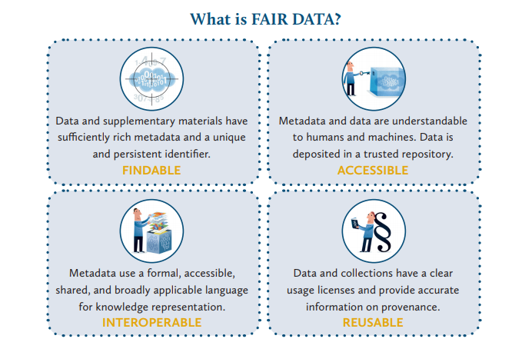
Ligue des Bibliothèques Européennes de Recherche/ Association of European Research Libraries (LIBER)
https://libereurope.eu/wp-content/uploads/2017/12/LIBER-FAIR-Data.pdf
Notes:
Just because I like graphics.

Slide 23
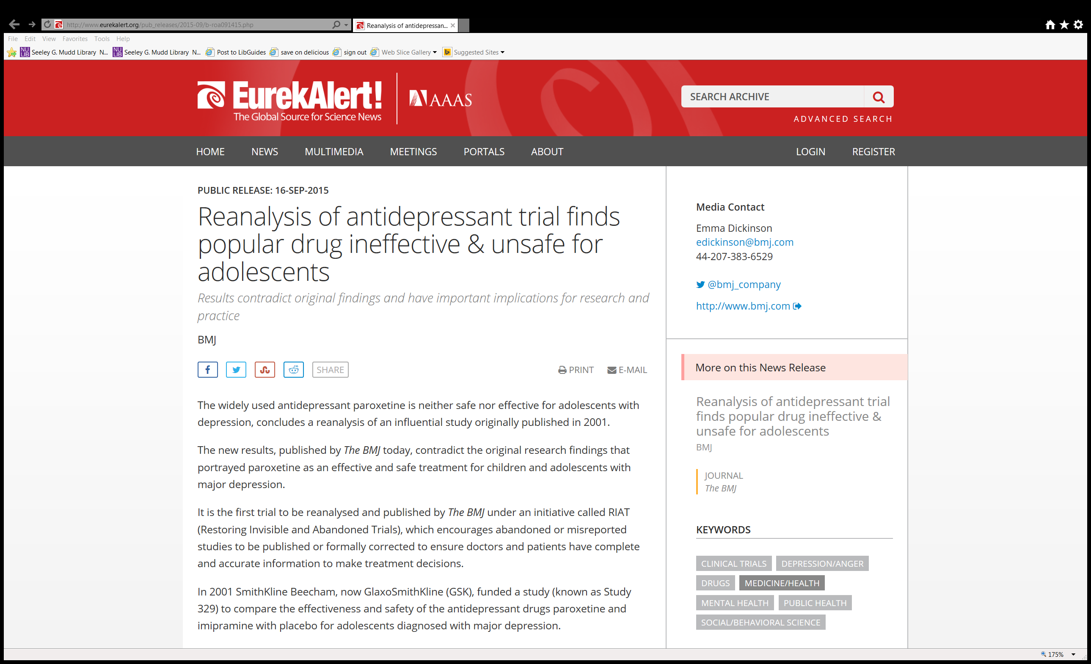
Data reuse success story # 1
Notes:
British journal of medicine.

Slide 24
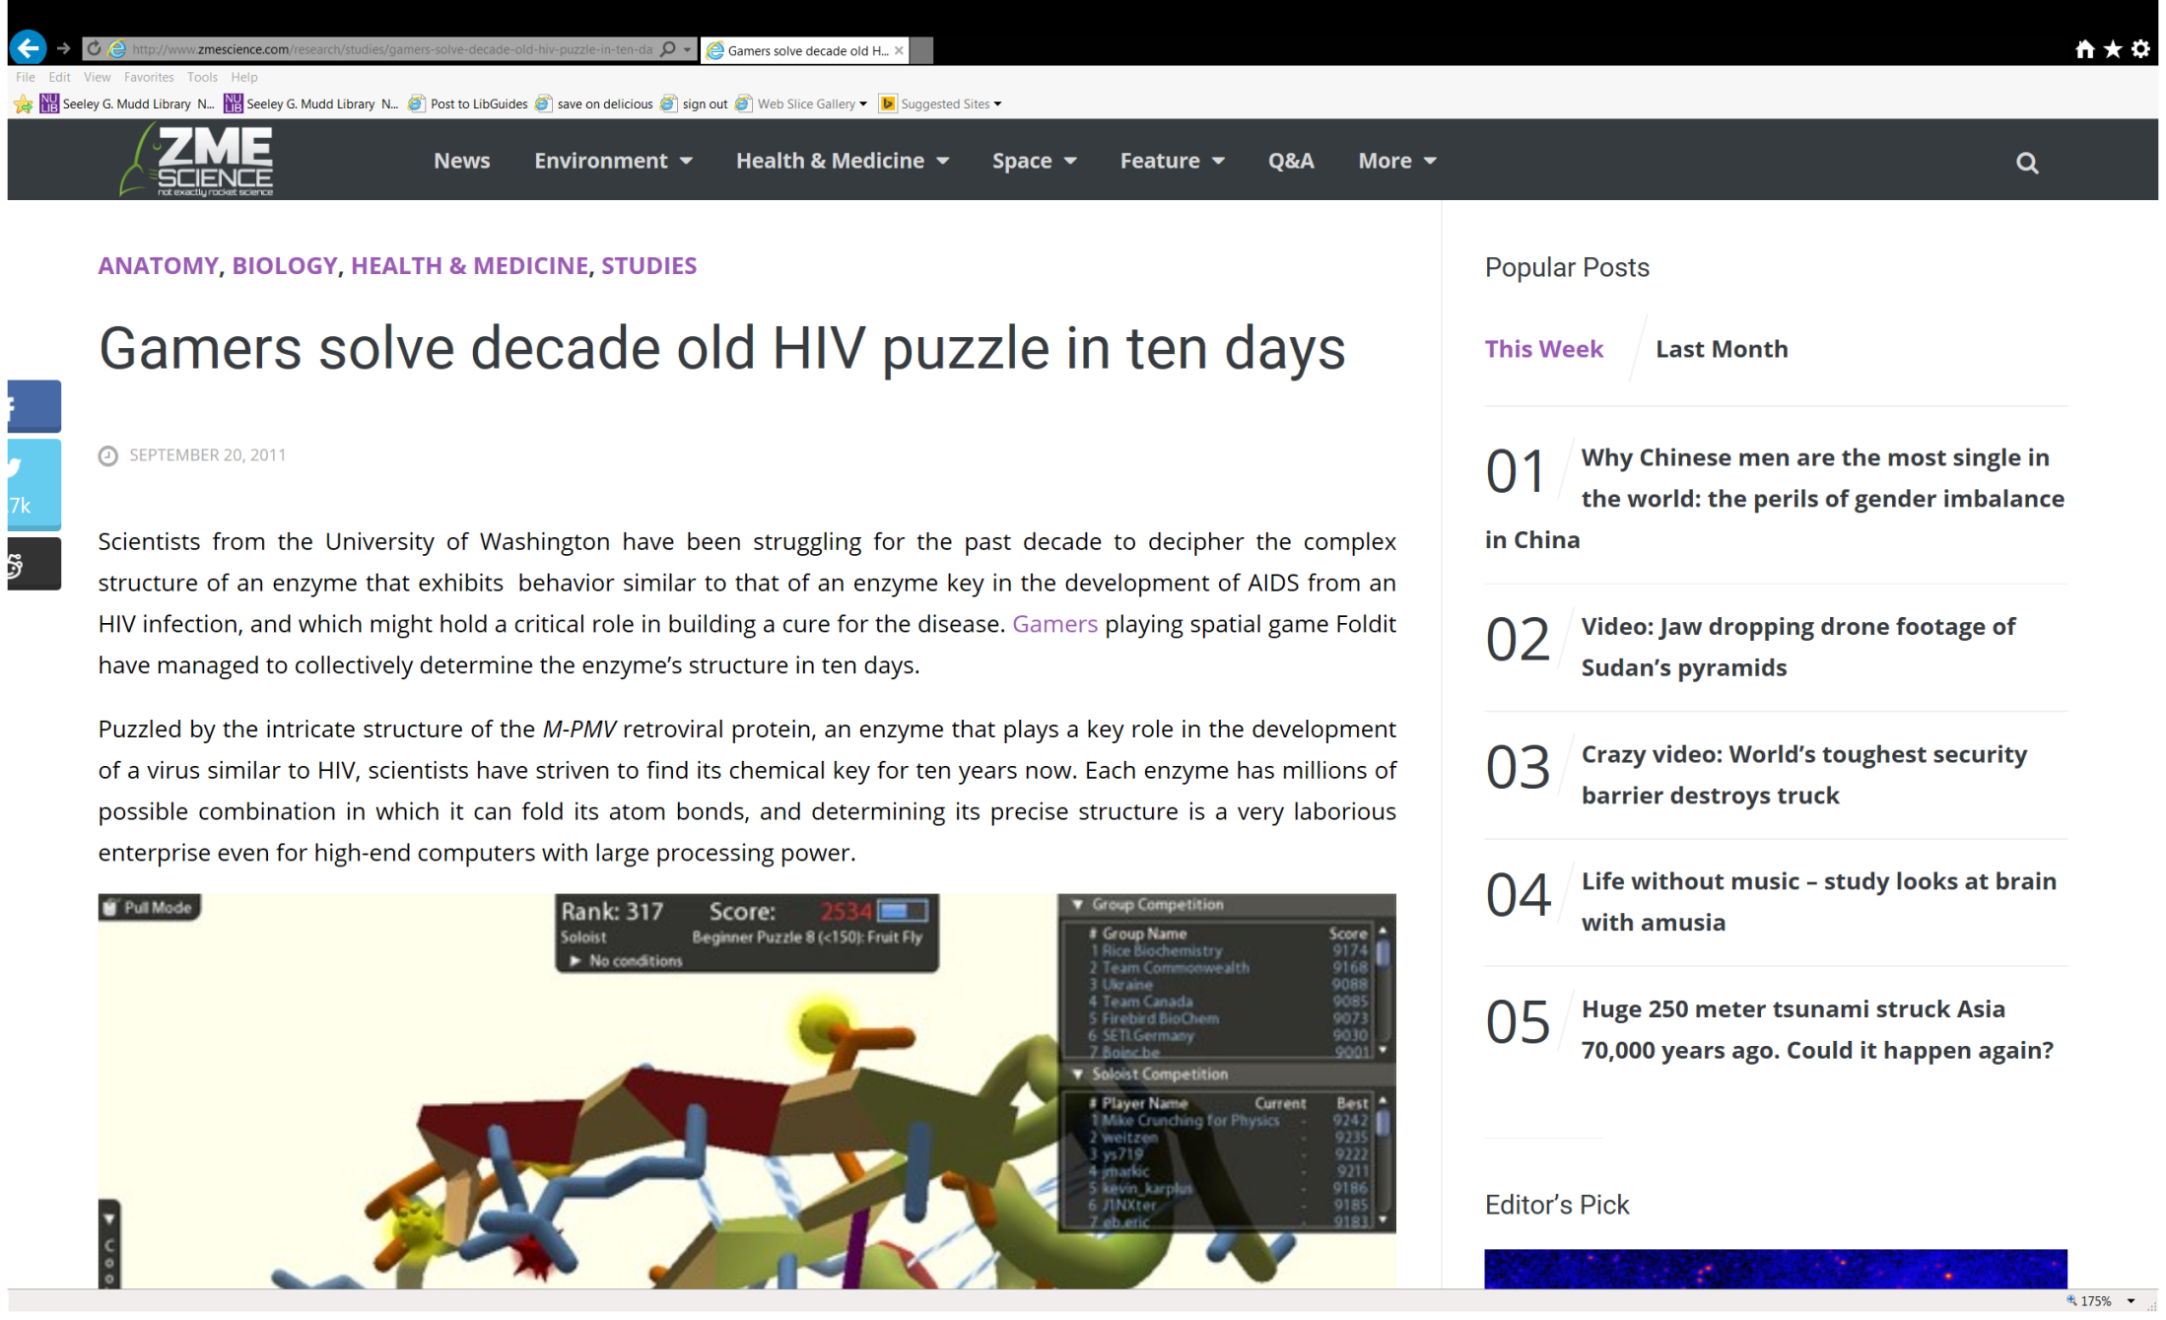
Data reuse success story # 2
Notes:
Foldit is a very simple game, which tackles biology’s biggest issue – folding proteins. To play the game you don’t need any biology background, just your native spatial reasoning skills. Motivation comes in the form of competition, and from this stand point, the game has been more than suitably designed. Basically you get scored for three factors: how well you pack the protein, how efficiently you hide the hydrophobics and how you clear the clashes. Trust me, it’s a lot simpler than it sounds.

Slide 25
Some Best Practices for Data Management

Slide 26
The Data Life Cycle
Assure
Preserve
Discover
Integrate
Analyze
Plan
Describe
Collect
Notes:
There are many representations of the data life cycle. Just google it.
The DMP occurs at the start of the cycle, when researchers are applying for a grant. However, the information in the plan directly relates to the data life cycle as a whole.
Data management planning is the starting point in the data life cycle. However the plan should be revisited often throughout the project to ensure proper data documentation and management.
The Data Life Cycle: An Overview
The data life cycle has eight components:
Plan: description of the data that will be compiled, and how the data will be managed and made accessible throughout its lifetime
Collect: observations are made either by hand or with sensors or other instruments and the
data are placed a into digital form
Assure: the quality of the data are assured through checks and inspections
Describe: data are accurately and thoroughly described using the appropriate metadata standards
Preserve: data are submitted to an appropriate long-term archive (i.e. data center)
Discover: potentially useful data are located and obtained, along with the relevant information about the data (metadata)
Integrate: data from disparate sources are combined to form one homogeneous set of data that can be readily analyzed
Analyze: data are analyzed

Slide 27
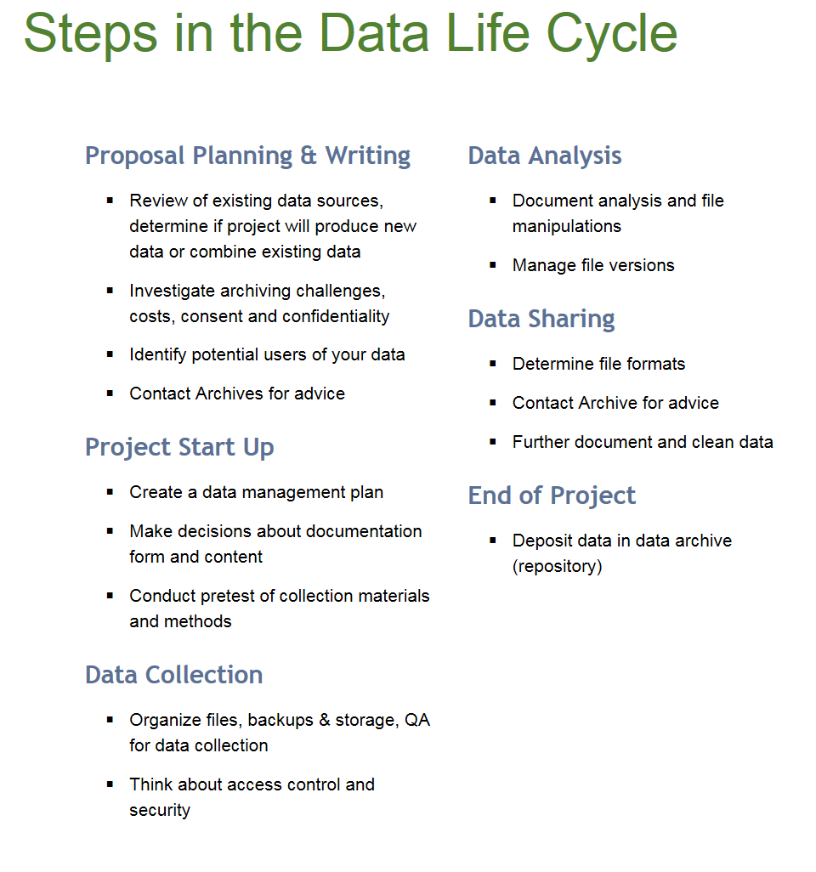
http://data.library.virginia.edu/data-management/lifecycle/

Slide 28
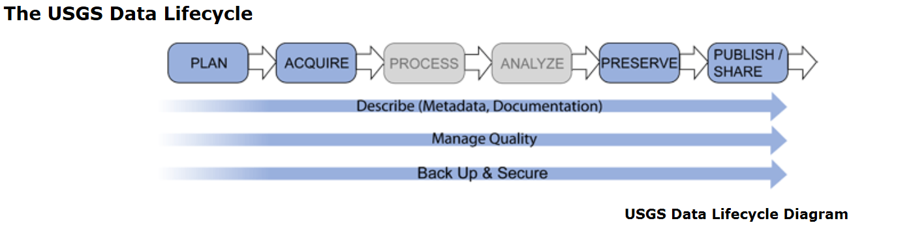

Slide 29
Aspects of Research Data Management
DMPs/Planning
File organization & naming
Documentation & metadata
Storage & backup
Legal/ethical considerations
Sharing & reuse
Preservation & Archiving
Notes:
Applies to all disciplines, but applications of these may be subject specific. Eg metadata
Some of these should be done throughout the data life cycle. (eg top 4)

Slide 30
Start with a plan…
Notes:
The place to start is with a data management plan.

Slide 31
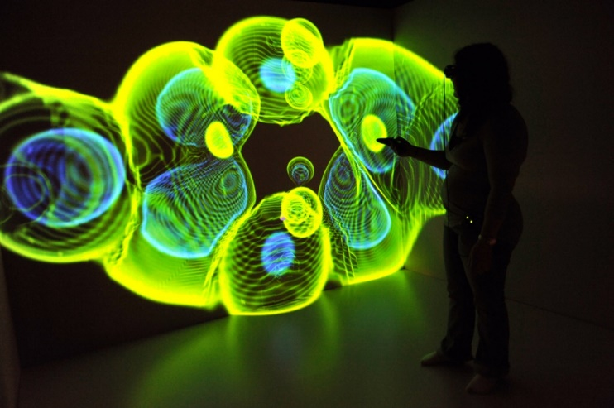
Points to address in your Data Management Plan (DMP)
Types of data to be produced.
Standards or descriptions that would be used with the data (metadata).
How these data will be accessed and shared.
Policies and provisions for data sharing and reuse.
Provisions for archiving and preservation.
flickr.com/photos/inl/5097547405
Notes:
There are typically 5 areas to be addressed in DMP. However, requiremets will change with funding agency, so be sure to check the agencies requirements.
Types of data to be produced.
Standards or descriptions that would be used with the data (metadata).
How these data will be accessed and shared.
Policies and provisions for data sharing and reuse.
Provisions for archiving and preservation

Slide 32
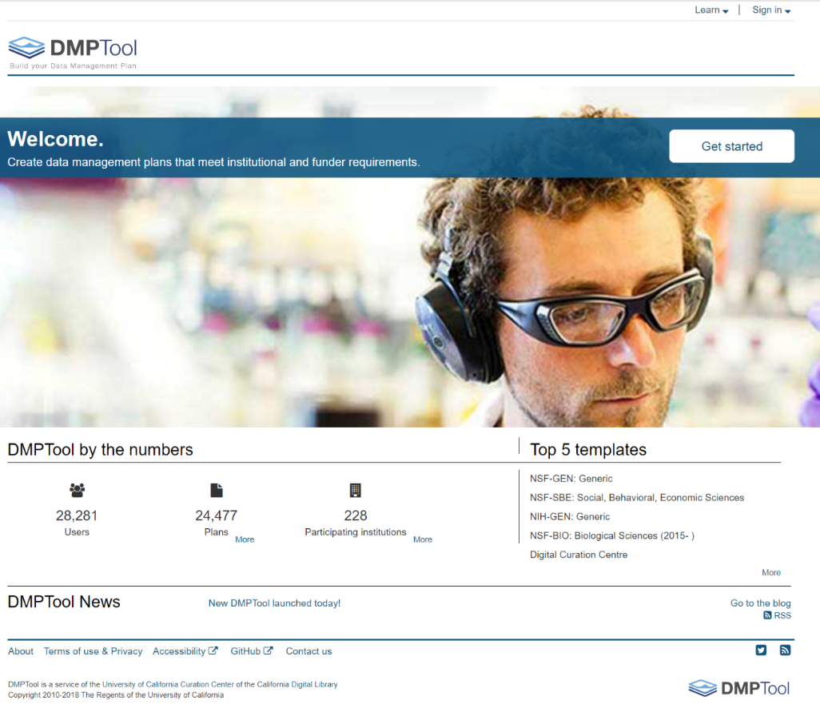
DMP Tool
Login with NetID
Generates Data Management Plans
Templates from federal agencies and private foundations
Saves your plans for reuse and adaption
Export as PDF, DOCX
dmptool.org

Slide 33
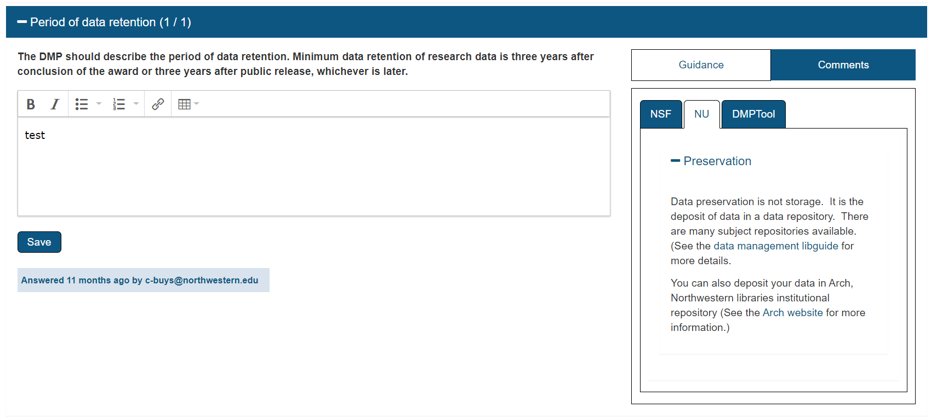

Slide 34
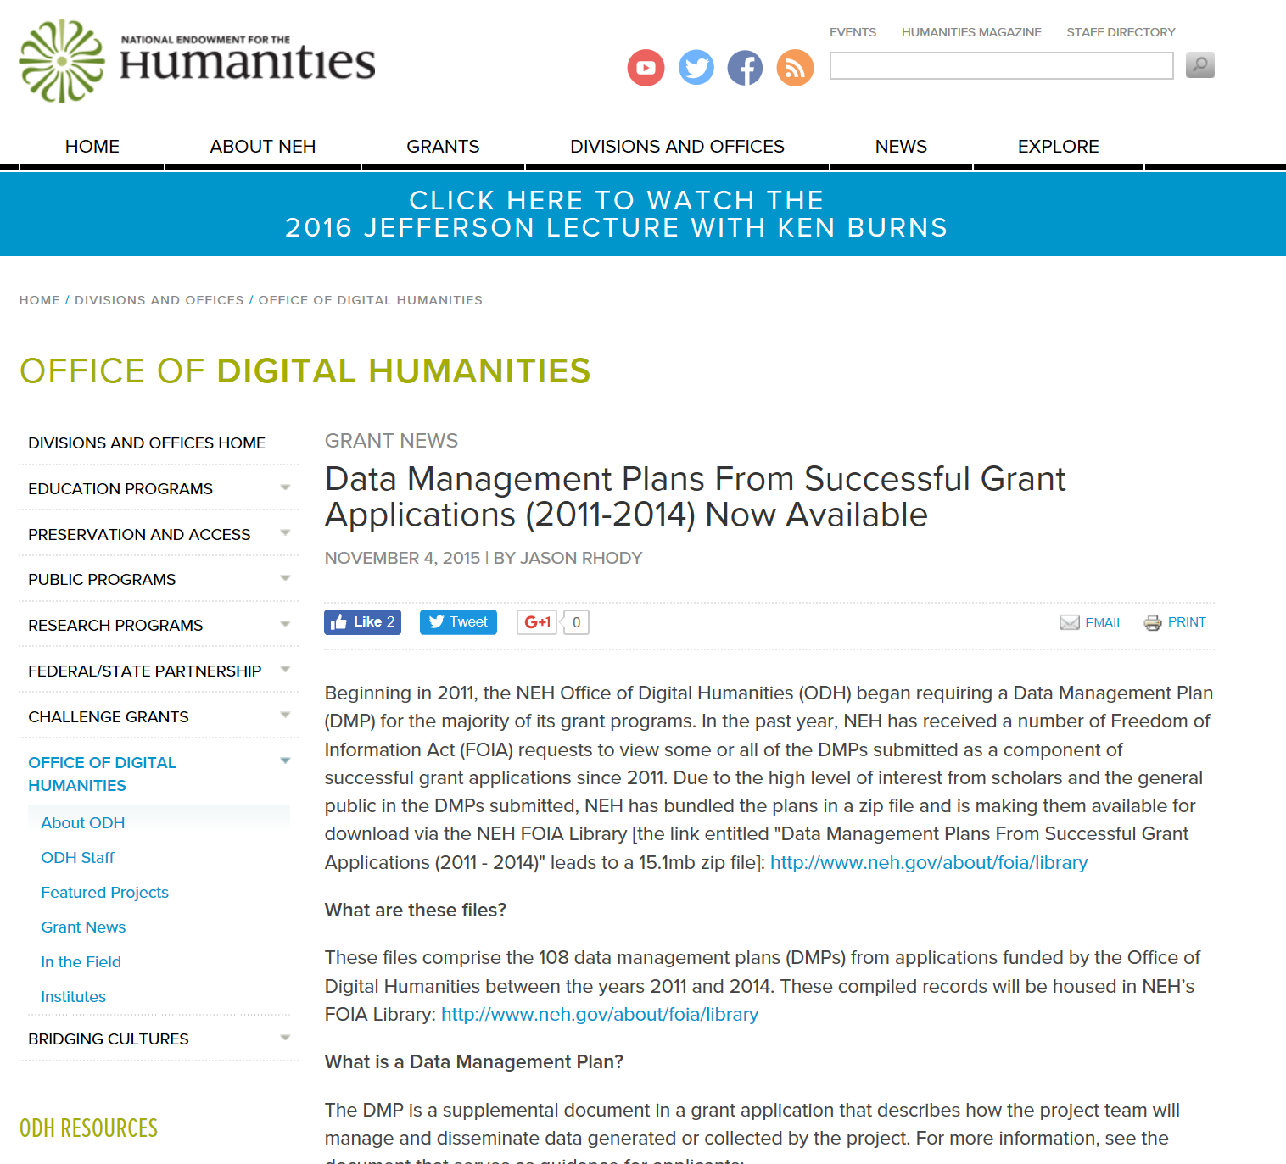
Notes:
the office of digital humanities also posts all DMPs from approved applications.

Slide 35
Aspects of Research Data Management
DMPs/Planning
File organization & naming
Documentation & metadata
Storage & backup
Legal/ethical considerations
Sharing & reuse
Preservation & Archiving
Notes:
Applies to all disciplines, but applications of these may be subject specific. Eg metadata
Some of these should be done throughout the data life cycle. (eg top 4)

Slide 36
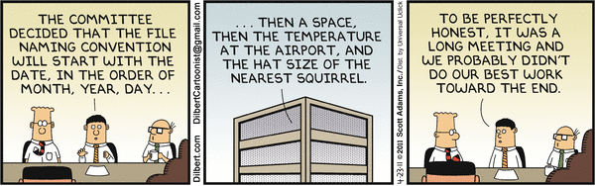
Thoughts on naming stuff and why you should care…
Find your files easier
Creates uniformity
Allows for sorting
Understand what is “under the hood”
Allows for versioning

Slide 37
Directories
Folders should be major functions/activities
Subfolders by year
Make folder names explanatory
Avoid personal names
Avoid duplication
Simple and simplistic
Source: http://bentley.umich.edu/dchome/resources/filenaming.php

Slide 38
Some good data practices
File organization and naming
Label and define the content of your data files in a systematic way
Use descriptive file names
  For example not- FIAGC (Fluffy is a great cat) but age, blood pressure etc.
Use consistent date formatting ( e.g. YYYYMMDD)
Keep file names short (no more than 25 characters)
Don’t use special characters
Use underscores instead of blank spaces
Keep track of versions
Don’t use confusing labels ( e.g. Pete’s data, final, final2, really final, really really final)
Notes:
This is the best date format to use. In the US we do month day year, but in Europe and other places they use day month year. Putting year frist will help avoid confusion.

Slide 39
Aspects of Research Data Management
DMPs/Planning
File organization & naming
Documentation & metadata
Storage & backup
Legal/ethical considerations
Sharing & reuse
Preservation & Archiving
Notes:
Applies to all disciplines, but applications of these may be subject specific. Eg metadata
Some of these should be done throughout the data life cycle. (eg top 4)

Slide 40
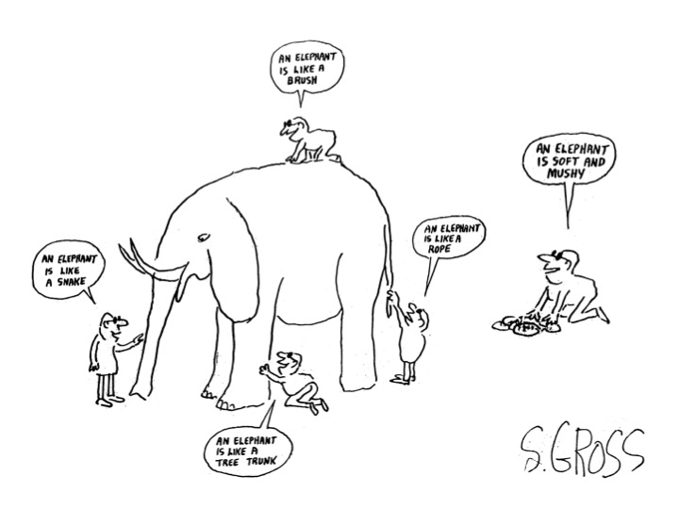
Data Description
https://www.flickr.com/photos/climateinteractive/13944682478/ (CC BY-NC-SA 2.0)
Notes:
how you describe your data is important. Good descriptions makes it easier for you and others to use the data

Slide 41
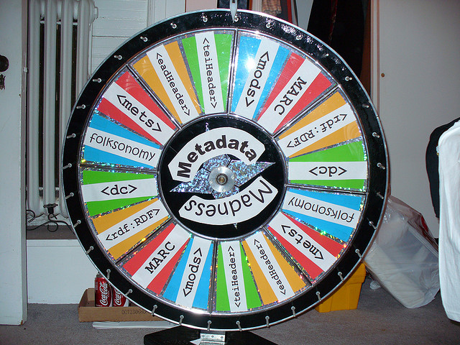
Description and Documentation (Metadata)
Commonly defined as “data about data”
It is information that describes the data
It gives you the ability to explain to your research to somebody that knows nothing about it
Provides information about one or more aspects of the data, such as:
  Means of creation of the data
  Purpose of the data
  Time and date of creation
  Creator or author of the data
  Location on a computer network where the data
  were created
  Standards used
https://www.flickr.com/photos/musebrarian/3289649684/ (CC BY-NC-SA 2.0)
Notes:
Essentially a controlled vocabulary to make data more discoverable even for the researcher

Slide 42
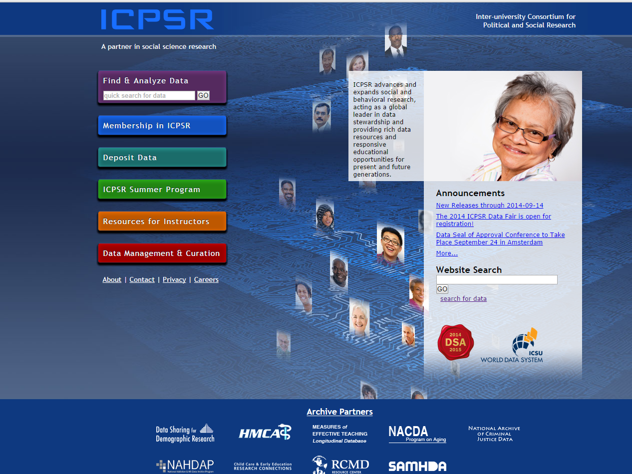
Metadata according to ICPSR…
A number of elements should be included in metadata, including, but not limited to:
Principal investigator
Funding sources
Data collector/producer
Project description
Sample and sampling procedures
Weighting
Substantive, temporal, and geographic coverage of the data collection
Data source(s)
Unit(s) of analysis/observation
Variables
Technical information on files
Data collection instruments
Notes:
Inter-university Consortium for Political and Social Research
ICPSR maintains a data archive of more than 250,000 files of research in the social sciences. It hosts 16 specialized collections of data in education, aging, criminal justice, substance abuse, terrorism, and other fields.

Slide 43
Aspects of Research Data Management
DMPs/Planning
File organization & naming
Documentation & metadata
Storage & backup
Legal/ethical considerations
Sharing & reuse
Preservation & Archiving
Notes:
Applies to all disciplines, but applications of these may be subject specific. Eg metadata
Some of these should be done throughout the data life cycle. (eg top 4)

Slide 44
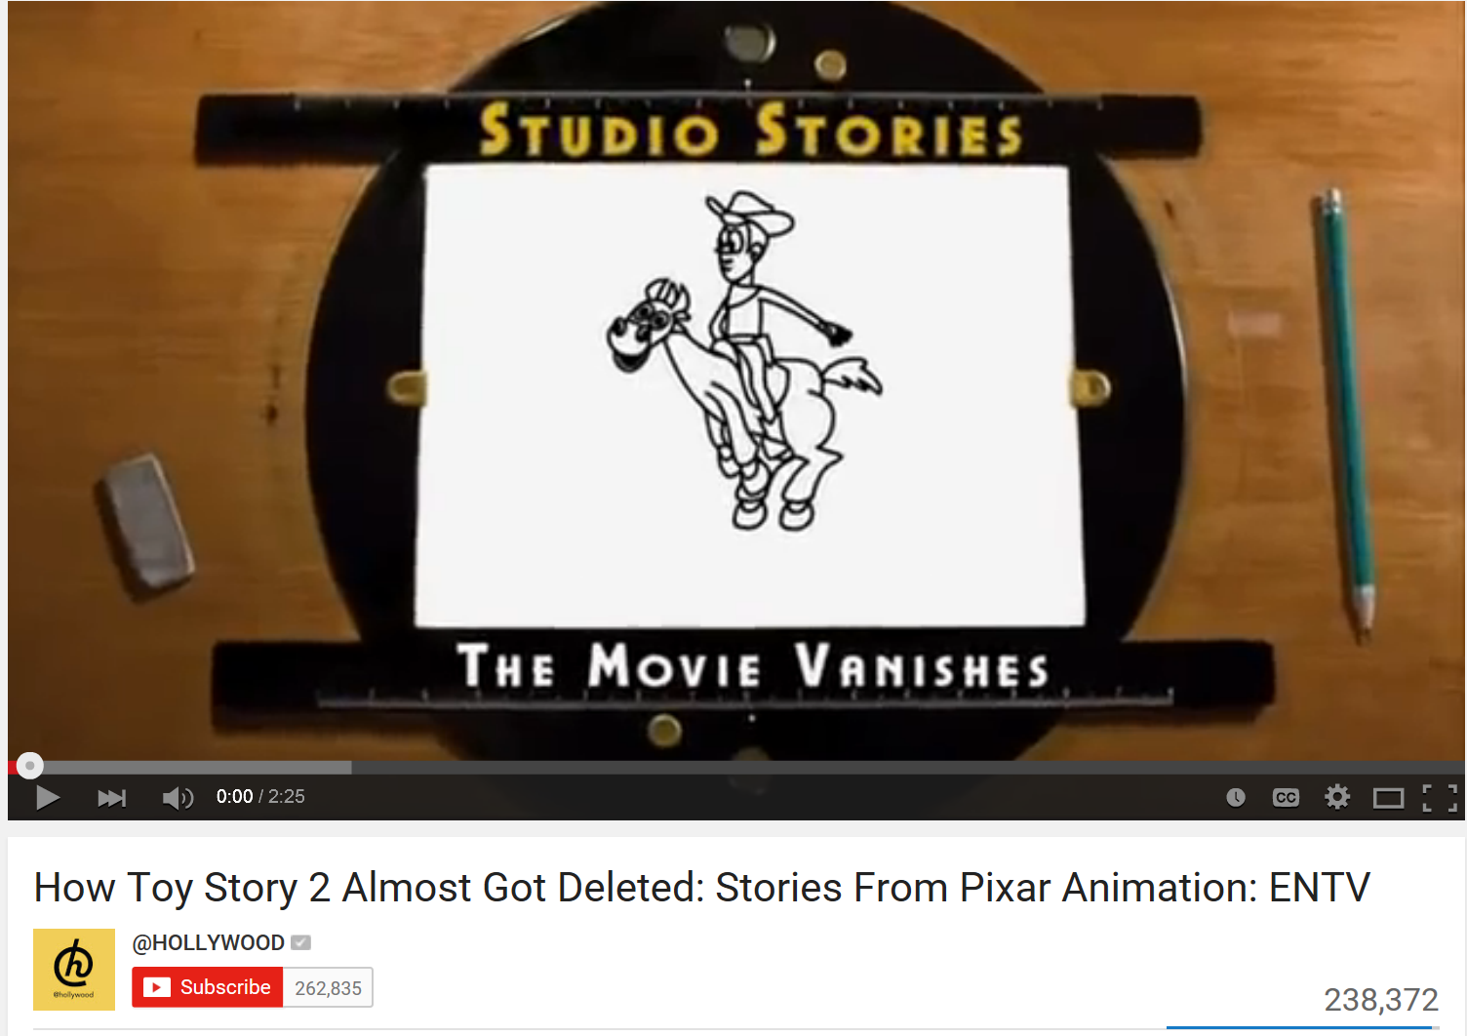
Toy Story 2
How Toy Story 2 Almost Got Deleted: Stories From Pixar Animation: ENTV
https://www.youtube.com/watch?v=8dhp_20j0Ys

Slide 45
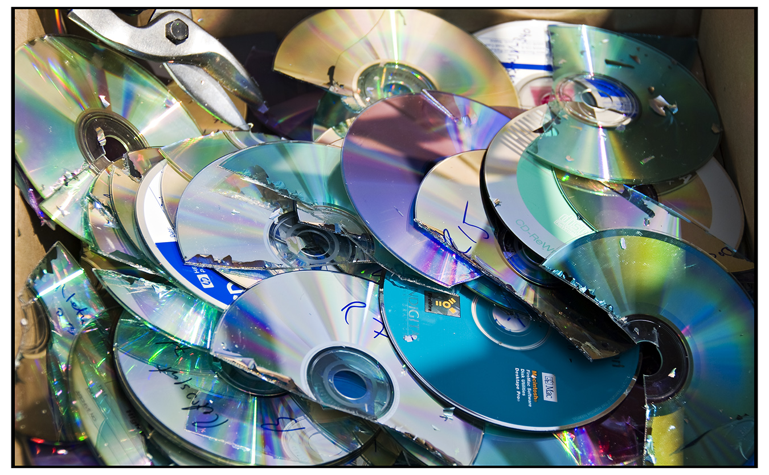

Storage, back up and securing data
Have at least 3 copies of your data- 2 local and 1 distant if possible
Don’t use your personal computer, data sticks or CDs if you can avoid it
  They break, get lost, lose data over time
Use a hard drive if you can
Use cloud storage if you can (but be aware of sensitive data)
flickr.com/photos/s_w_ellis/3877534599 (CC By 2.0)
Notes:
Hopefully by now you understand that data backups and storage are very important . These are a few best practices.
Opportunities may vary depending on the researchers situation

Slide 46
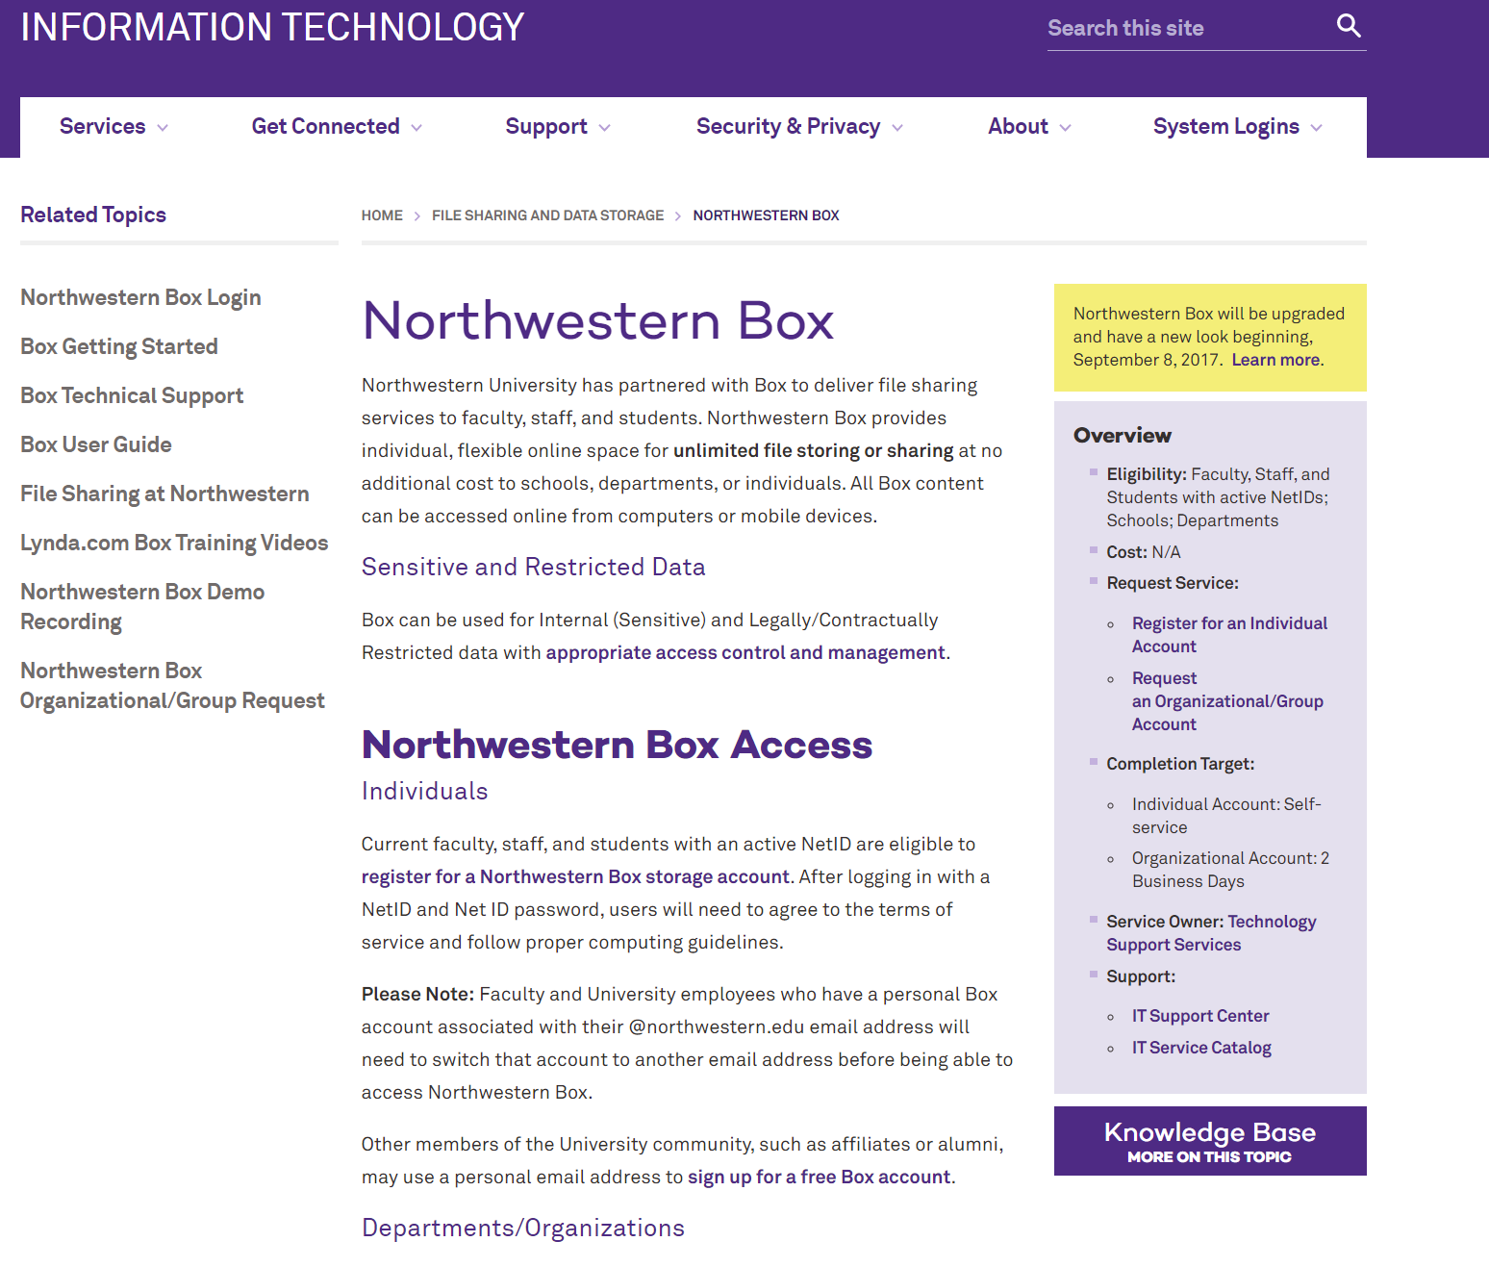
http://www.it.northwestern.edu/file-sharing/box.html

Slide 47
Dear Technology Leaders and UNITS Representatives,
Northwestern Information Technology has identified that the Box file sharing service is currently experiencing an unplanned outage.
Please note this is affecting all Box customers. The vendor is aware of the outage and working to restore service. Thank you for your patience, and we will provide further updates as they become available.
You may also find the most up-to-date information about the Box service at status.box.com. We are also tracking the outage on the Status of University IT Services page: service-status.northwestern.edu/view.php?ID=5260
Northwestern IT Communications
Contact us at it-communications@northwestern.edu
Follow Northwestern IT on Twitter and Facebook!

Slide 48
Aspects of Research Data Management
DMPs/Planning
File organization & naming
Documentation & metadata
Storage & backup
Legal/ethical considerations
Sharing & reuse
Preservation & Archiving
Notes:
Applies to all disciplines, but applications of these may be subject specific. Eg metadata
Some of these should be done throughout the data life cycle. (eg top 4)

Slide 49
Preservation and Sharing data
Data storage is not data preservation
Look for best practices in your fields
Look at repository requirements before you start your project (this will help with data description)
Not all data is worth preserving

Slide 50
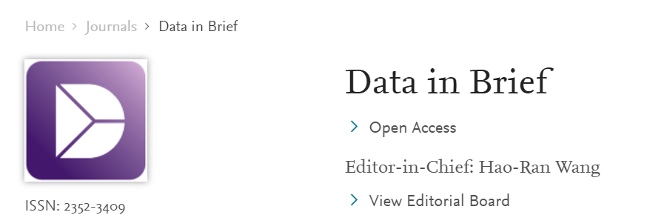


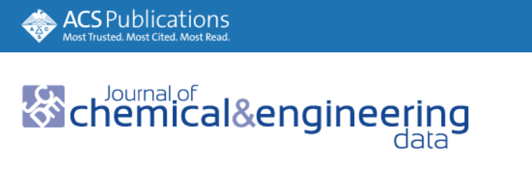
Data Journals
Primarily publishes Data Descriptors
Detailed descriptions of research datasets, including the methods used to collect the data and technical analyses supporting the quality of the measurements.
Focus on helping others reuse data
Helps with reproducibility
Make your data, which is often buried in supplementary material, easier to find.
Increase citations.
Potential for new collaborations.
Notes:
Another way to find/ share data.

Slide 51
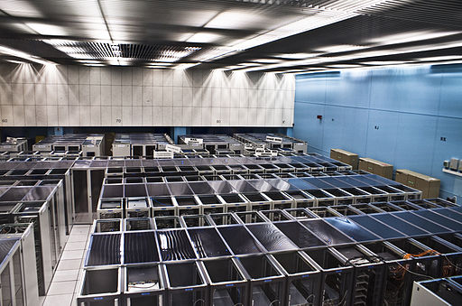
Preservation and Sharing data
Funder repositories (very few)
Publisher
  Elsevier- Mendeley data https://data.mendeley.com/
  ACS- partnered with Figshare https://acs.figshare.com/
  IEEE DataPort https://ieee-dataport.org/about-ieee-dataport
  Springer-Nature https://www.springernature.com/gp/authors/research-data-policy
Disciplinary repositories (e.g.Genbank, World Protein Bank etc.)
  Registry of Research Data Repositories http://www.re3data.org/
General repositories
  Figshare
  Harvard Dataverse
  Dryad
  Open Science Framework (osf.io)
Institutional repositories
By Florian Hirzinger - www.fh-ap.com (Own work (Florian Hirzinger)) [CC BY-SA 3.0 (http://creativecommons.org/licenses/by-sa/3.0) or GFDL (http://www.gnu.org/copyleft/fdl.html)], via Wikimedia Commons

Slide 52
Research & Data Repository Services
Northwestern’s research and data repositories are built for sharing and preserving research and scholarly outputs
Compliant with public access requirements from funding agencies and publishers
All works receive a Digital Object Identifier (DOI) for citation and persistent linking.
Copyright is retained by the author. The author grants Northwestern University a non-exclusive license to preserve and provide online access to the content
Visibility options include Public Access, Northwestern University (end-users need to login with NetID), or Embargo (i.e. set a future release date)
Deposited content becomes part of the library’s digital preservation program

Slide 53

NORTHWESTERN UNIVERSITY LIBRARIES INSTITUTIONAL REPOSITORIES
Galter Health Sciences Library Repository:
https://digitalhub.northwestern.edu/
For Feinberg affiliates only
Accepts some data sets
Northwestern Libraries Repository: ARCH- Gateway to discovery
https://arch.library.northwestern.edu
Open to Northwestern faculty, staff, students, or researchers
Will accept data sets underlying publications
Notes:
Open to Northwestern faculty, staff, student, or researcher at Northwestern University, with a current Northwestern University NetID and password.
The content must be in digital form.
The content must be permanent. The NULR is an archive that preserves scholarly output, not a place to store works in process. If you require this kind of service, please visit http://box.northwestern.edu.
Scholarly publishers often allow researchers to upload either the pre-print (before submission to the journal) or the post-print (after submission and peer-review) versions of journal articles to institutional repositories
As part of deposit you must choose a license. NULR prefers but does not require that materials be made available with a Creative Commons license. We recommend CC BY for articles and CC0 for data sets.

Slide 54
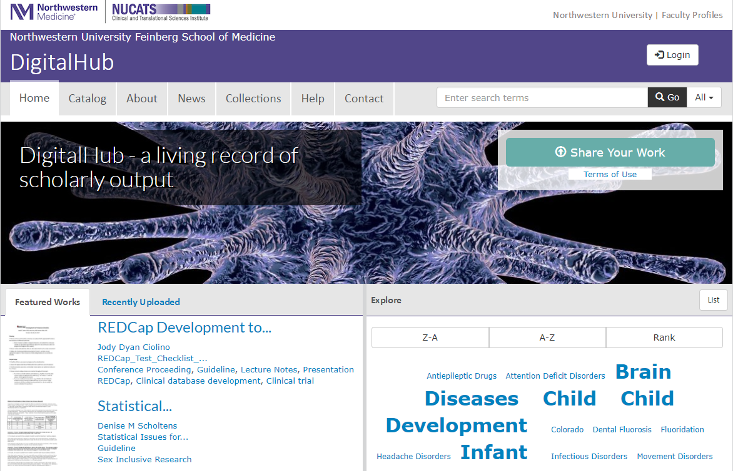
DigitalHub
Northwestern Medicine only
Research papers
Technical reports
Documentation
Presentations
Case studies
Datasets
Posters
Managed by the Galter Library
DigitalHub@northwestern.edu
digitalhub.northwestern.edu

Slide 55
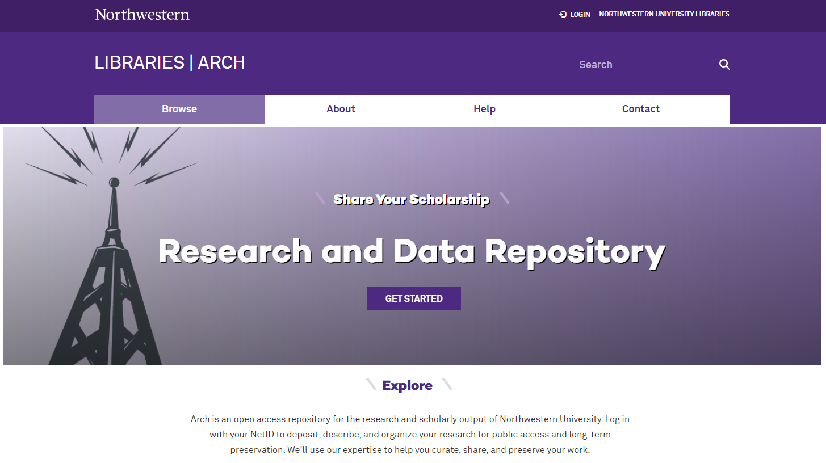
Arch
All Northwestern University
Research papers
Technical reports
Documentation
Presentations
Case studies
Datasets
Posters
Managed by the Main Library
digitalscholarship@northwestern.edu
arch.library.northwestern.edu

Slide 56
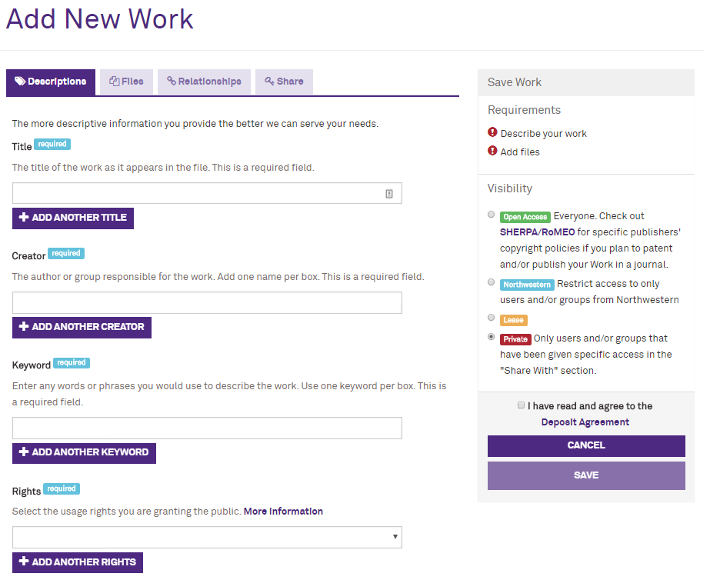
Self-deposit Process
Go to arch.library.northwestern.edu
Log in with your NetID
Describe your work
Upload files
Select visibility setting
Agree to Deposit Agreement
Save to the repository

Slide 57
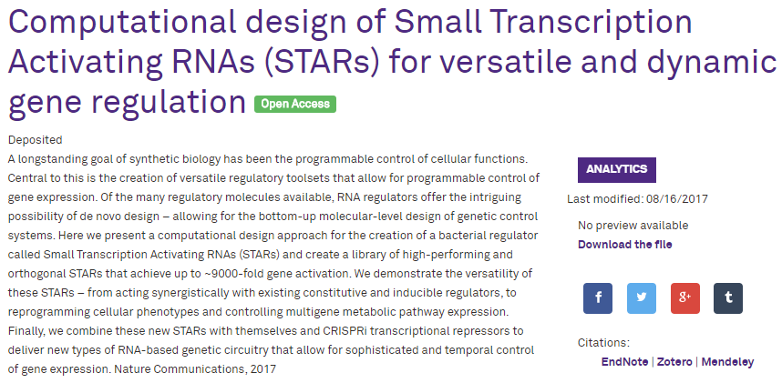
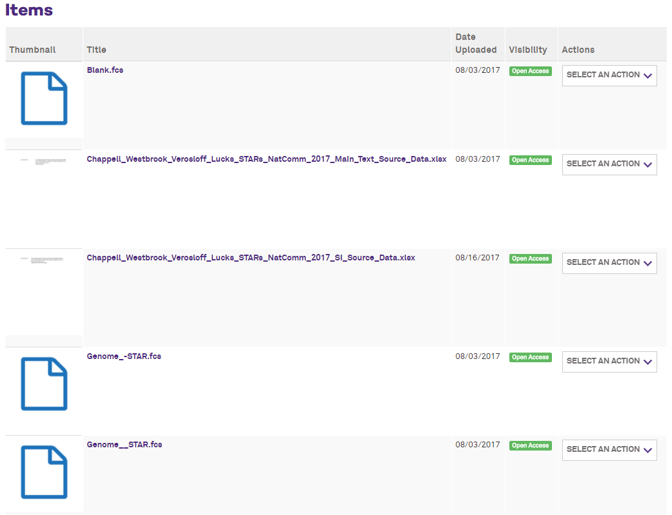
Example: Dataset
Faculty member in Chemical and Biological Engineering wants to provide access to the underlying data in support of his publication:
Digital Object Identifier (DOI)
Cited in journal article
Publicly available
Contact Chris Diaz for assistance with any deposit: chris-diaz@northwestern.edu

Slide 58
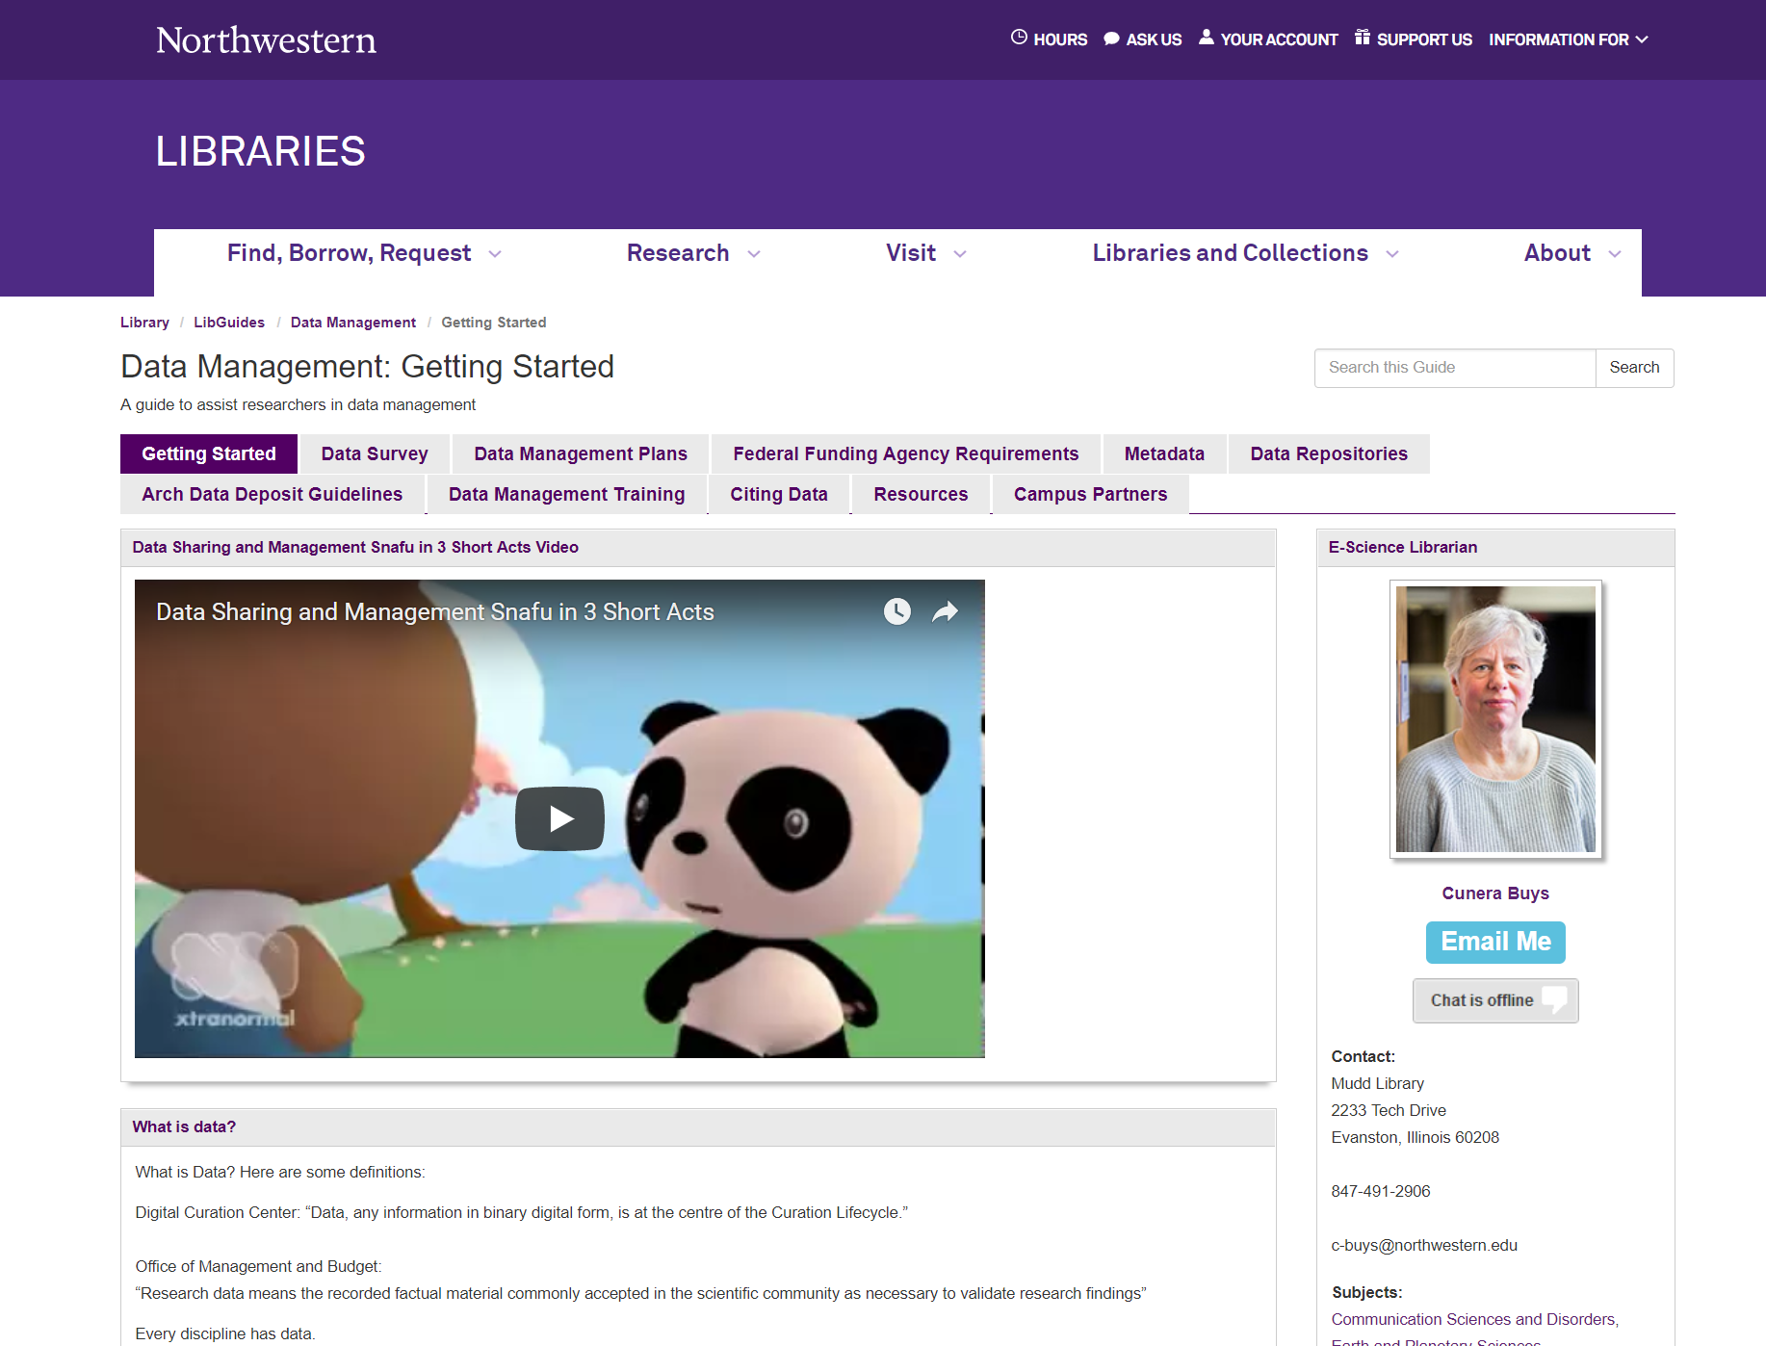
Research Guide
Resources for…
Data Management Plans
Funding Agency Policies
Data repositories
Data Citation
Metadata
Contact Cunera Buys for assistance: c-buys@northwestern.edu
libguides.northwestern.edu/datamanagement

Slide 59
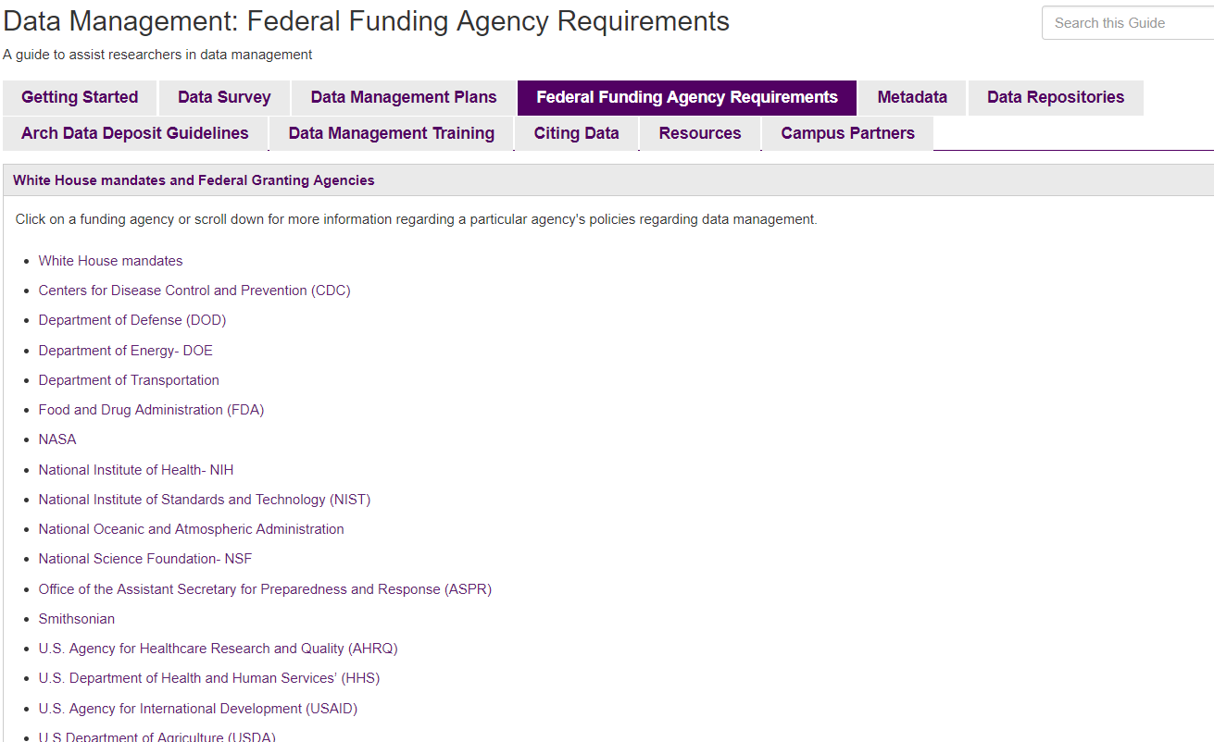

Slide 60
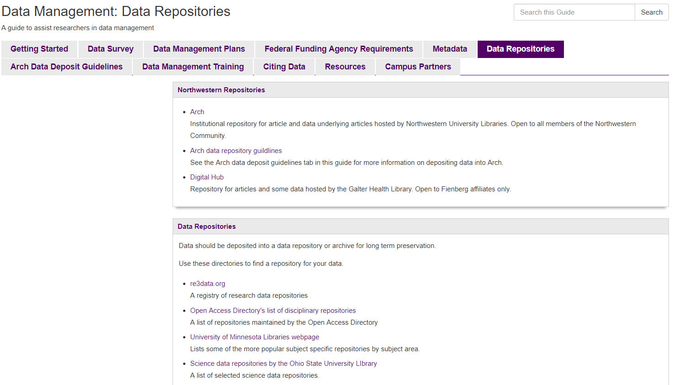

Slide 61
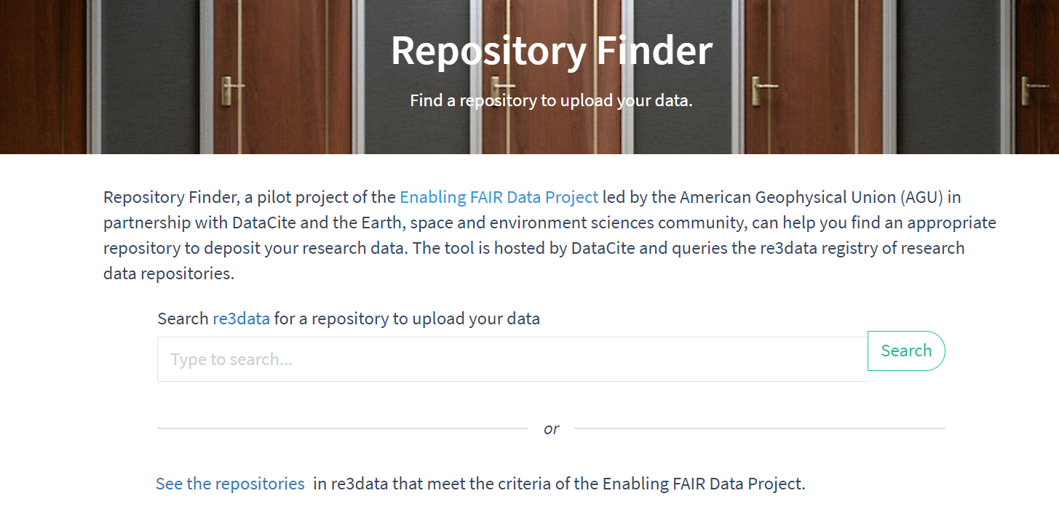
Notes:
Repository Finder (https://repositoryfinder.datacite.org/ )
Built on top of the Re3data registry
Pilot project of the space and environment sciences community
Allows you to easily find a repository to deposit data and to find FAIR repositories.

Slide 62

Need Help?
Create or advise on DMPs for granting agencies
Help with describing your data
Help with best practices in data management
Find an appropriate repository for your data
Deposit your data in a repository
Consultations
Workshops
Contact:
Cunera Buys
Data Management Librarian
c-buys@northwestern.edu
https://www.flickr.com/photos/49889874@N05/5645164344 (CC BY 2.0)

Slide 63

RESOURCES:
Northwestern University Library Data Management LibGuide: http://libguides.northwestern.edu/datamanagement
DMPTool: https://dmp.org/
Northwestern University's Research Data: Ownership, Retention and Access Policy: http://www.research.northwestern.edu/policies/documents/research_data.pdf
Cunera Buys- Data Management librarian: c-buys@northwestern.edu
Notes:
Will post to Arch

