Slide 1
Chicano Immigration Activism, 1970s
Alvaro Marcelino Hernandez
Posner Fellowship/ Latina/o/x Studies
Northwestern University
Notes:
Explain “Chicano”

Slide 2
Positionality
¿Álvaro? or Alvaro?
Notes:
History/Heritage
Education
Previous Research Experience
URAP and Latinx Chicago first-year seminar
Posner Experience
Archival Research

Slide 3
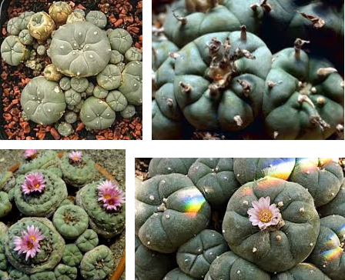
“You on Peyote or something?”
Patino, Jimmy. Raza Si, Migra No. The University of North Carolina Press, 2017. Pp. 2.
“Peyote”. Google images.
Notes:
San Diego
Herman Baca & “Bert” Corona
The Immigrant Question
Deportation Regime
Maria Elena? And Sexual Violence
CASA vs LULAC
My Research Queston
In the Southwest, San Diego activists and Herman Baca mobilized against a deportation regime after
years of unjust immigration officials' brutality, discrimination. One of the first chapters
focuses on the rape of Maria Elena? and how her courage to share her grievance against Border Agent Cocke helped fuel San Diego activists to rally against Immigration officials and sexual violence particularly on immigrant women on the border. Something interesting Patino reveals is the polarity between pro
-immigrant sensibilities and a focus on Mexican Americans with citizenship even though both groups shared a common antagonist. Organizations such as CASA advocated for immigrant rights while other groups like the UFW and LULAC were a lot more hesitant to take up the cross of immigrants.

Slide 4
Why was immigration important to Chicago Latinx and Chicanx communities?
What were some strands of immigration activism and how were they manifested?
Methodologies
Archival Research
Chicago Sun-Times
Literature Review
Chicano Movement
Chicago Latinx Immigration History
Notes:
Labor migration
Women
Harassment
Southwest,san diego

Slide 5
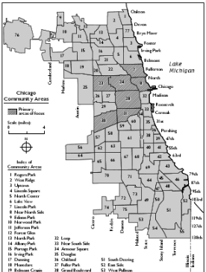
Chicago Latinx Immigration History
Notes:
Labor Migration + Settlements
Prejudice, discrimination, and racism
Police brutality, INS terror, and urban renewal
Political Consciousness
Chicano Movement
Pilsen and otherr neighborhoods

Slide 6
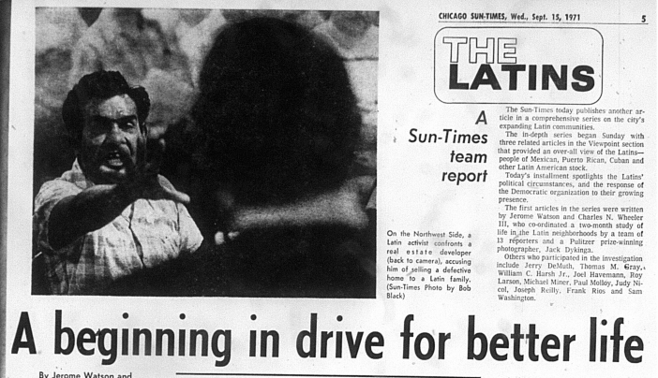
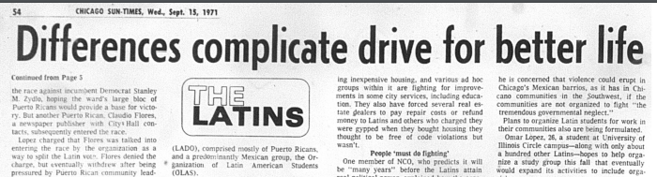
Chicago Sun-Times Newspaper Coverage

Slide 7
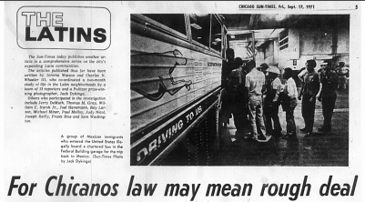
Chicago Sun-Times Newspaper Coverage
Notes:
Migration!! Puerto ricans!!
Chicago Sun-Times
Multimedia Center at NU, floor 2
Microfilm

Slide 8
Thank you . . .
Special thanks to my mentor Dr. Myrna Garcia for her patience, diligence, and honesty throughout my Posner adventure

